Slide 1
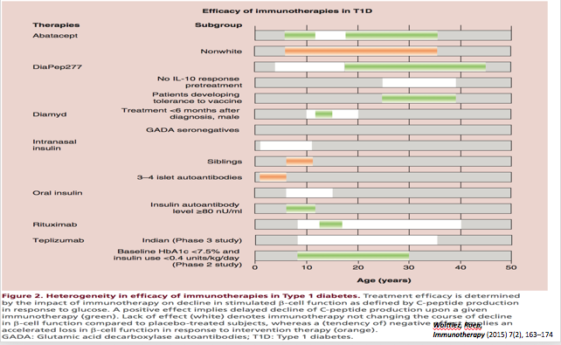
Efficacy of Immunotherapy in T1DM:
Some Can Delay Decline in C-peptide
Woittiez, Roep,
Immunotherapy (2015) 7(2), 163–174

Slide 2
Insulin Resistance within the β-Cell Centric Construct
Insulin Resistance is understood to expose and exacerbate the core β-cell defect
Genetically- Based
Exacerbated by Environmental issues: Diet, Activity, Biome
Includes Multiple Causes of Insulin Resistance
Insulin Resistance Impairs β-Cell Function by:
Lipo- and gluco-toxicity
Inflammatory mechanisms
Adipocytokines effect on β-cell

Slide 3
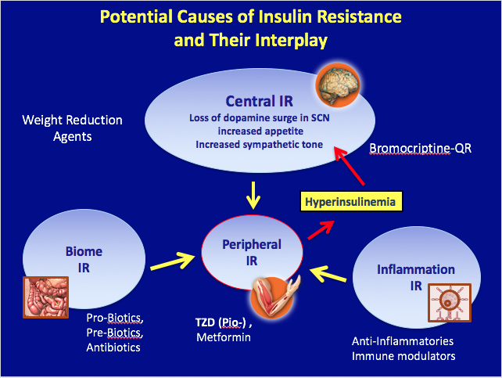

Slide 4
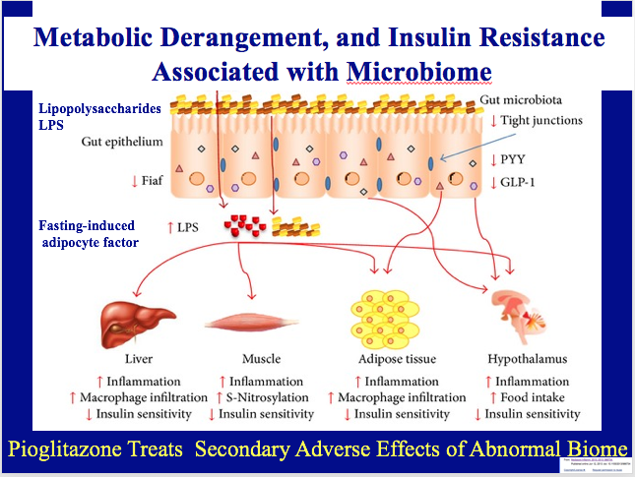

Slide 5
New β-Cell Centric Construct: Implications
Environmental Risk Factors in T1D/T2D, ? ‘LADA’
T1D
Seasonality at diagnosis
Migrants assume risk of host country
Risk factors from case-control studies
  • Hormones • Vitamin D
  • Stress • Cow’s Milk
  • Improved Hygiene • Gut-microbial Balance – Biome
  • Infant/childhood diet • Lack of Physical Activity
  • Viruses – exposures as early as in utero
T2D
Obesity-Diet
Lack of Physical Activity
AGE ingestion
LADA
Coffee
More Educated

Slide 6
Can Keep Current Terminology
Incorporate the β-Cell Centric Approach with each to determine issues in individual patient or a New Terminology?
Younger
Older
‘LADA’
 | T2D | MODY, monogenic | T1D | SPIDDM | Autoimmune T2D | T2D
Genes
- mono |  | +,which
- poly | +,which |  | +,which | +,which | +,which | +,which
Inflammation | +/- | ─ | + | + | + | +/-
Resistance | +/- |  | +/- | ─ | +/- | +/-
Environment | +,which |  | +,which | +,which | +,which | +,which
Easier to get buy-in from many different stakeholders, MDs, etc

Slide 7
Or New Terminology Should Reflect the β-Cell Centric Approach;
Disease = DIABETES; Phenotype= Hyperglycemia
Younger
Older
‘LADA’
 | T2D | MODY, monogenic | T1D | SPIDDM | Autoimmune T2D | T2D
Genes
- mono |  | +,which
- poly | +,which |  | +,which | +,which | +,which | +,which
Inflammation | +/- |  | + | + | + | +/-
Resistance | +/- |  | +/- | ─ | +/- | +/-
Environment | +,which |  | +,which | +,which | +,which | +,which
Implications for Therapy: Use whatever logically sensible/necessary based on cause of hyperglycemia in each patient

Slide 8
New approach is Commensurate with Natural History of ALL DM
Age 0-15 15-40+ 15-50+ 25-70+
Macrovascular Complications
Disability
IR Phenotype
MI
CVA
Amp
IGT ALL DM
DEATH
Blindness
Amputation
CRF
ETOH
BP
Smoking
Eye
Nerve
Kidney
Disability
Microvascular Complications
Risk of Dev. Complications
Notes:
8

