Slide 1
New β-Cell Centric Construct: Implications
Genetics 101 for DM
Phenotype is DEPENDENT ON
Genotype:
Number of Genes- which genes- their nature, how many
different ones, the ‘severity/intensity’ of expression!;
epigenetics*
i.e: Genes influence:
B-Cell: Insulin secretory dynamics, sites of susceptibility of β-Cell to
destruction by endogenous/ exogenous triggers
Immune Modulation/Inflammation
Insulin Resistance
Environment
(AND some address susceptibility to DM COMPLICATIONS)
*Int J Biochem Cell Biol. 2015 May 27. pii: S1357-2725(15)00143-0. doi: 10.1016/j.biocel.2015.05.022. [Epub ahead of print]
Epigenetic dynamics in immunity and autoimmunity. Zhao M1, Wang Z1, Yung S2, Lu Q. ;
Understanding type 2 diabetes: from genetics to epigenetics. Raciti GA, Longo M, Parrillo L, Ciccarelli M, Mirra P, Ungaro P, Formisano P, Miele C, Béguinot F.
Acta Diabetol. 2015 Apr 5.

Slide 2
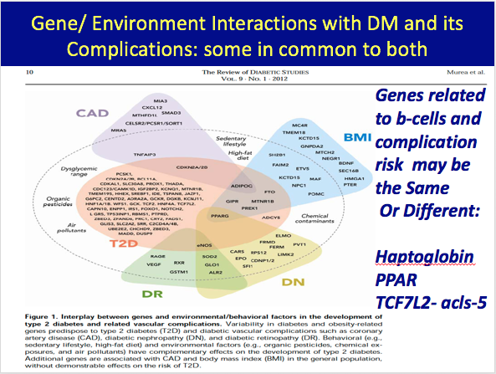

Slide 3
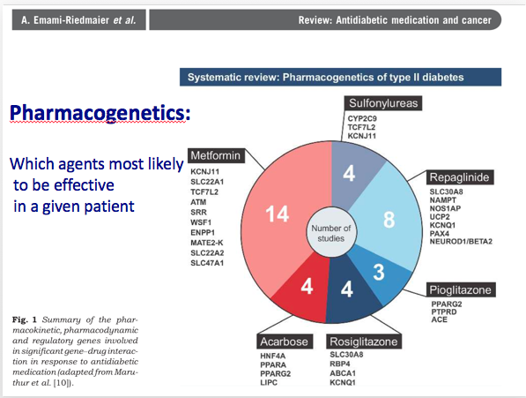
TAK-OEC

Slide 4
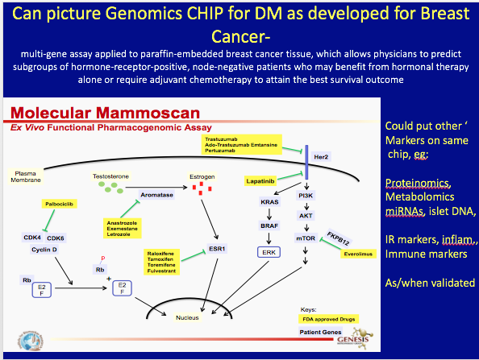

Slide 5
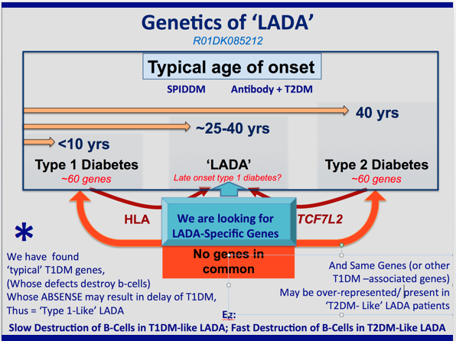
*

Slide 6
New β-Cell Centric Construct: Implications β-cell Issues
Usual use of Glycemic Criteria- HgA1c, FBS, PPG
Markers-Usual/Classic= C-Peptide
New Non-Invasive
  β-Cell Mass Measures-
  Nano-particle labeled exendin imaging
  Circulating DNA Markers of β-Cell Destruction
  Glazer- Hebrew Univ
  Circulating mRNAs
Try to Determine Mono-Genetic Causes
NO LOGIC FOR USE OF AGENTS THAT MAY CONTRIBUTE TO APOPTOSIS of β-Cell
STOP USING SU’s, GLINIDES; Minimize INSULIN THERAPY

Slide 7
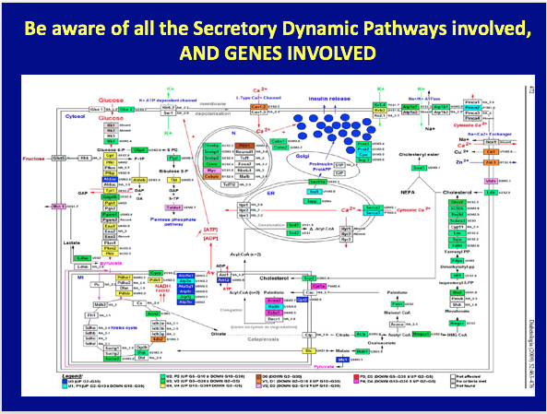

Slide 8
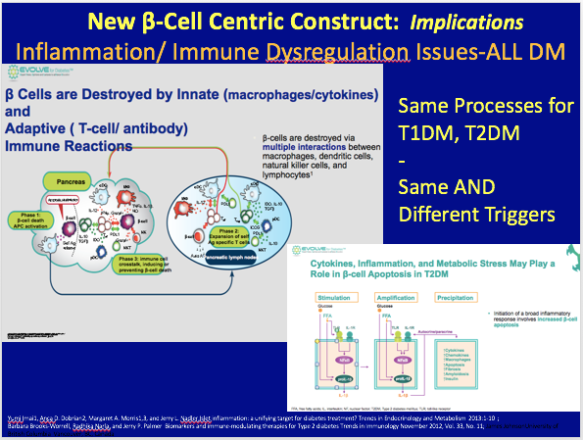

Slide 9
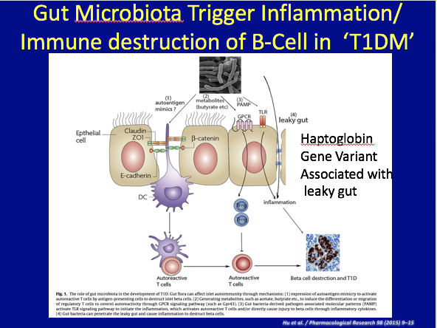

Slide 10
