Slide 1
Pushback
What about ‘pure’ Insulin Resistance Syndromes?

Slide 2
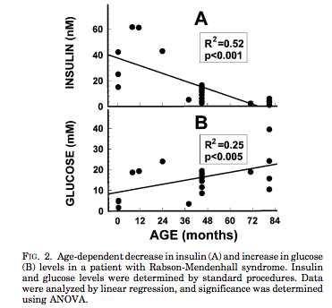
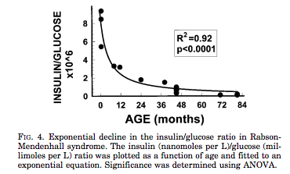
The β-Cell:
The ‘Final Common Denominator’
Rare Insulin Resistance Syndromes, e.g. leprechaunism, may not have a specific β-cell genetic defect, but β-cells damage may be part of the disease
Longo, et al, Progressive decline in insulin levels in Rabson-Mendenhall syndrome. JCEM,1999 Aug;84(8):2623-9.

Slide 3
Phenotypic Presentation is defined by:
Slope = ‘Natural History’ over time, i.e.,RATE OF β-cell LOSS. Slope is not linear in either T1DM or T2DM, and may be intermittently relapsing, remitting, stabilized, and improved. Complete loss of β-cell mass may never be reached, especially if newer agents better preserve β-cells.
100%
−
−
−
−
−
−
−
−
−
0% −
Severity =
β-cell loss of mass
Pre-Diabetes = FBS ≥100, PPG ≥140
β−Cell
Mass
All DM = FBS ≥126, PPG ≥200
%
β−Cell
Mass
I I I I I/ ≈ / I I I I I I I I I I I I I I I I I I I I I I I I I I I I I I I I I I I I I I I I I I I I I I I I I I I I I I I I I I I I
Increasing Age
Age at presentation = tipping point when the combined gene effect / environmental trigger is exposed as phenotypic hyperglycemia

Slide 4
Phenotypic Presentation is defined by:
Disease Modification: B-Cell Function/ Mass
1. Avoid Agents that destroy Beta Cells
2. Use agents that preserve Beta-cells
3. Newer / Future Agents to Increase Beta-Cells
100%
−
−
−
−
−
−
−
−
−
0% −
Pre-Diabetes = FBS ≥100, PPG ≥140
All DM = FBS ≥126, PPG ≥200
β−Cell
Mass
%
β−Cell
Mass
Disease Modification
I I I I I/ ≈ / I I I I I I I I I I I I I I I I I I I I I I I I I I I I I I I I I I I I I I I I I I I I I I I I I I I I I I I I I I I I
Increasing Age

Slide 5
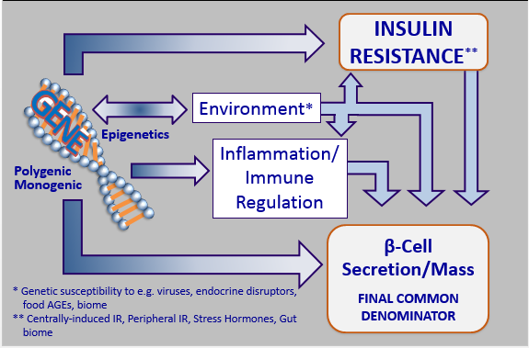
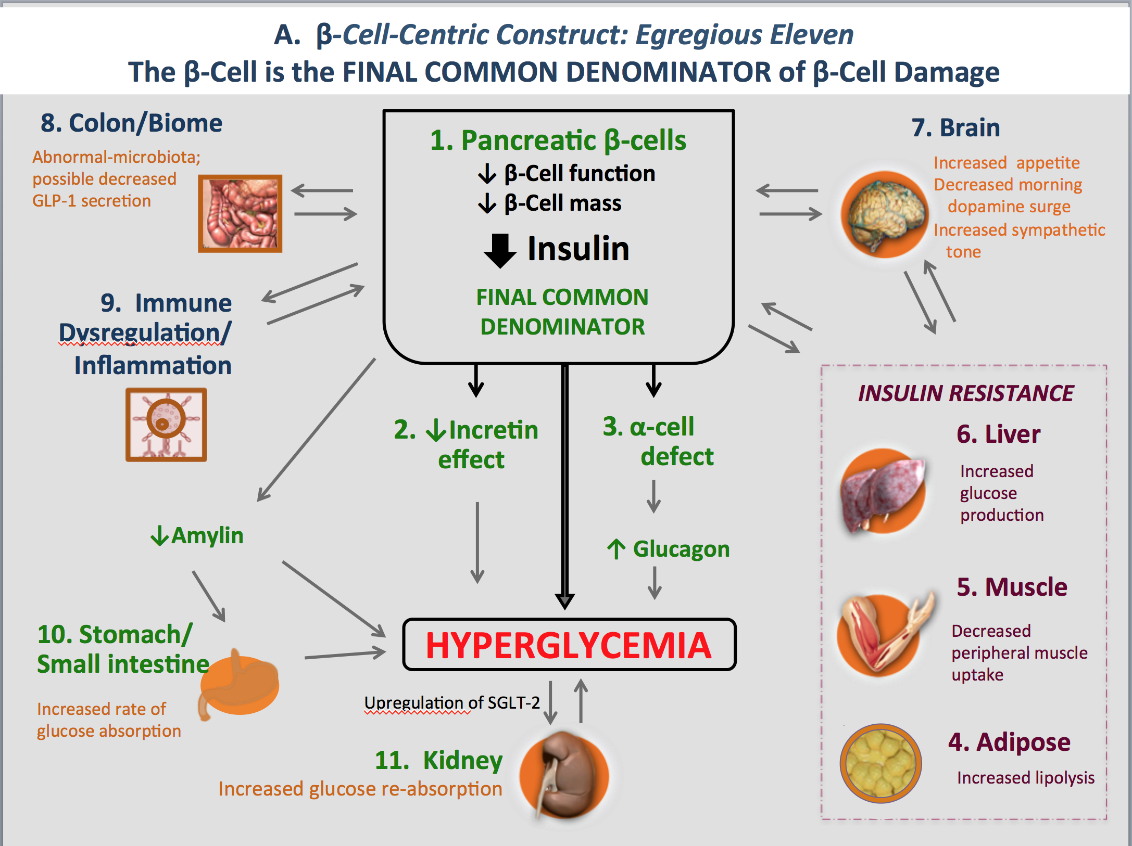
The β-cell centric classification allows for individualized care by identifying and treating patient-specific etiologies and mediating pathways of hyperglycemia
EGREGIOUS ELEVEN
β-Cell Centric Classification of DM:
Implications for Classification, Diagnosis, Prevention, Therapy, Research
One CORE Defect- the β-Cell
(at least) 6 treatable Causes of
β-Cell Damage / HYPERGLYCEMIA
  5 treatable mediators
  of HYPERGLYCEMIA
resulting from β-Cell Damage

Slide 6

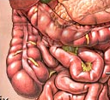
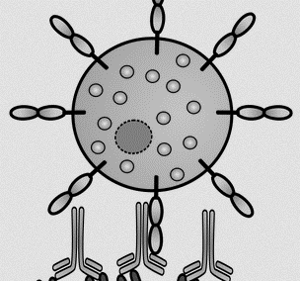
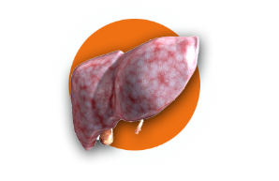

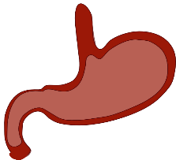
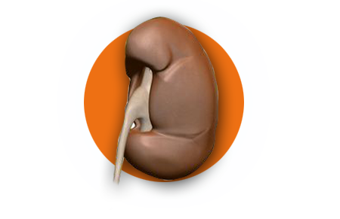

A. β-Cell-Centric Construct: Egregious Eleven
The β-Cell is the FINAL COMMON DENOMINATOR of β-Cell Damage
8. Colon/Biome
1. Pancreatic β-cells
↓ β-Cell function
↓ β-Cell mass
7. Brain
Abnormal-microbiota;
possible decreased
GLP-1 secretion
Increased appetite
Decreased morning dopamine surge
Increased sympathetic tone
Insulin
9. Immune
Dysregulation/
Inflammation
FINAL COMMON DENOMINATOR
INSULIN RESISTANCE
2. ↓Incretin
effect
3. α-cell
defect
6. Liver
Increased
glucose
production
↓Amylin
↑ Glucagon
5. Muscle
10. Stomach/
Small intestine
Hyperglycemia
Decreased peripheral muscle uptake
Increased rate of glucose absorption
Upregulation of SGLT-2
11. Kidney
Increased glucose re-absorption
4. Adipose
Increased lipolysis

Slide 7
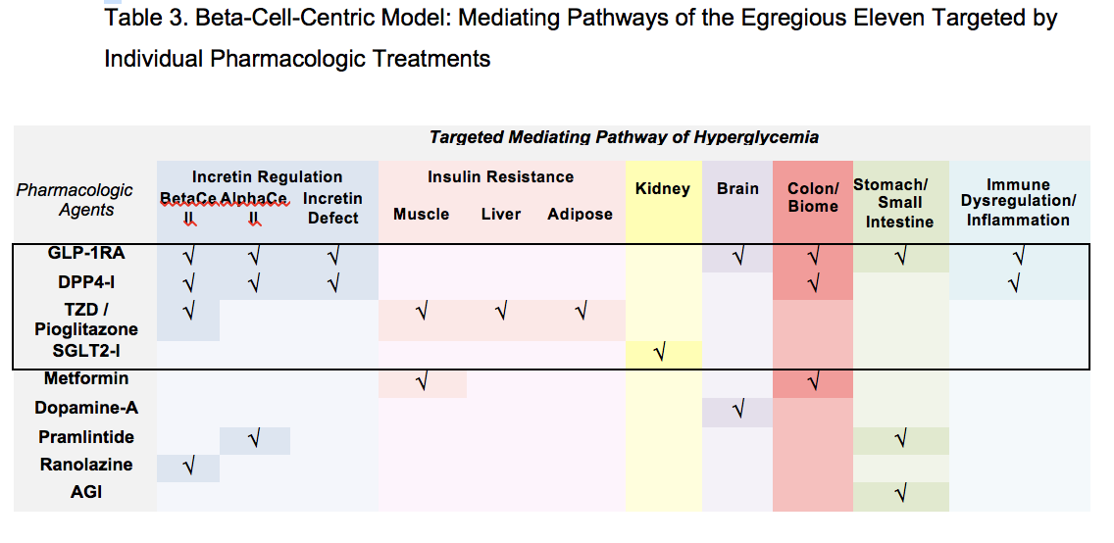
Logic for Combination therapy- Use least number of Agents that treat most number of mechanisms of hyperglycemia

