Slide 1
A Unifying Pathophysiologic Approach to The Complications of Diabetes in the Context of the Beta-cell Classification of Diabetes
A Clinical-Translator’s Point-of-View:
At the Interface of Patient Care and Basic Science
Stanley Schwartz MD, FACE, FACP
Affiliate, Main Line Health System
Emeritus, Clinical Associate Professor of Medicine
University of Pennsylvania
stschwar@gmail.com

Slide 2
I was asked how to Diagnose Diabetes Mellitus in Adults:
Type 1, Type 2, LADA or, Since we quickly noted
That Confusion Abounds, Isn’t it
Time for A New Classification Schema for the
Diagnosis and Treatment of Diabetes Mellitus (DM)
Get us ready for ‘PRECISION MEDICINE’

Slide 3
Purely Clinical Answer
Empiric, Pragmatic Approach
It doesn’t matter which label is applied ☺
Insulin-Dependent
  DKA- ketosis prone : insulin needed for survival
OR NOT- Everyone else- USE WHATEVER agent(s) necessary to control glycemia
Use ‘best clinical guess’; ‘label’ patient; Independent of age
(but must work under constraints of current ‘definitions’ for the classification of T2D- per payors/ governments)

Slide 4
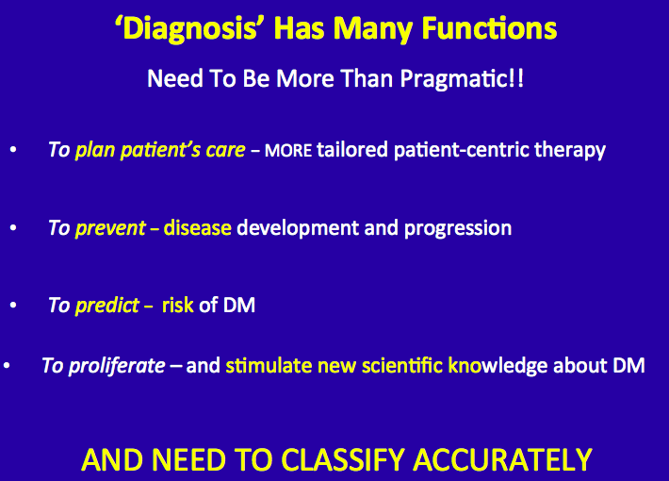

Slide 5
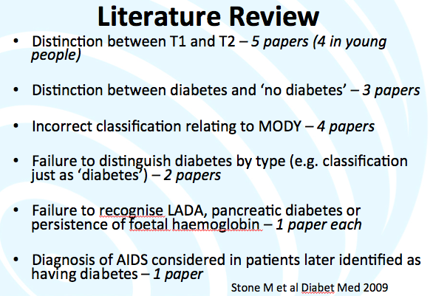
Current DM Classification Failing
(Certainly appropriate with knowledge available when current classification adopted)
BUT WE’VE LEARNED SO MUCH MORE SINCE THEN
OLD=
T1DM= Immune destruction of β-cells
T2DM= Insulin Resistance
This distinction has been used as basis of distinction between T1D, and T2D
Notes:
The four types of diabetes include:
The typical child with type 1 diabetes;
Early onset of type 2 diabetes, particularly in non-Caucasian groups;
An atypical form of diabetes sometimes with fluctuating insulin dependency, seen in African Americans; and
The very rare “maturity onset diabetes of youth” (MODY), which has been found to be related to identifiable genetic mutations, transmitted in an autosomal dominant pattern, and virtually always in Caucasians.

Slide 6
Current DM Classification Failing
(Certainly appropriate with knowledge available when current classification adopted)
Diagnosis is often imprecise/ or overlapping phenotypes
  Flatbush DM- present in DKA- ‘turn out to be T2DM’
  LADA- Adults who look like ‘typical T1DM’
  Antibody positive patients who look like ‘T2DM’
  T1DM with Insulin Resistance (like T2DM)
Notes:
The four types of diabetes include:
The typical child with type 1 diabetes;
Early onset of type 2 diabetes, particularly in non-Caucasian groups;
An atypical form of diabetes sometimes with fluctuating insulin dependency, seen in African Americans; and
The very rare “maturity onset diabetes of youth” (MODY), which has been found to be related to identifiable genetic mutations, transmitted in an autosomal dominant pattern, and virtually always in Caucasians.

Slide 7
Definitions: T1D, ‘LADA’, T2D
May Seem Precise BUT…, Overlapping Phenotypes
In particular :
‘LADA’- Ambiguous classification
Later age; SPIDDM, ‘Slowly progressive T1D
  ‘Slower’ destruction of β-cells than T1D
    Antibody positive T2D = ‘T1.5D’
      ‘Faster’ destruction of β-cells than in T2D
    T-cell abnormal SPIDDM
      Antibody negative
    Insulin commonly considered the ‘go to’ drug, even in patients with LADA with retained β-cell function

Slide 8
Comparing Definitions for T1D, ‘LADA’, T2D
IMMUNITY AGE GENES BMI INSULIN THERAPY
child
adult
adult
adult
HLA++
HLA+
HLA
?
T1D
In children
T1D
In adults
LADA
T2D
Strong
+++
++
+
weak
low
normal
normal
high
Immediate
Immediate
Variable
Infrequent
Adapted from Leslie et al. Diabetes Metab Res Rev. 2008 Oct;24(7):511-9

Slide 9
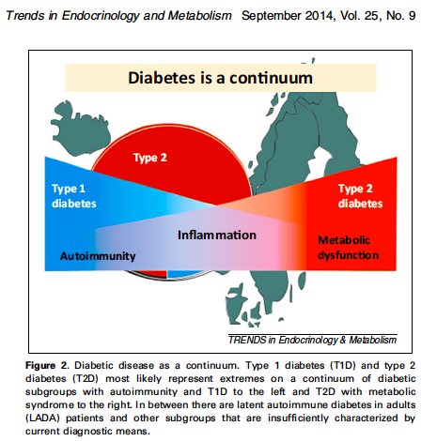
Diabetes is a Continuum OF β-cell FUNCTION
    SO ISSUE IS LESS
    ‘What is LADA?’-
    ISSUE IS WHAT ARE MECHANISMS
    And RATE OF DESTRUCTION OF
    β-cells
    In ALL PATIENTS WITH DIABETES-
    ?Improve therapy!!
Leif Groop, Can genetics improve precision of therapy in diabetes?

Slide 10
The β-Cell Centric Classification of DM
Intuitively obvious approach…
ANSWERS THE CALL TO ACTION
ALL DM = Hyperglycemia
Classify each patient by the specific cause(s) of the
β-cell dysfunction in the clinical presentation of their disease
Prescribe personalized treatment
(patient-centric/ PRECISION MEDICINE)
through targeted therapies aimed at
all possible mediating pathways of hyperglycemia
The ‘β-Cell Centric’ Classification will help improve diagnosis and treatment,
especially as our knowledge-base expands

Slide 11
β-Cell Centric Classification of Diabetes:
Implications for Classification, Diagnosis, Prevention, Therapy, Research
INSULIN RESISTANCE
G
E
Environment
N
E
Epigenetics
Inflammation/
Immune Regulation
Polygenic
Monogenic
β-Cell
secretion/mass
FINAL COMMON
DENOMINATOR
CLASSIFY PATIENT BY CAUSE(s) of
Beta-Cell Dysfunction In EACH Individual

Slide 12
β-Cell Centric Classification of Diabetes:
Implications for Classification, Diagnosis, Prevention, Therapy, Research
INSULIN** RESISTANCE
G
E
Environment*
N
E
Epigenetics
Inflammation/
Immune Regulation
Polygenic
Monogenic
β-Cell
secretion/mass
FINAL COMMON
DENOMINATOR
*Environment= Genetic suceptibility to
eg: viruses, endocrine disruptors, food AGEs, Gut Biome
**Insulin Resistance (IR)= Centrally Induced IR, Peripheral IR, Stress Hormones, Gut Biome

