Slide 1
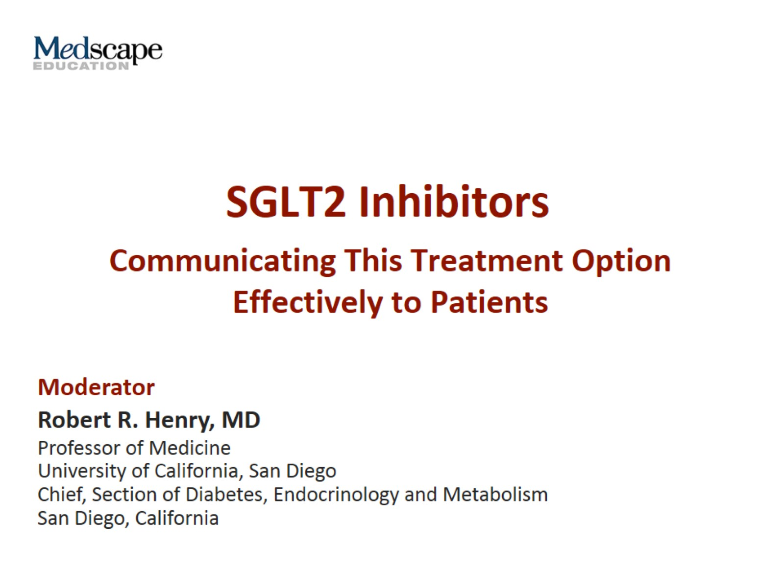
SGLT2 Inhibitors

Slide 2
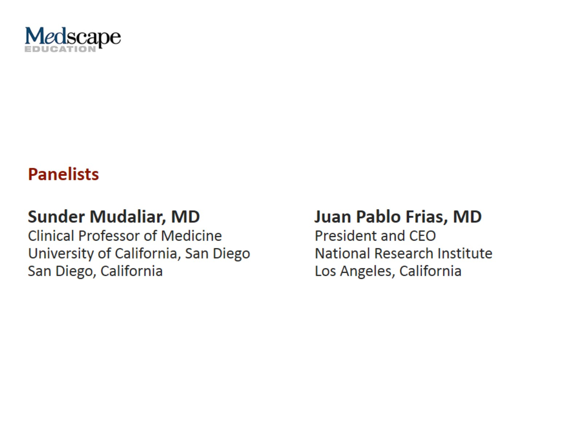

Slide 3
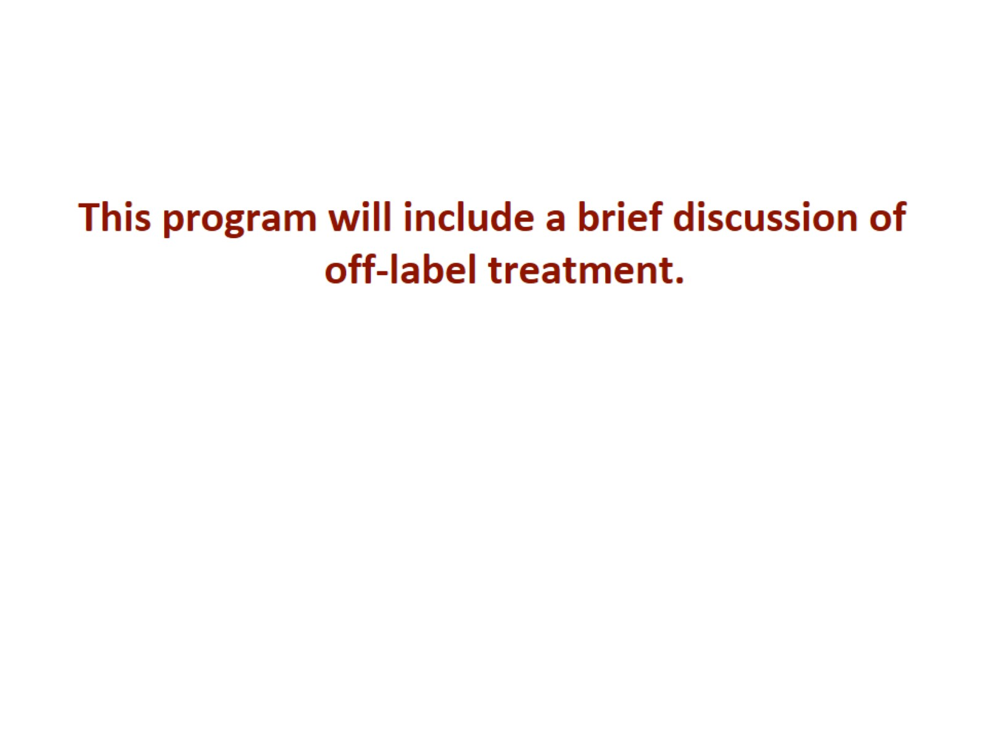

Slide 4
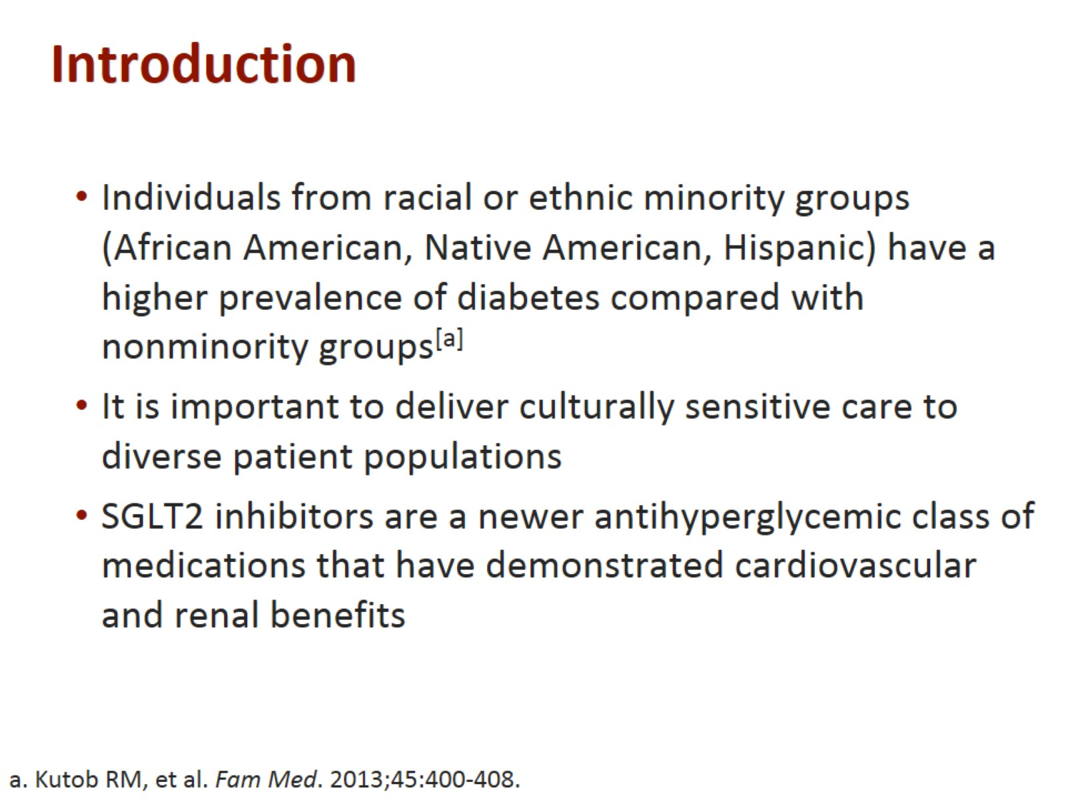
Introduction

Slide 5
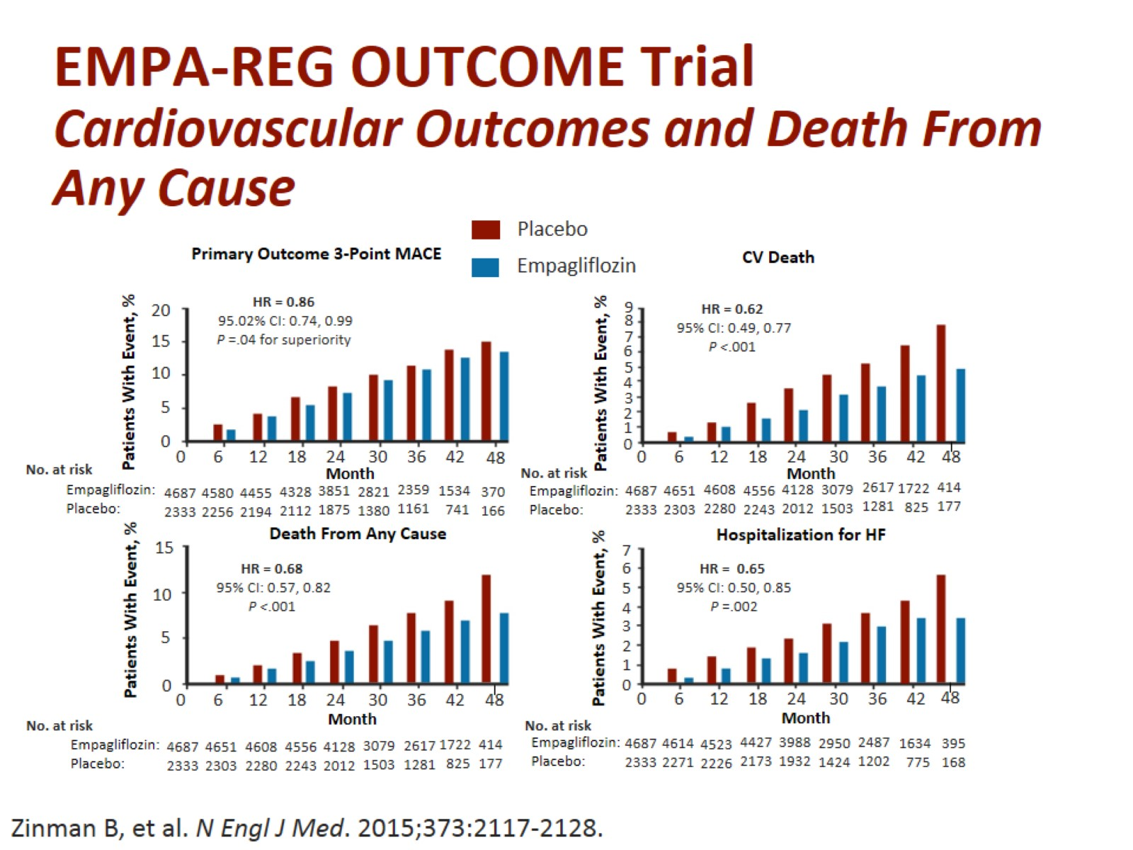
EMPA-REG OUTCOME Trial
Cardiovascular Outcomes and Death From
Any Cause

Slide 6
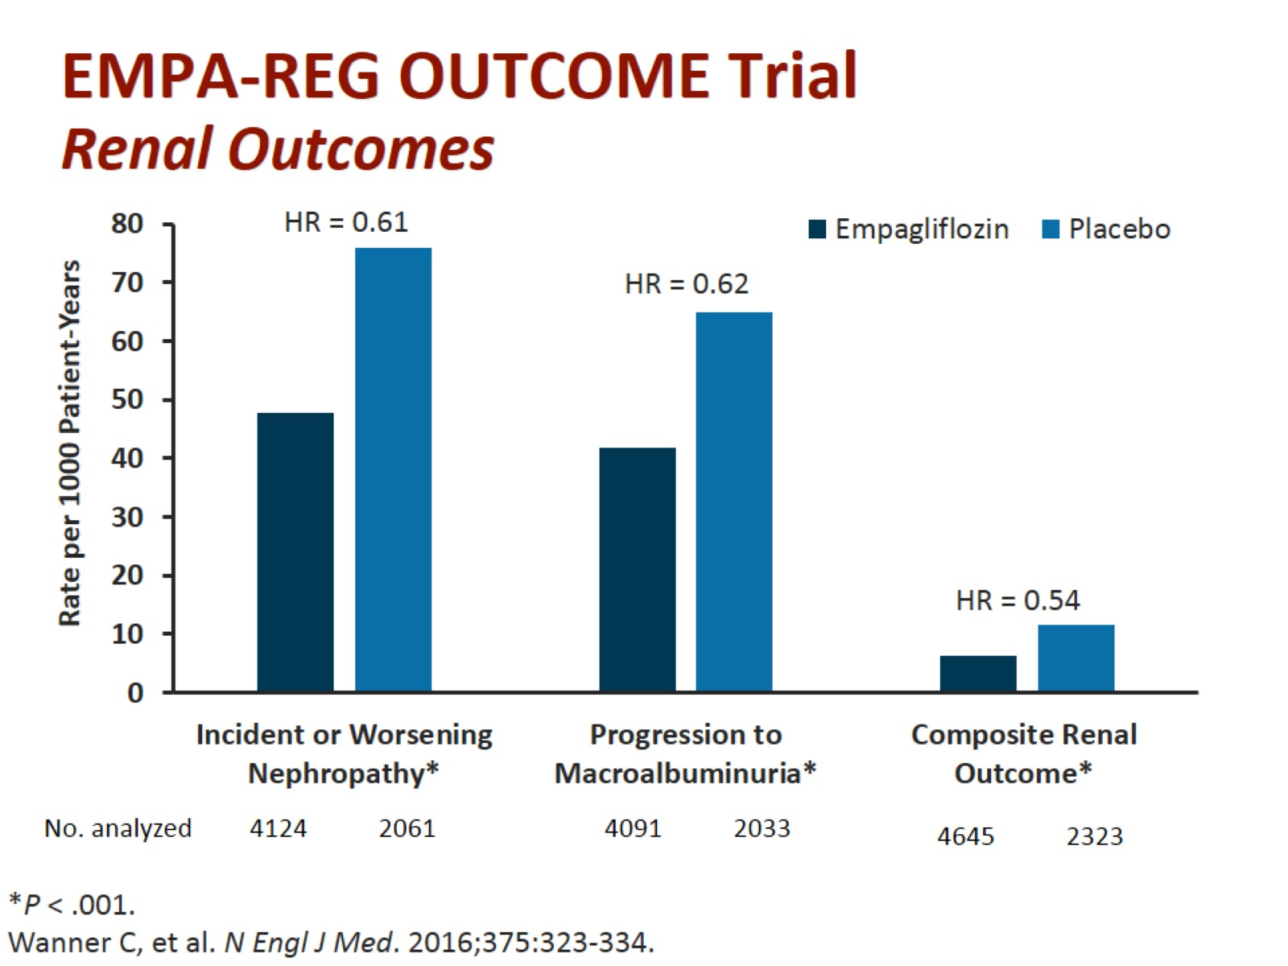
EMPA-REG OUTCOME Trial
Renal Outcomes

Slide 7
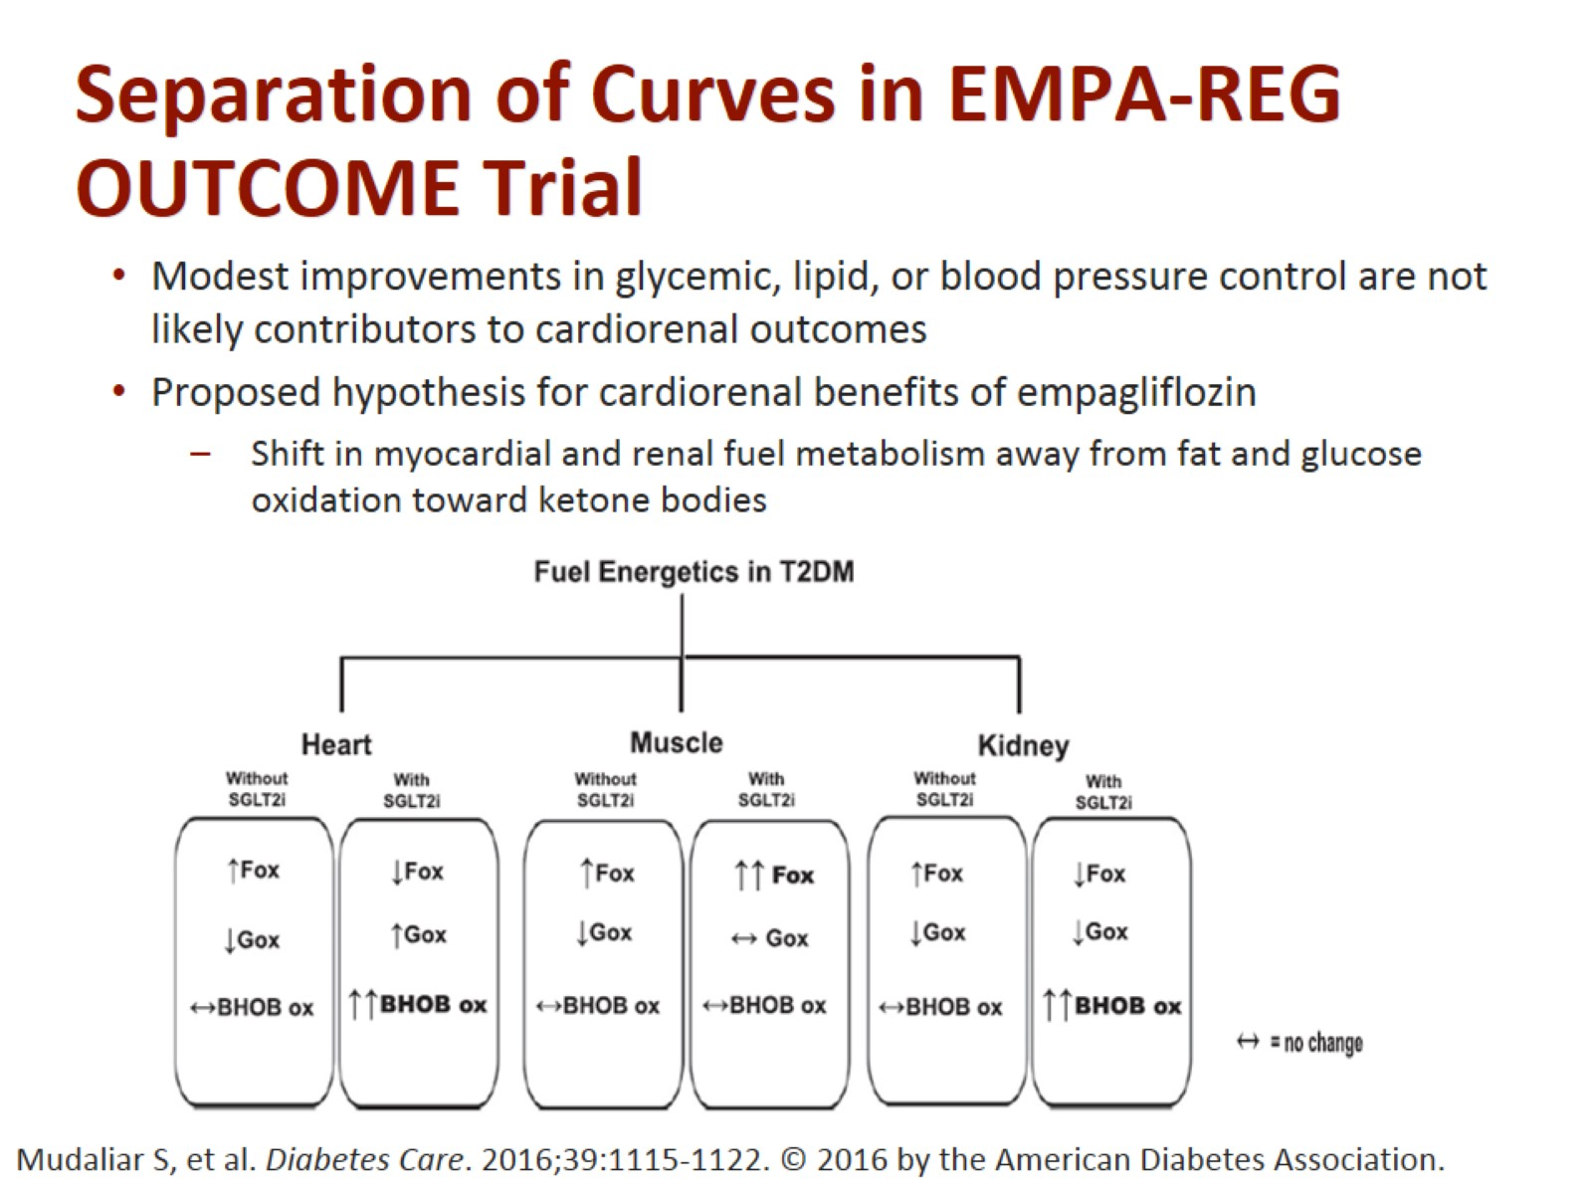
Separation of Curves in EMPA-REG OUTCOME Trial

