Slide 1
Heart failure

Slide 2
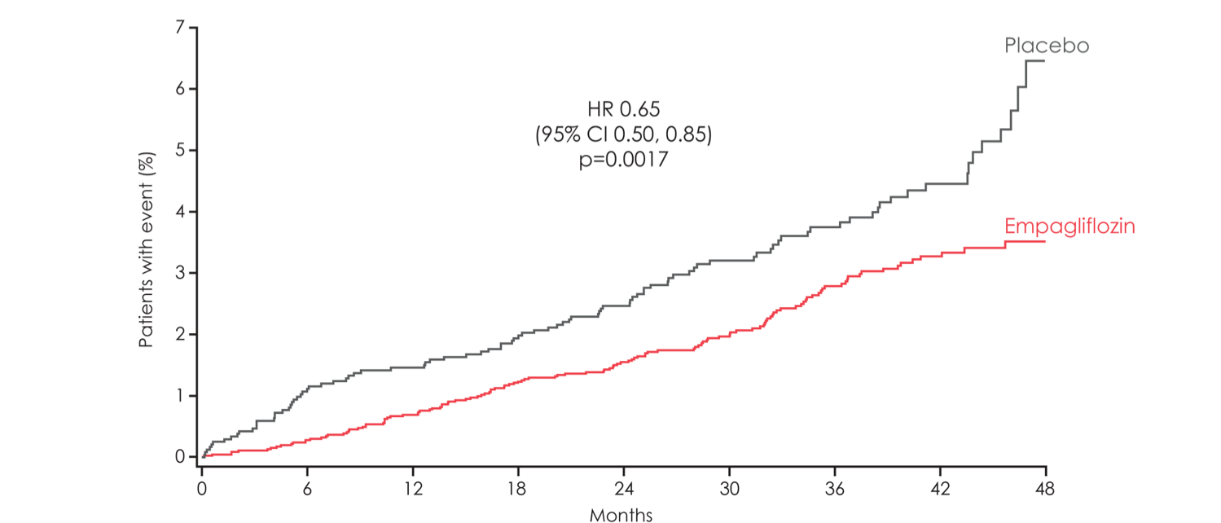
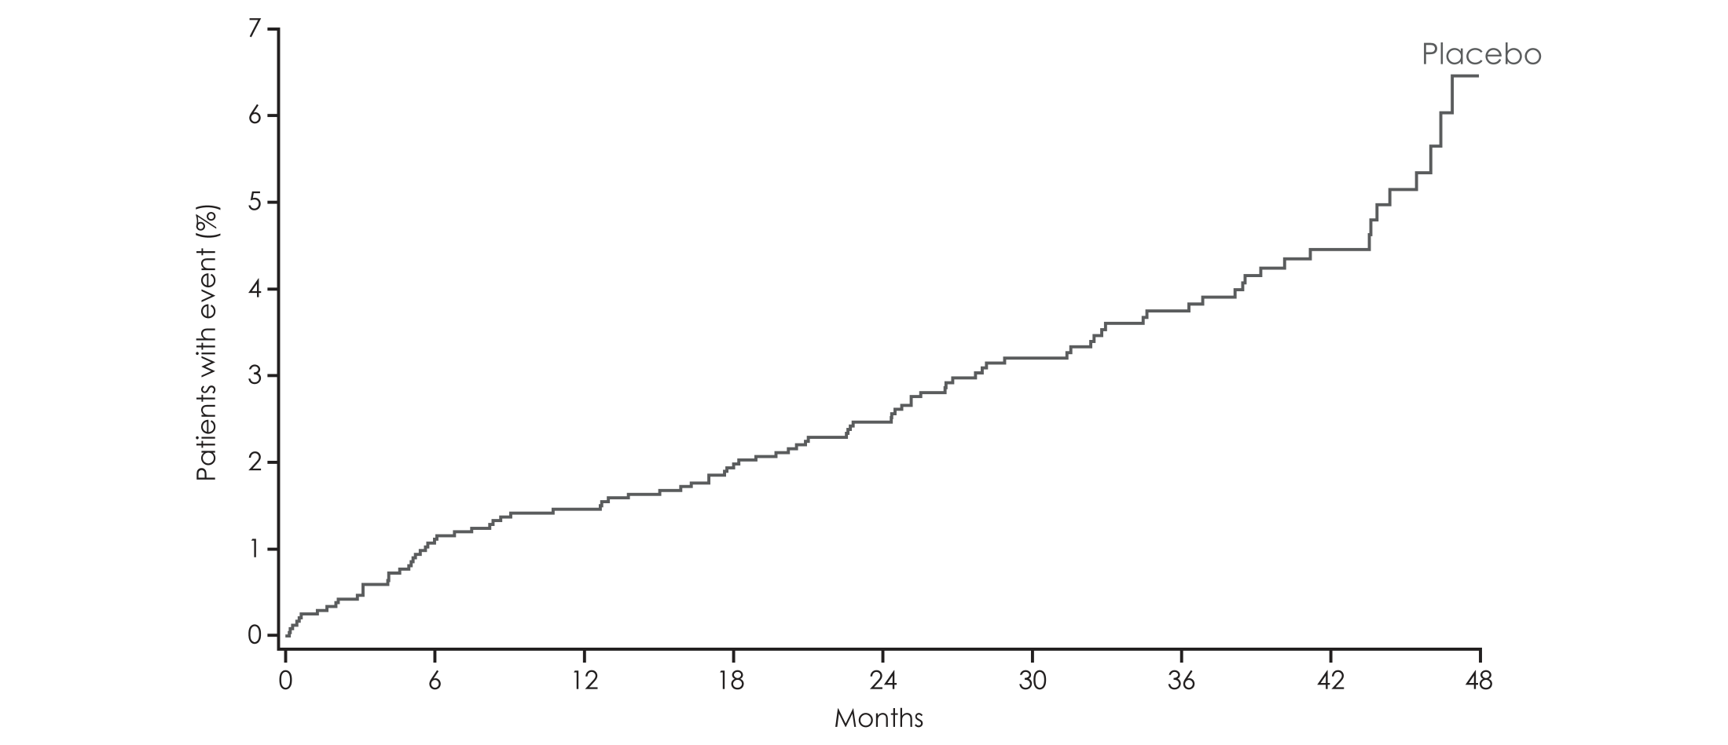
Hospitalisation for heart failure
HR 0.65
(95% CI 0.50, 0.85)
p=0.0017

Slide 3
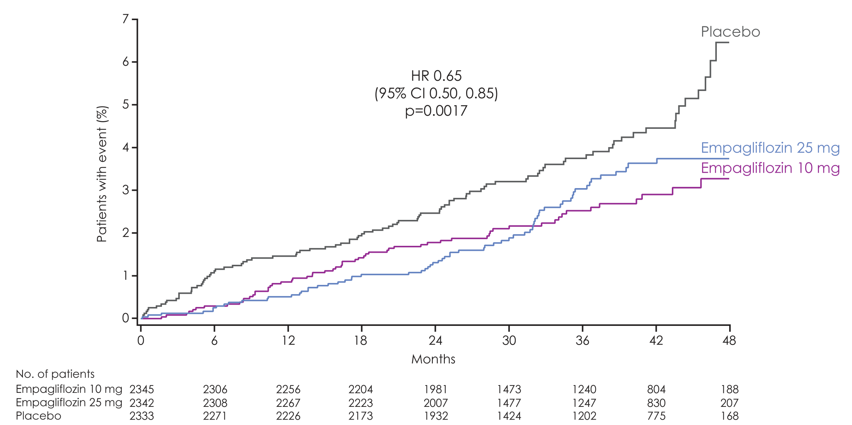
Hospitalisation for heart failure
Empagliflozin 10 mg
HR 0.62
(95% CI 0.45, 0.86)
p=0.0044
Empagliflozin 25 mg
HR 0.68
(95% CI 0.50, 0.93)
p=0.0166

Slide 4
All-cause mortality

Slide 5
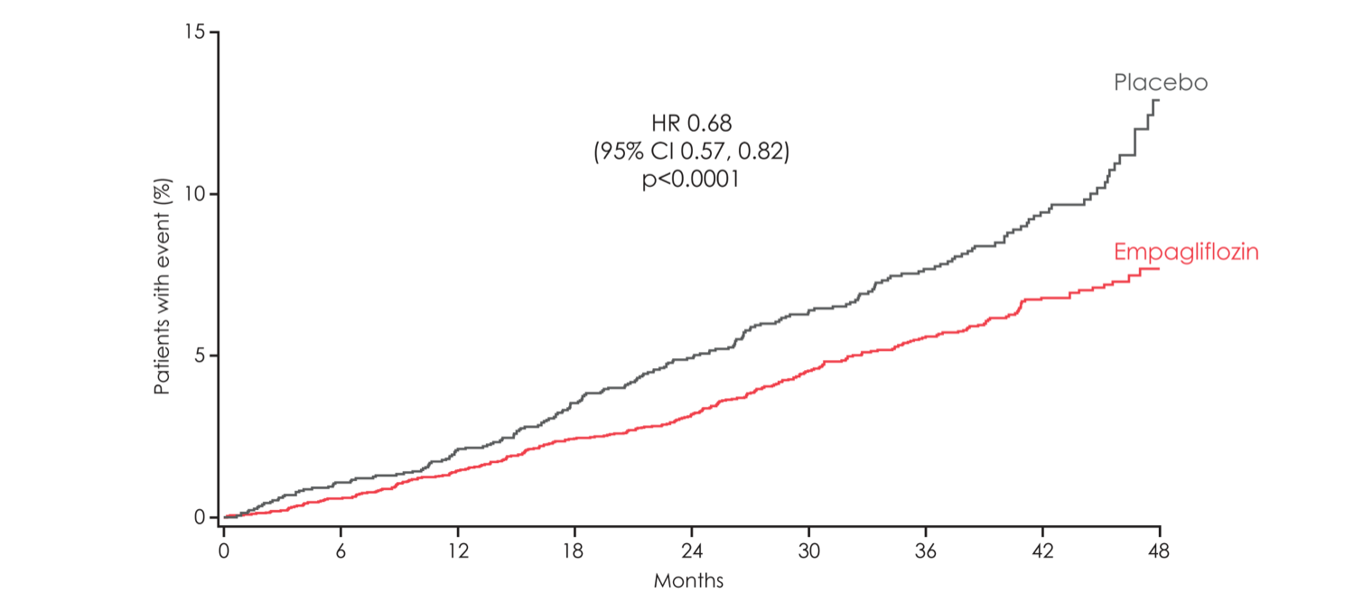
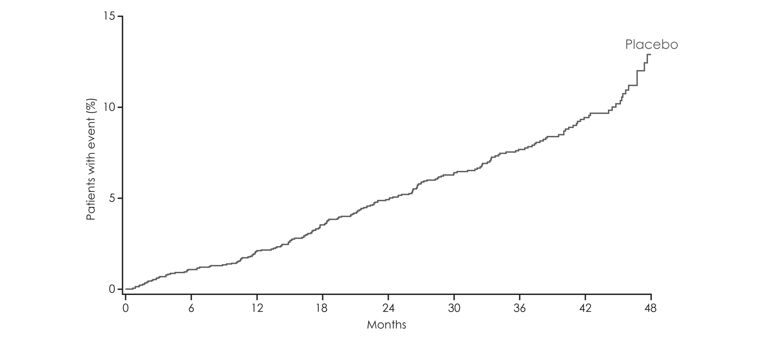
All-cause mortality
HR 0.68
(95% CI 0.57, 0.82)
p<0.0001

Slide 6
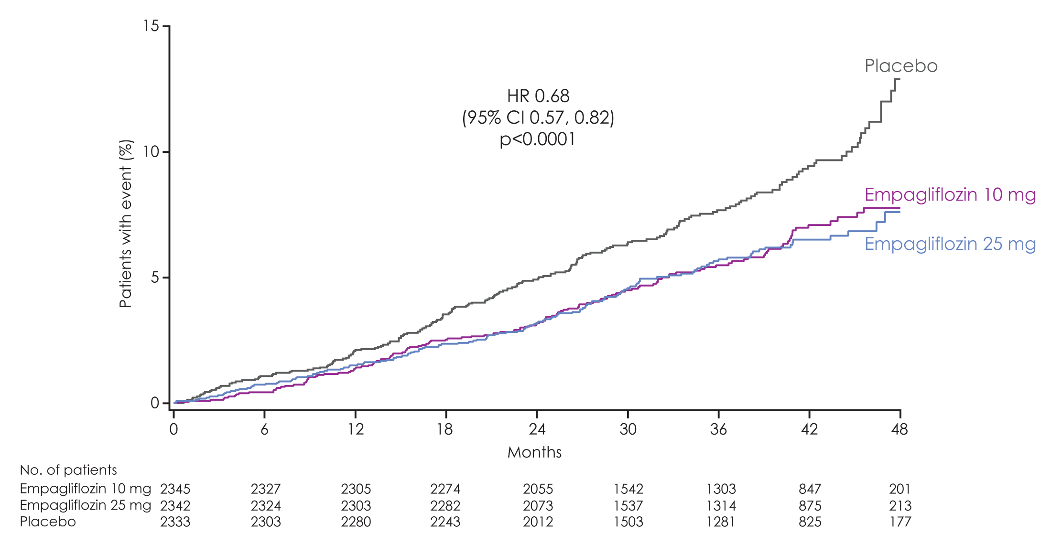
All-cause mortality
Empagliflozin 10 mg
HR 0.70
(95% CI 0.56, 0.87)
p=0.0013
Empagliflozin 25 mg
HR 0.67
(95% CI 0.54, 0.83)
p=0.0003
HR 0.68
(95% CI 0.57, 0.82)
p<0.0001

Slide 7
All-cause mortality, CV death and non-CV death
Patients with event/analysed
Empagliflozin |  | Placebo |  | HR | 95% CI |  | p-value
All-cause mortality | 269/4687 |  | 194/2333 | 0.68 | (0.57, 0.82) |  | <0.0001
CV death | 172/4687 |  | 137/2333 | 0.62 | (0.49, 0.77) |  | <0.0001
Non-CV death | 97/4687 |  | 57/2333 | 0.84 | (0.60, 1.16) |  | 0.2852
Favours empagliflozin
Favours placebo
Notes:
ACM: Table 15.2.4.1.5: 1
CV death: Table 15.2.4.1.1: 1
Non-CV death: Table 15.2.4.1.1: 3

