Slide 1
Cardiovascular outcomes
Silvio E Inzucchi
Professor of Medicine, Yale University School of Medicine, New Haven, CT, USA

Slide 2
Disclosure
Consultations and non-financial support
  Boehringer Ingelheim, Merck, Janssen, Novo Nordisk, Sanofi/Regeron, Intarcia, Lexicon, Poxel, Takeda, Eli Lilly
CME funding to Yale University
  Boehringer Ingelheim, Eli Lilly, Novo Nordisk, Abbott, Merck and Sanofi

Slide 3
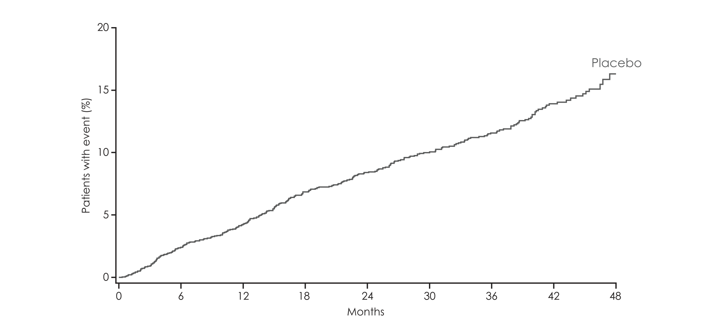
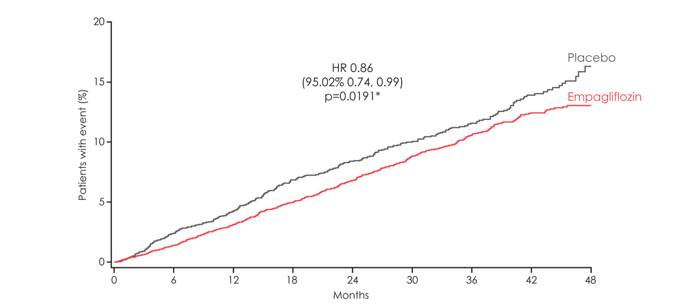
Primary outcome:
3-point MACE
HR 0.86
(95.02% CI 0.74, 0.99)
p=0.0382*

Slide 4
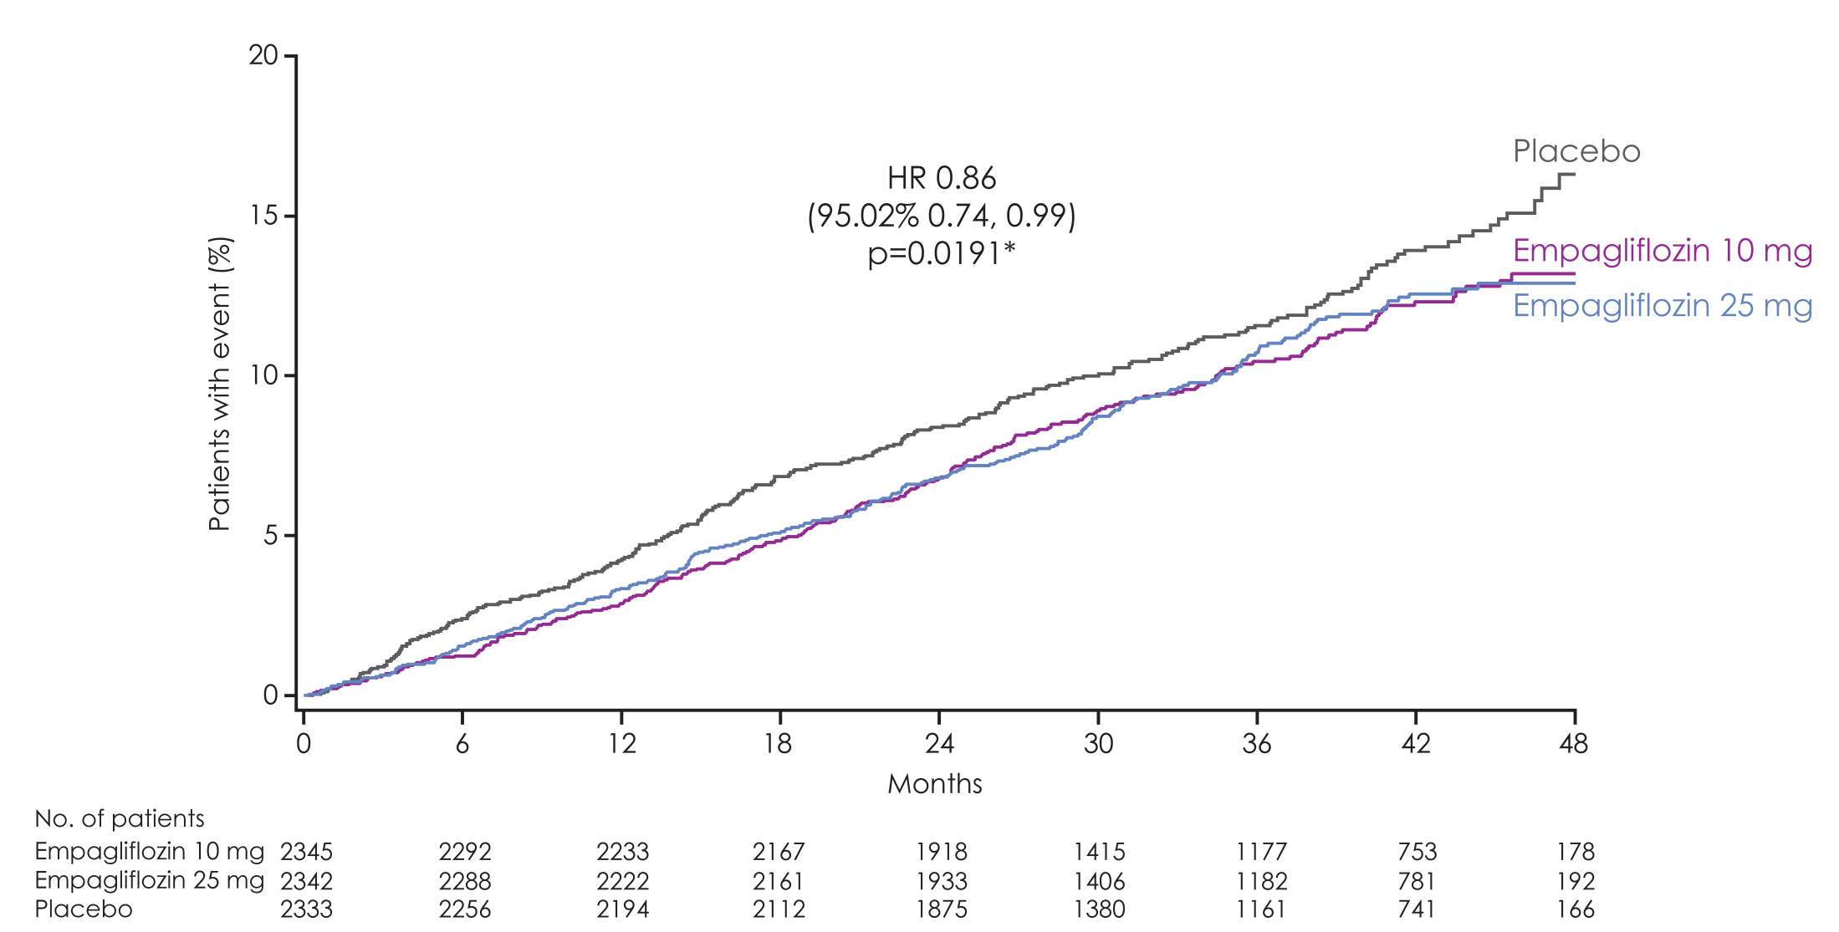
3-point MACE
Empagliflozin 10 mg
HR 0.85
(95% CI 0.72, 1.01)
p=0.0668
Empagliflozin 25 mg
HR 0.86
(95% CI 0.73, 1.02)
p=0.0865

Slide 5
3-point MACE: sensitivity analyses
On-treatment analysis**
 |  | 407/4607 | 227/2308 | 0.87 | (0.74, 1.02) |  | 0.0839
Per protocol analysis***
 |  | 487/4654 | 278/2316 | 0.86 | (0.75, 1.00) |  | 0.0519
Patients with event/ analysed
 | Empagliflozin |  | Placebo | HR | (95% CI) |  | p-value
Intent-to-treat population
 |  | 490/4687 | 282/2333 | 0.86 | (0.74, 0.99)* |  | 0.0382
Favours empagliflozin
Favours placebo
Notes:
ITT: Table 15.2.1.1: 2
OS: Table 15.2.1.2: 1
PPS: Table 15.2.1.2: 3

Slide 6
CV death, MI and stroke
Patients with event/ analysed
 | Empagliflozin |  | Placebo |  | HR | (95% CI) |  | p-value
3-point MACE |  | 490/4687 |  | 282/2333 | 0.86 | (0.74, 0.99)* |  | 0.0382
CV death
Favours empagliflozin
Favours placebo
Notes:
Table 15.2.4.1.1: 1
Table 15.2.4.1.2: 1
Table 15.2.4.1.3: 1
Table 15.2.4.1.5: 1
Table 15.2.4.1.8: 1
Table 15.2.4.1.9: 1

Slide 7
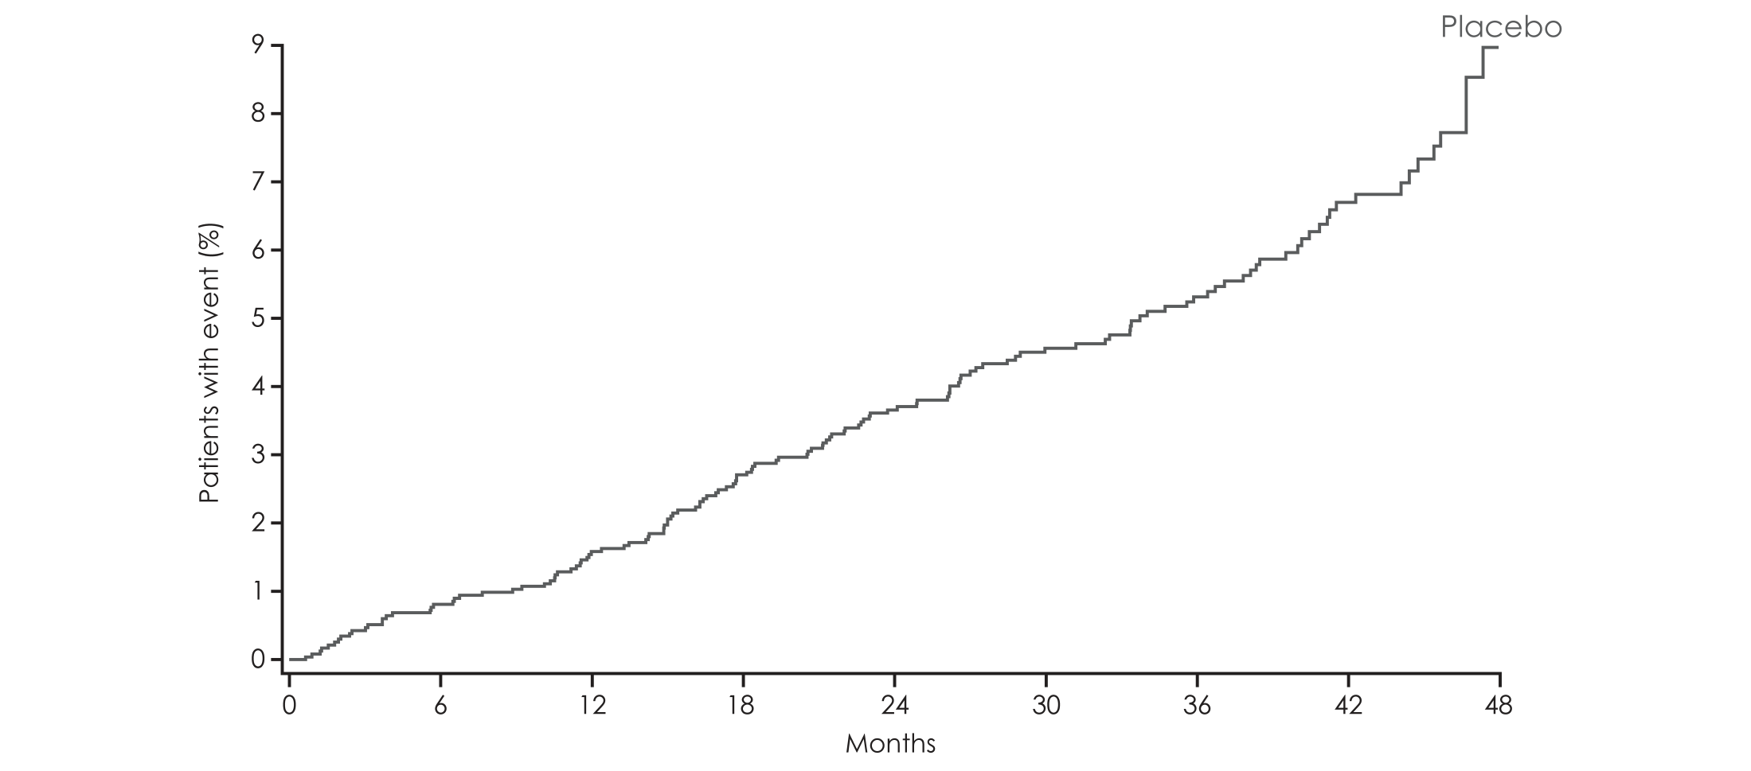
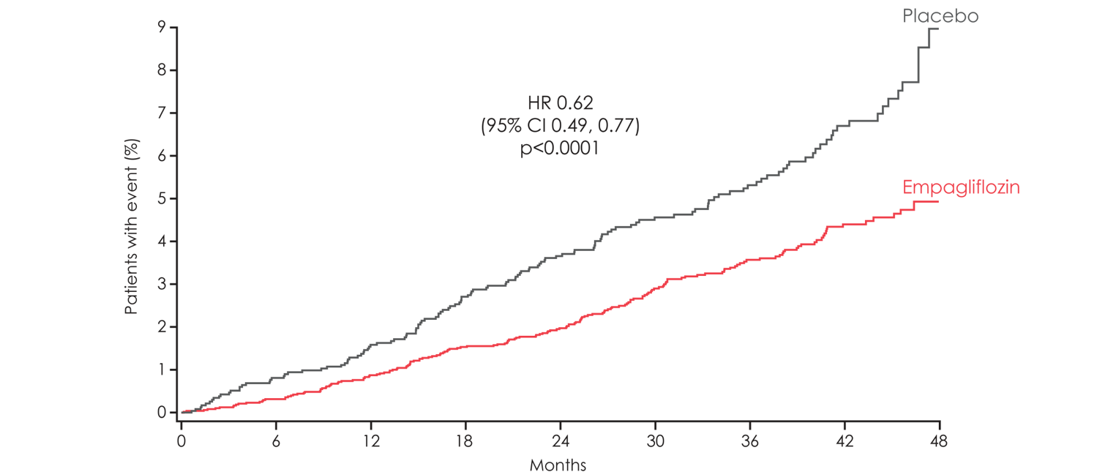
CV death
HR 0.62
(95% CI 0.49, 0.77)
p<0.0001

Slide 8
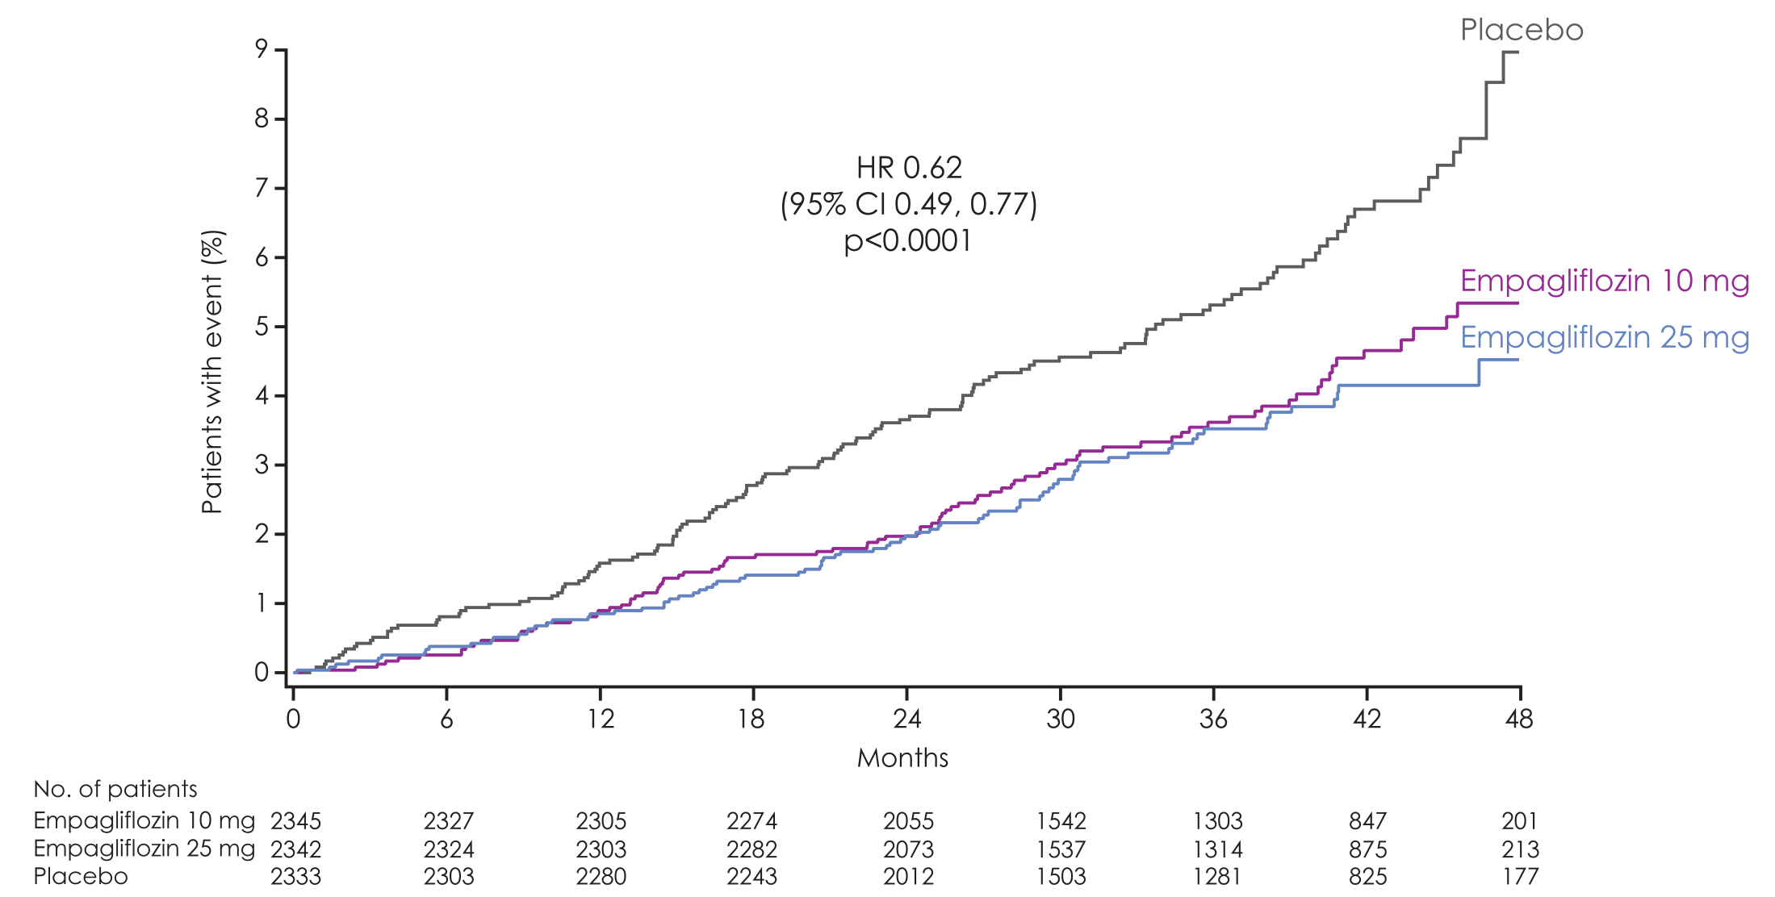
CV death
Empagliflozin 10 mg
HR 0.65
(95% CI 0.50, 0.85)
p=0.0016
Empagliflozin 25 mg
HR 0.59
(95% CI 0.45, 0.77)
p=0.0001

Slide 9
CV death, MI and stroke
Patients with event/analysed
 | Empagliflozin |  | Placebo |  | HR | (95% CI) |  | p-value
3-point MACE |  | 490/4687 |  | 282/2333 | 0.86 | (0.74, 0.99)* |  | 0.0382
CV death |  | 172/4687 |  | 137/2333 | 0.62 | (0.49, 0.77) |  | <0.0001
Non-fatal MI
Non-fatal stroke
Favours empagliflozin
Favours placebo
Notes:
Table 15.2.4.1.1: 1
Table 15.2.4.1.2: 1
Table 15.2.4.1.3: 1
Table 15.2.4.1.5: 1
Table 15.2.4.1.8: 1
Table 15.2.4.1.9: 1

Slide 10
CV death, MI and stroke
Patients with event/analysed
 | Empagliflozin |  | Placebo |  | HR | (95% CI) |  | p-value
3-point MACE |  | 490/4687 |  | 282/2333 | 0.86 | (0.74, 0.99)* |  | 0.0382
CV death |  | 172/4687 |  | 137/2333 | 0.62 | (0.49, 0.77) |  | <0.0001
Non-fatal MI |  | 213/4687 |  | 121/2333 | 0.87 | (0.70, 1.09) |  | 0.2189
Non-fatal stroke |  | 150/4687 |  | 60/2333 | 1.24 | (0.92, 1.67) |  | 0.1638
Favours empagliflozin
Favours placebo
Notes:
Table 15.2.4.1.1: 1
Table 15.2.4.1.2: 1
Table 15.2.4.1.3: 1
Table 15.2.4.1.5: 1
Table 15.2.4.1.8: 1
Table 15.2.4.1.9: 1

Slide 11
Fatal and non-fatal stroke
Patients with event/analysed
 | Empagliflozin |  | Placebo | HR | (95% CI) |  | p-value
Intent-to-treat population
 |  | 164/4687 | 69/2333 | 1.18 | (0.89, 1.56) |  | 0.2567
Numerical difference largely driven by events occurring >30 days after treatment stop
Favours
empagliflozin
Favours
placebo
On-treatment analysis*
 | 141/4607 | 66/2308 | 1.04 | (0.78, 1.40) |  | 0.7849
Favours
empagliflozin
Favours
placebo
Notes:
Table 15.2.1.1: 2
On-treatment per protocol analysis (OS): Table 15.2.4.1.3: 3
On-treatment set (up to treat. stop + 30 days/indiv. trial compl): Table 15.2.4.1.3: 5

Slide 12
3-point MACE and 4-point MACE
Patients with event/analysed
 | Empagliflozin |  | Placebo |  | HR | (95% CI) |  | p-value
3-point MACE |  | 490/4687 |  | 282/2333 | 0.86 | (0.74, 0.99)* |  | 0.0382
CV death |  | 172/4687 |  | 137/2333 | 0.62 | (0.49, 0.77) |  | <0.0001
Non-fatal MI |  | 213/4687 |  | 121/2333 | 0.87 | (0.70, 1.09) |  | 0.2189
Non-fatal stroke |  | 150/4687 |  | 60/2333 | 1.24 | (0.92, 1.67) |  | 0.1638
4-point MACE
Favours empagliflozin
Favours placebo
Notes:
Table 15.2.4.1.1: 1
Table 15.2.4.1.2: 1
Table 15.2.4.1.3: 1
Table 15.2.4.1.5: 1
Table 15.2.4.1.8: 1
Table 15.2.4.1.9: 1

Slide 13
3-point MACE and 4-point MACE
Patients with event/analysed
 | Empagliflozin |  | Placebo |  | HR | (95% CI) |  | p-value
3-point MACE |  | 490/4687 |  | 282/2333 | 0.86 | (0.74, 0.99)* |  | 0.0382
CV death |  | 172/4687 |  | 137/2333 | 0.62 | (0.49, 0.77) |  | <0.0001
Non-fatal MI |  | 213/4687 |  | 121/2333 | 0.87 | (0.70, 1.09) |  | 0.2189
Non-fatal stroke |  | 150/4687 |  | 60/2333 | 1.24 | (0.92, 1.67) |  | 0.1638
4-point MACE |  | 599/4687 |  | 333/2333 | 0.89 | (0.78, 1.01)* |  | 0.0795
Favours empagliflozin
Favours placebo
Notes:
Table 15.2.4.1.1: 1
Table 15.2.4.1.2: 1
Table 15.2.4.1.3: 1
Table 15.2.4.1.5: 1
Table 15.2.4.1.8: 1
Table 15.2.4.1.9: 1

Slide 14
3-point MACE: subgroup analysis
HR (95% CI)
p-value
for interaction
 | Empagliflozin | Placebo
All patients | 4687 | 2333
Age, years |  |  |  |  |  | 0.01
<65 | 2596 | 1297
≥65 | 2091 | 1036
Sex |  |  |  |  |  | 0.81
Male | 3336 | 1680
Female | 1351 | 653
Race |  |  |  |  |  | 0.09
White | 3403 | 1678
Asian | 1006 | 511
Black/African-American | 237 | 120
HbA1c, % |  |  |  |  |  | 0.01
<8.5 | 3212 | 1607
≥8.5 | 1475 | 726
Body mass index, kg/m² |  |  |  |  |  | 0.06
<30 | 2279 | 1120
≥30 | 2408 | 1213
eGFR, mL/min/1.73m² |  |  |  |  |  | 0.20
≥90 | 1050 | 488
60 to <90 | 2425 | 1238
<60 | 1212 | 607
Favours empagliflozin
Favours placebo

Slide 15
CV death: subgroup analyses
HR (95% CI)
p-value
for interaction
 | Empagliflozin | Placebo
All patients | 4687 | 2333
Age, years |  |  |  |  |  | 0.21
<65 | 2596 | 1297
≥65 | 2091 | 1036
Sex |  |  |  |  |  | 0.32
Male | 3336 | 1680
Female | 1351 | 653
Race |  |  |  |  |  | 0.43
White | 3403 | 1678
Asian | 1006 | 511
Black/African-American | 237 | 120
HbA1c, % |  |  |  |  |  | 0.51
<8.5 | 3212 | 1607
≥8.5 | 1475 | 726
Body mass index, kg/m² |  |  |  |  |  | 0.05
<30 | 2279 | 1120
≥30 | 2408 | 1213
eGFR, mL/min/1.73m² |  |  |  |  |  | 0.15
≥90 | 1050 | 488
60 to <90 | 2425 | 1238
<60 | 1212 | 607
Favours empagliflozin
Favours placebo

