Slide 2
Disclosure
Consultations and Honoraria
  AstraZeneca, Boehringer Ingelheim, Eli Lilly, Janssen, Merck,
  Novo Nordisk, Sanofi, Takeda
Grant Support
  Boehringer Ingelheim, Novo Nordisk, Merck

Slide 3
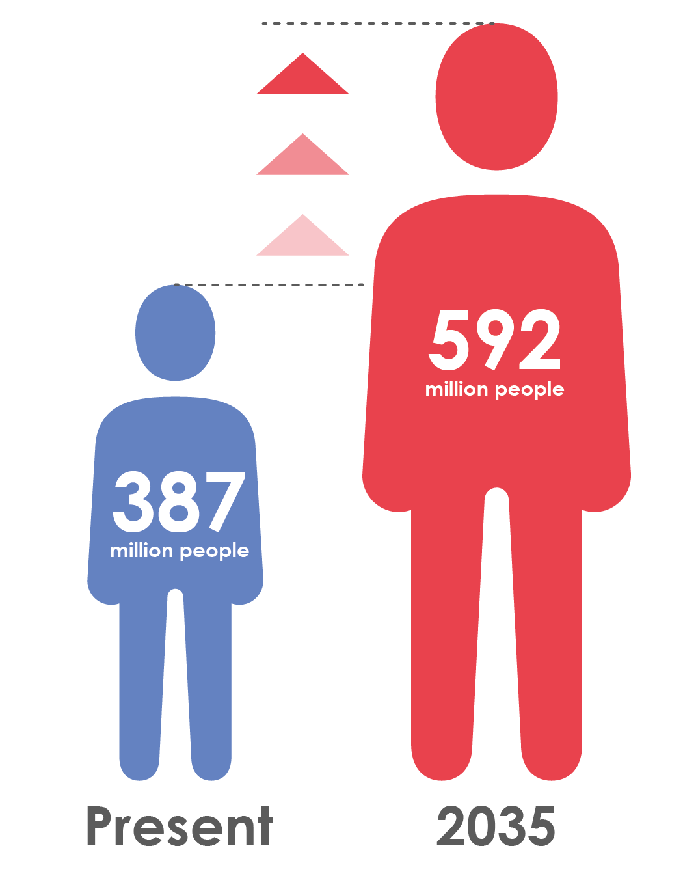

Type 2 diabetes is increasingly prevalent
Globally, 387 million people are living with diabetes¹
At least 68% of people >65 years with diabetes die of heart disease²
Mortality risk associated with diabetes (n=820,900)³
This will rise to 592 million by 2035¹

Slide 4
Diabetes is associated with significant loss of life years
Men
Women
7
6
5
4
3
2
1
0
Non-vascular deaths
Vascular deaths
7
6
5
4
3
2
1
0
Years of life lost
0
40
50
60
70
80
90
0
40
50
60
70
80
90
Age (years)
Age (years)
On average, a 50-year-old individual with diabetes and no history of vascular disease will die 6 years earlier compared to someone without diabetes
.

Slide 5
Meta-analysis of intensive glucose control in T2DM: major CV events including heart failure
 | Number of events
 | More intensive | Less intensive | Difference in HbA1c (%) |  | HR (95% CI)
Stroke | 378 | 370 | -0.88 |  | 0.96 (0.83, 1.10)
Myocardial infarction | 730 | 745 | -0.88 |  | 0.85 (0.76, 0.94)
Hospitalisation for or death from heart failure | 459 | 446 | -0.88 |  | 1.00 (0.86, 1.16)
Favours more intensive
Favours less intensive
Meta-analysis of 27,049 participants and 2370 major vascular events from:
  ADVANCE
  UKPDS
  ACCORD
  VADT

Slide 6
Meta-analysis of intensive glucose control in T2DM: mortality
 | Number of events
 | More intensive | Less intensive | Difference in HbA1c (%) |  | HR (95% CI)
All-cause mortality | 980 | 884 | -0.88 |  | 1.04 (0.90,1.20)
CV death | 497 | 441 | -0.88 |  | 1.10 (0.84,1.42)
Non-CV death | 476 | 432 | -0.88 |  | 1.02 (0.89,1.18)
Favours more intensive
Favours less intensive
Meta-analysis of 27,049 participants and 2370 major vascular events from
  ADVANCE
  UKPDS
  ACCORD
  VADT

Slide 7
Recent trials of newer glucose-lowering agents have been neutral on the primary CV outcome
HR: 1.0
(95% CI: 0.89, 1.12)
SAVOR-TIMI 53
HR: 0.98
(95% CI: 0.88, 1.09)
TECOS
HR: 0.96
(95% CI: UL ≤1.16)
EXAMINE
2013 | 2014 | 2015
HR: 1.02
(95% CI: 0.89, 1.17)
ELIXA
DPP-4 inhibitors*
EMPA-REG OUTCOME®
Lixisenatide
Empagliflozin

