Slide 1
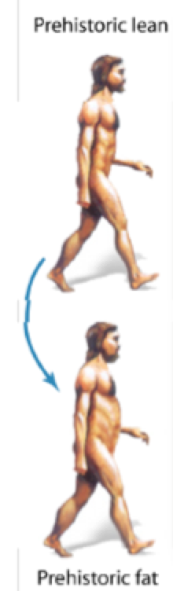
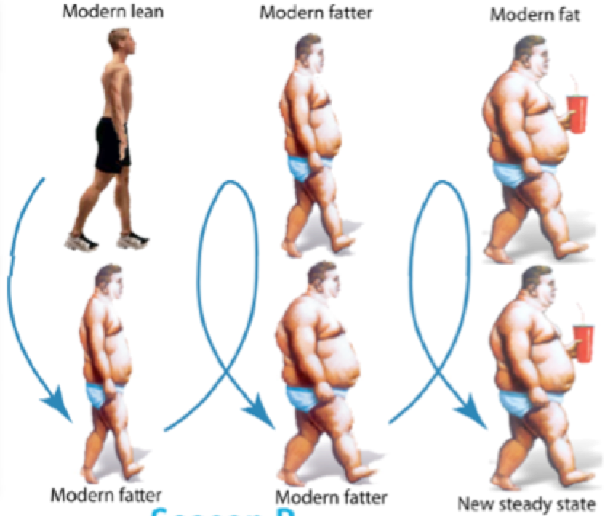
Once Upon a Time, Insulin Resistance was Adaptive… but Not Today
Adaptive Diurnal/Seasonal
Insulin Resistance
Maladaptive Insulin Resistance,
Increased Sympathetic Tone
All Day/Year Long
Cyclic DOPA surge suppressed by factors in modern life:
High carb/fat diet
Lack of exercise
Abnormal sleep/ wake cycle
Obesity
Diabetes
Curtis BM, O’Keefe JA. Mayo Clin Prco. 2002;77:45-54.
CINCOTTA
Notes:
3. The pathology of glucose metabolism that contributes to T2DM evolved as part of an adaptive, short-term “fight or flight” mechanism; over the long term in the modern world, this mechanism leads to a maladaptive pathophysiology. The normal, adaptive role of dopamine and its diurnal variations should be contrasted with the abnormal, maladaptive suppression of dopamine surges due to disruption by high-fat/high-calorie diets and sedentary lifestyles. One advisor [Sciales] said, “Make it fun. Insulin resistance is adaptive… it’s great. We evolved with it for starvation, hibernation, and fight-or-flight responses. But, it’s only great for the short term. Over the long term, insulin resistance is maladaptive.”
Curtis 2002/p47/c1/para5, p48/Table2

Slide 2
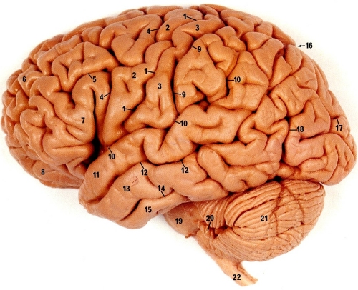
Bromocryptine QR:
Proposed mechanism of action
Morning administration
(within 2 hours
of waking) of AGENT
Low dopaminergic tone in hypothalamus in early morning in diabetes
Restoration of morning peak in dopaminergic activity (via D2 receptor-mediated activity)
Corrects
Sympathetic tone
HPA axis tone
 Hepatic gluconeogenesis
 FFA and TG
 Insulin resistance
 Inflammation/hypercoagulation
Sympathetic tone
HPA axis tone
 Hepatic gluconeogenesis
 FFA and TG
 Insulin resistance
 Inflammation/hypercoagulation
Impaired glucose metabolism, hyperglycemia and insulin resistance
Adverse cardiovascular pathology
Decreased postprandial glucose levels
Reduction in insulin resistance
Day-long reduction in plasma glucose, TGs and FFAs
Fonseca. Use of Dopamine agonists in Type-2-Diabetes. Oxford American Pocket Cards. OUP, 2010
Cincotta. Hypothalamic role in Insulin Resistance and insulin Resistance Syndrome. Frontiers in Animal Diabetes Research Series. Taylor and Francis, Eds Hansen, B Shafrir, E London, pp 271-312, 2002
2
Notes:
2-CYC10529
2
The central and peripheral dopaminergic system is involved in the regulation of energy homeostasis
Dopaminergic neurotransmission is thought to affect both glucose and lipid metabolism, and in patients with diabetes there is an early morning dip in hypothalamic dopaminergic tone which leads to an increase in sympathetic tone, activation of the hypothalamic-pituitary-adrenal axis, and potentiates systemic low-grade inflammation. These actions precipitate abnormalities in glucose metabolism, insulin resistance and cardiovascular pathology.
When administered within 2 hours of waking, CYCLOSET is thought to restore the dopaminergic activity via its D2-mediated action, improving postprandial glucose (at each of the three standard meals of the day) without increasing insulin secretion. It also reduces triglycerides and free fatty acids.
2

Slide 3
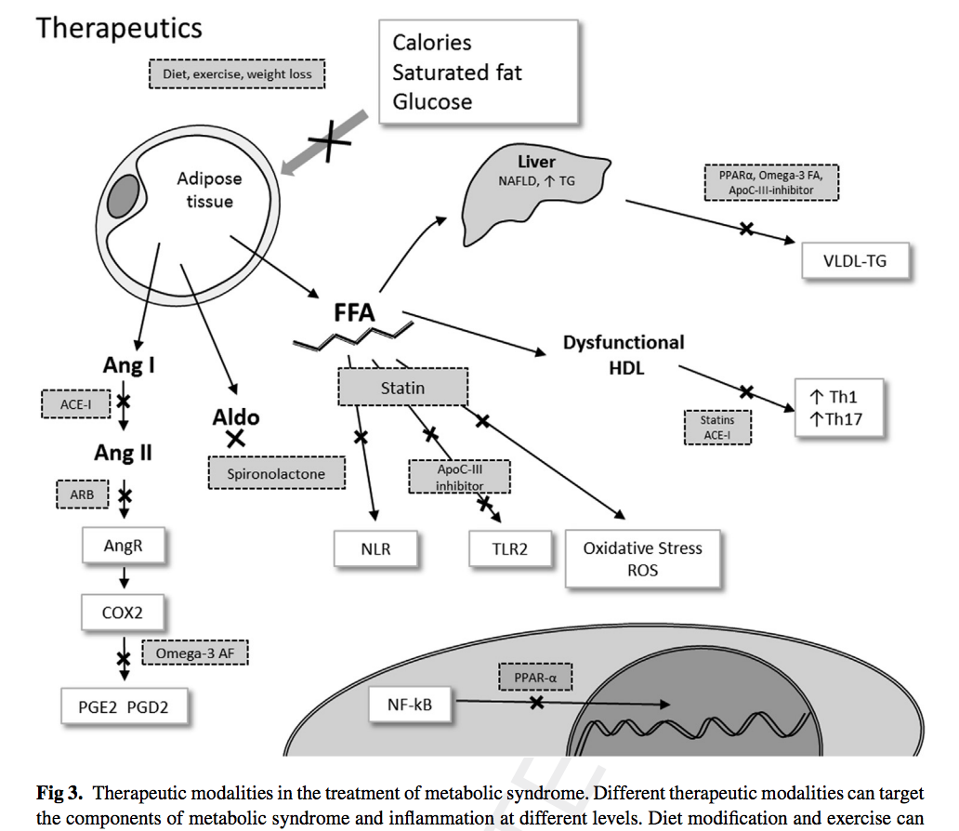
Treatment IR induced Inflammation

Slide 4
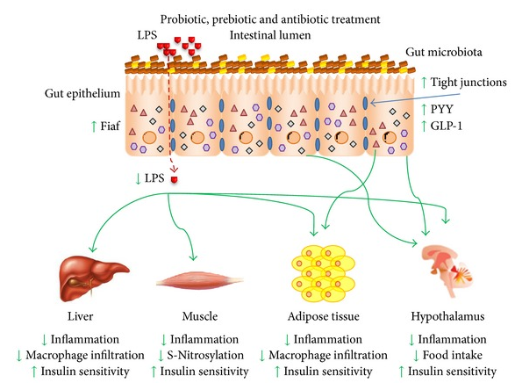
Probiotic, Prebiotic and Antibiotic Treatment of Abnormal Gut Biome

Slide 5
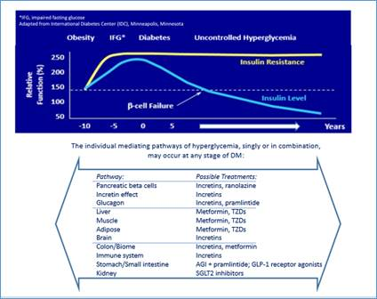
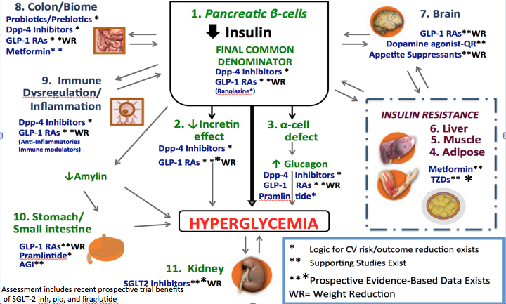
Treat across natural history of Diabetes
Patient-Centric, eventually Precision Medicine
Least # Agents Rx’ing Most # mechanisms Hyperglycemia
NO SU/ Insulin only if don’t respond to 3-4 non-Hypoglycemic Agents
Notes:
. Treat with Least Number of agents that address most Number of Mechanisms of hyperglycemia
2. Treat across natural history of Diabetes
Delay Need for Insulin
No need for Early Insulin
If need Insulin, Continue Non-Insulin RX OR WITH USE NEW GLP-1 BASAL COMBO
(Avoids need for Meal-Time Insulin- (Decrease Risk Hypoglycemia 85%- Garber)
4. Get Patients off insulin who had been given early Insulin

Slide 6
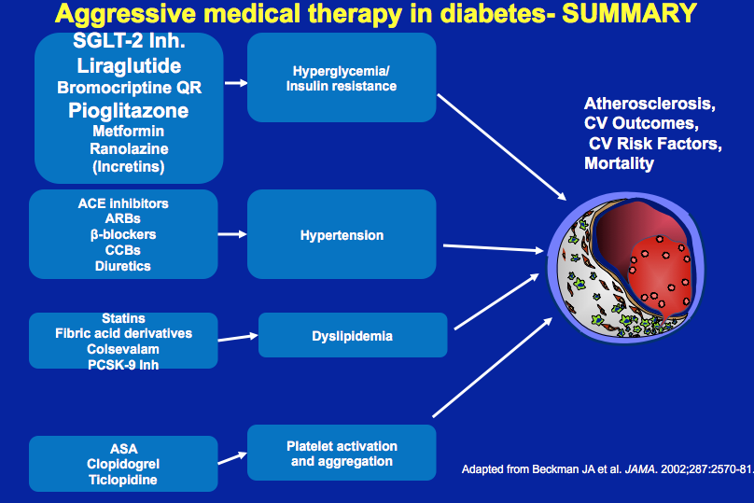

Slide 7
Conclusion 1
Current Guidelines and classifications of DM , though appropriate at creation, are, given new knowledge, inadequate:
new classification schema -the β-cell as THE CORE DEFECT in ALL DM
The various mediators of β-cell dysfunction offer key opportunities for Prevention, Therapy, Research and Education
Patient care should shift from current classifications that limit therapeutic choices to:
one that views a given patient’s disease and treatment course based on their individual cause(s) of metabolic dysregulation, e.g. genes, inflammation, insulin resistance, gut biome, central (brain) mechanisms, etc.

Slide 8
Conclusion-2
Defining markers, and Processes of Care = patient-centric approaches
In T1D and LADA, in particular, incretins, insulin sensitizers, SGLT-2 inhibitors, anti-inflammatories/ immune modulators and others are either underutilized in some cases, and under-evaluated in others
More research always needed, but,
in an evidence-based PRACTICE approach to care,
we can START NOW

