Slide 1
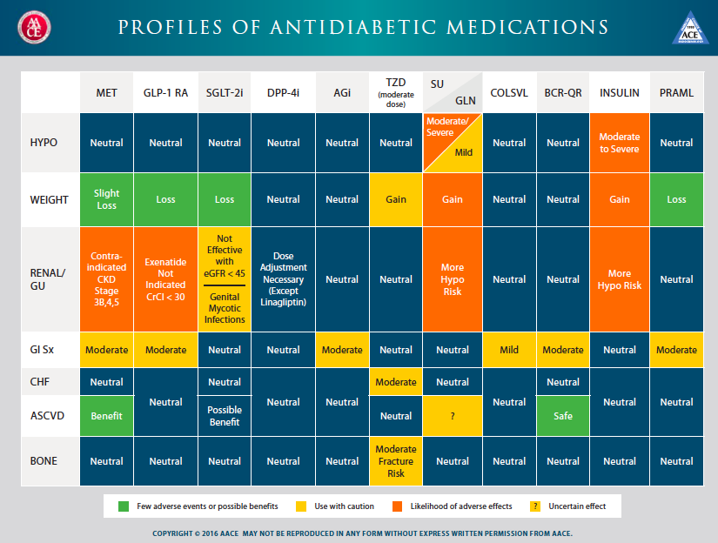
A Process Of Precision Medicine-
Matching Right Drug to Right Patient

Slide 2
Our Guideline Principles
Egregious Eleven with CV Assessment
1. Match Right Drug to right Patient, and Vice Versa- Precision Medicine-
  Based on co-morbidities, drug tolerance, cautions
2. Early Combination Therapy-Use Least Number of Agents that Treat Most Number of Mechanisms of
  Hyperglycemia
3. Not first Line, Second Line, Third Line
4. Not Competition Between Classes
5 Prioritization Based on Glycemic Benefit PLUS, CV risk factor or Outcome reduction, and weight reduction
6. Fast Therapeutic Changes- Consider Fructosamine 1 Month after a Change
7.
8.
Use Over Natural History of Diabetes
Consider Therapy for Prevention
2. Treat Pre-Diabetes
EE principles
No Need for Early Insulin
5. Delay Need for Insulin Inherent in EE as Using Agents that are Neutral or Preserve Beta-cell
  Function
If need Insulin keep non-insulin therapies, add basal- will likely not need bolus therapy
Consider Trying to Get Patients off Insulin who have Residual Beta-Cell Function
8.

Slide 3
Related Principles
Treat to prevent /delay diabetes via Rx pre-diabetes- Defronzo Triple Therapy data
Treat Cardio-metabolic syndrome
Treat insulin resistance multiple ways
Treat ‘Type 1’s with ‘Adjuctive’ therapies
NO ORAL MEDS THAT POTENTIALLY DECREASE B-Cell Function or mass- eg: NO SU/ glinides
Minimize/ avoid insulin
Avoid bolus insulin- 87% hypo with BB due bolus-(Garber)
Take folks off insulin (myth most ‘T2DM’ will have b-cell failure- eg: think of bariatric surgery folk

Slide 4
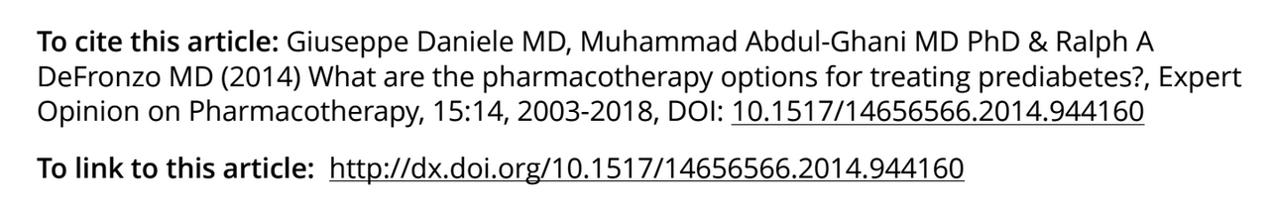
Related Principles
Treat to prevent /delay diabetes via Rx pre-diabetes- Defronzo Triple Therapy data
List ref

Slide 5
Related Principles
Treat Cardio-metabolic syndrome
Treat insulin resistance multiple ways

Slide 6
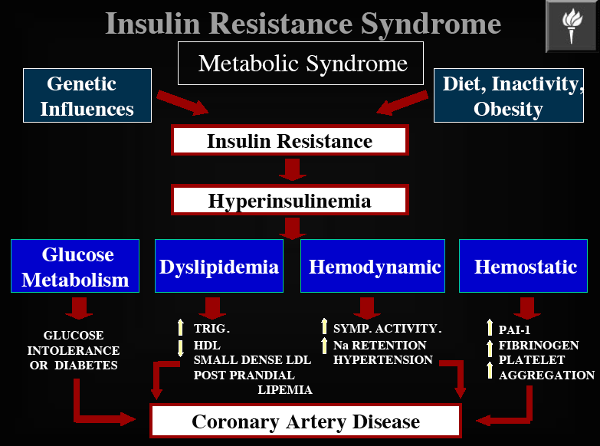
Primary Hyperinsulinemia- Genetic propensity
( Corkey)
INACTIVITY,DIET
FFAs
INFLAMMATION, OXIDATIVE STRESS
INCREASED PAI-1,NFKB,MMPS,
ROS,AP-1,Egr-1

Slide 7
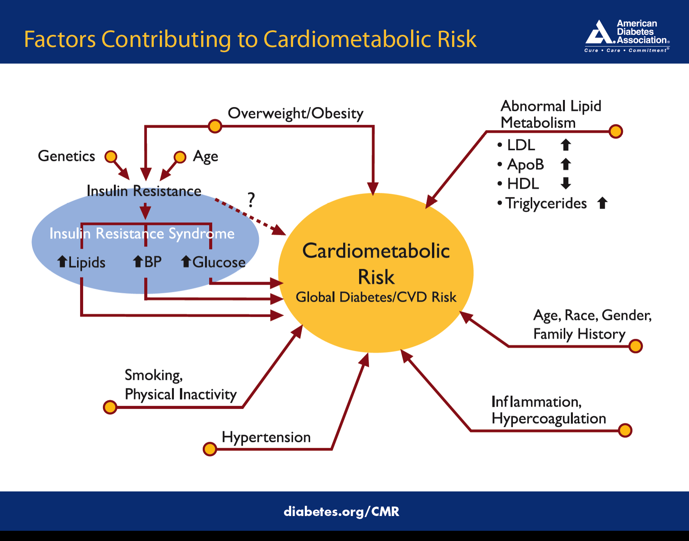

Slide 8
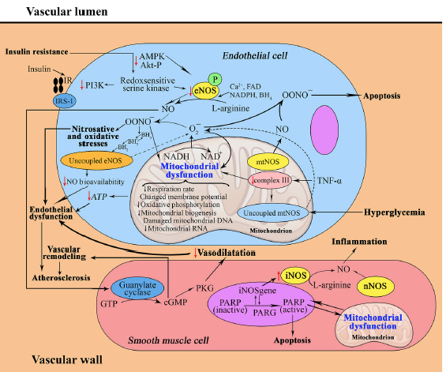
IR and Vasculature-
Nitricoxide and mitochondria in metabolic syndrome LarisaLitvinova, Frontiers in Physiology, February2015|Volume6|Article20 | 1

Slide 9
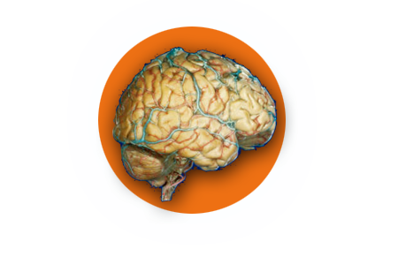
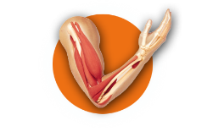
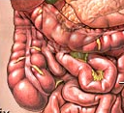
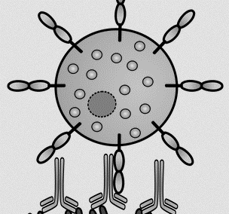
Potential Causes of Insulin Resistance and Their Interplay
Central IR
Loss of dopamine surge in SCN
increased appetite
Increased sympathetic tone
Weight Reduction
Agents
Bromocriptine-QR-
Hyperinsulinemia
Biome
IR
Peripheral
IR
Inflammation
IR
Pro-Biotics,
Pre-Biotics,
Antibiotics
TZD (Pio-) ,
Metformin
Anti-Inflammatories
Immune modulators

