Slide 1
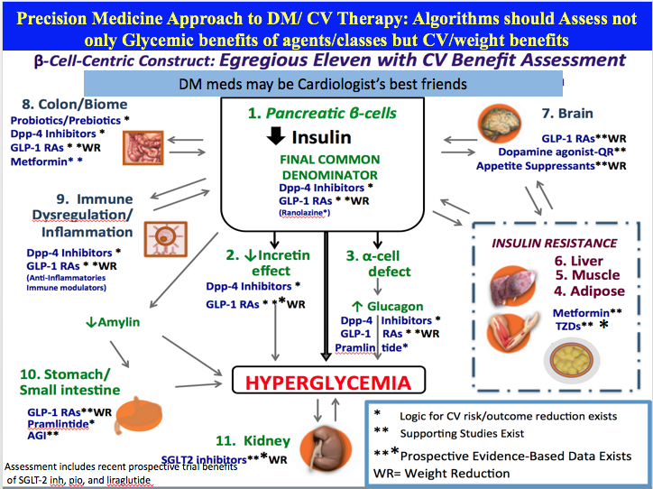

Slide 2
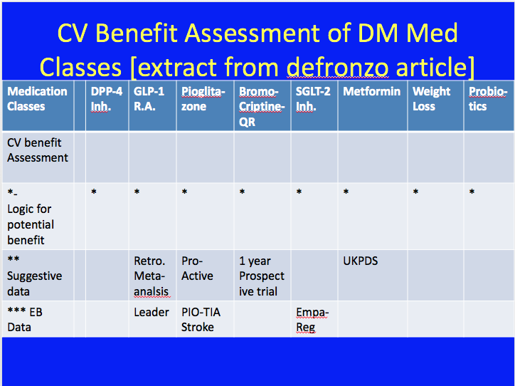

Slide 3
CV Outcome Studies
Empa-reg
Leader
Pio Stroke (Proactive)
Bromocriptine
Metformin-UKPDS

Slide 4
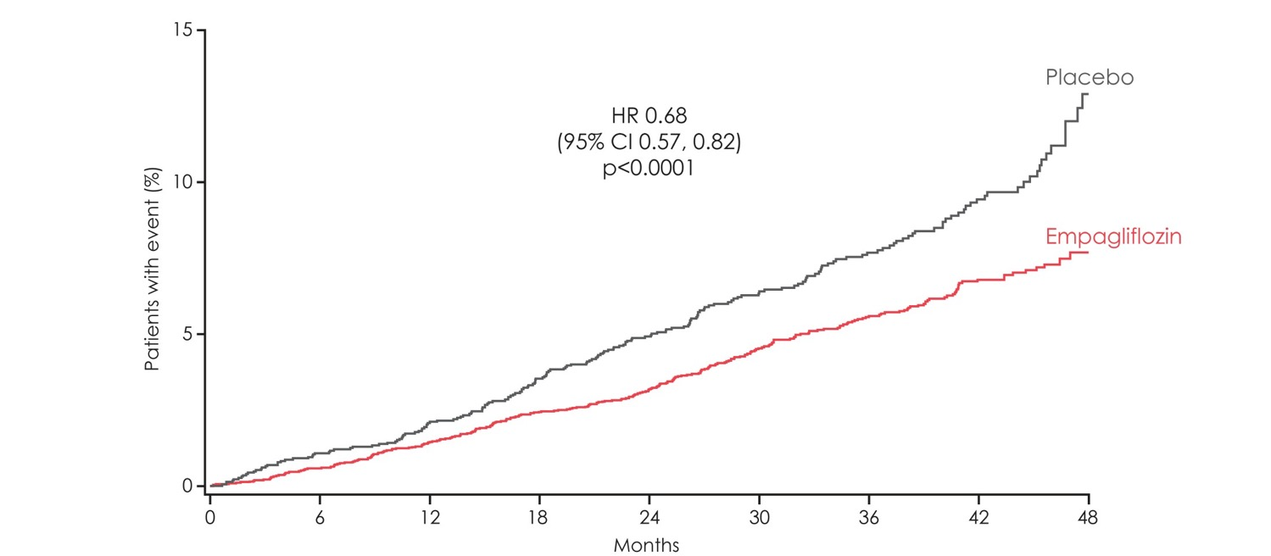
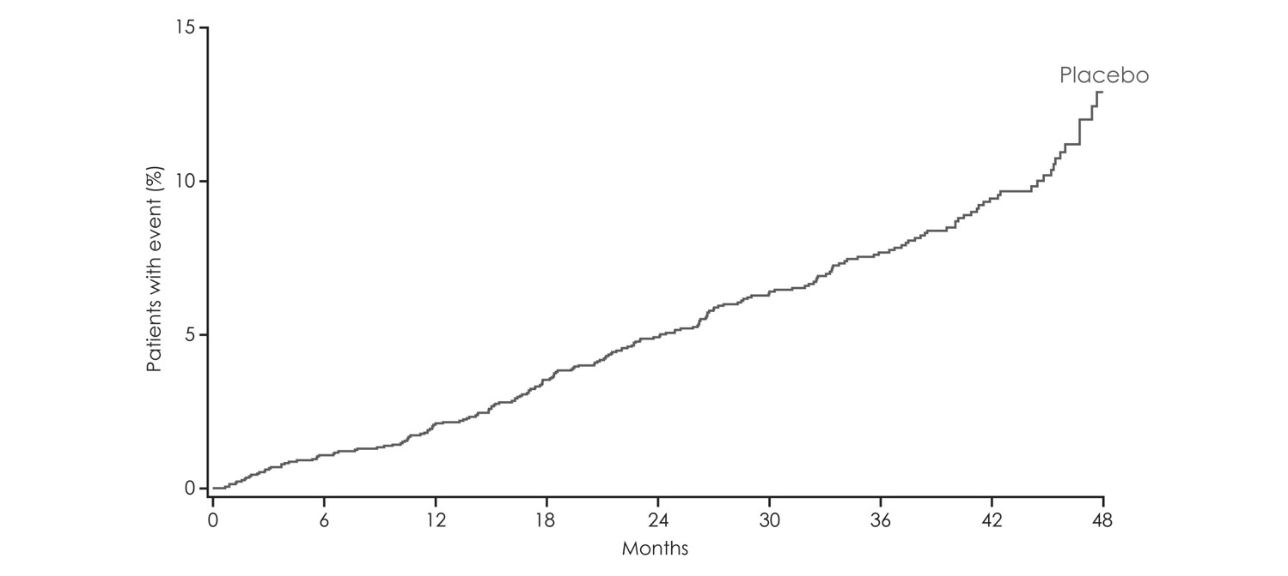
Empa-Reg reduction in All-cause mortality
HR 0.68
(95% CI 0.57, 0.82)
p<0.0001
Kaplan-Meier estimate. HR, hazard ratio

Slide 5
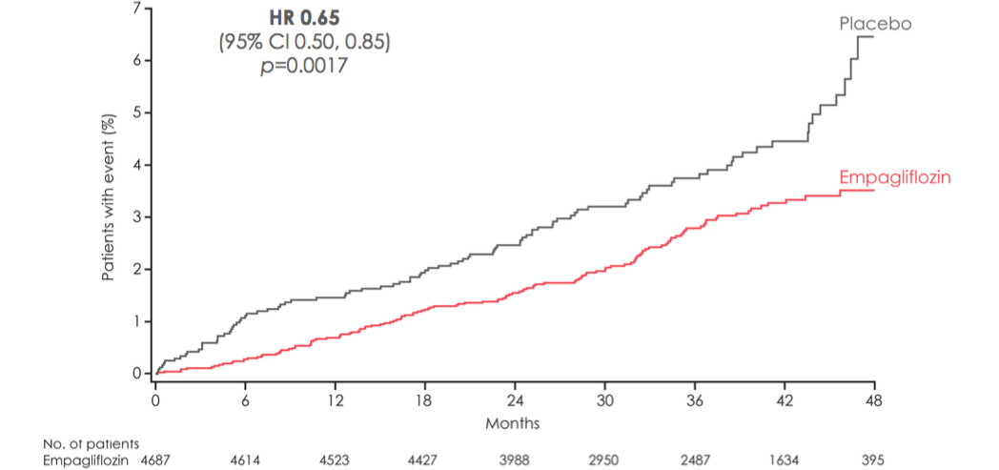
Reduction in CHF admissions

Slide 6
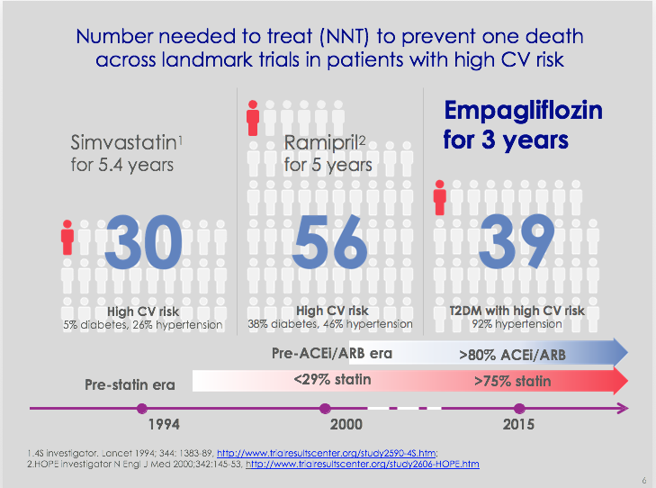

Slide 7


Slide 8
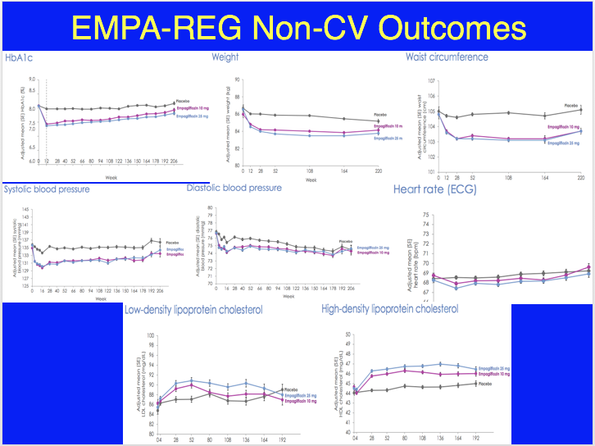

Slide 9
Postulate
These effects-
Decrease arterial stiffness
Decreases sympathetic tone
Results in early benefit
  Suggested by no increased pulse with decreased BP
  Similar pattern in bromocriptine-QR study where benefits attributed to decreased sympathetic tone

Slide 10
LEADER Trial with Liraglutide Reduce CV Outcomes: TBA 6/16
The company said that the placebo-controlled trial had met the primary endpoint of showing non-inferiority and had also demonstrated "a statistically significant reduction in cardiovascular risk." The company said that "the superior reduction of major adverse cardiovascular events ... was derived from all three components of the endpoint."

Slide 11
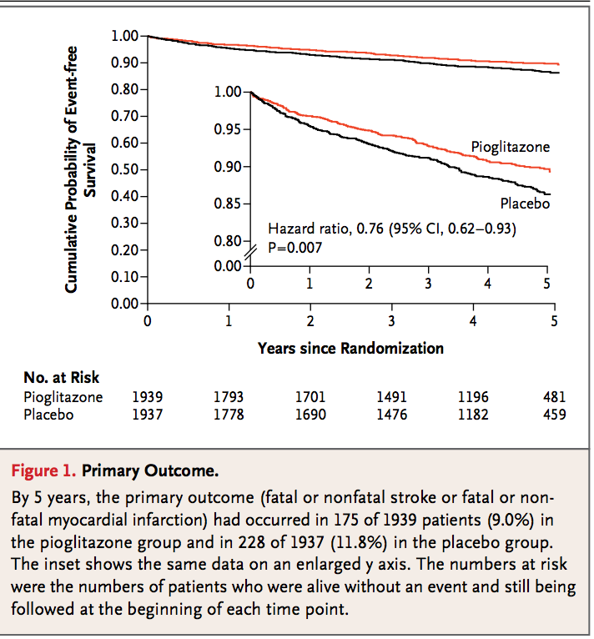
Pioglitazone Decreases MI and CVA in IR patients after TIA- IRIS study
Rx 100 pts,
Will stop a
CVA in
3 patients;
Or
Rx 33 patients
to prevent 1
CVA
Nat Rev Cardiol. 2016 Apr;13(4):182. doi: 10.1038/nrcardio.2016.34. Epub 2016 Mar 3. Cerebrovascular disease: Pioglitazone reduces risk of stroke or MI. Huynh K.

Slide 12
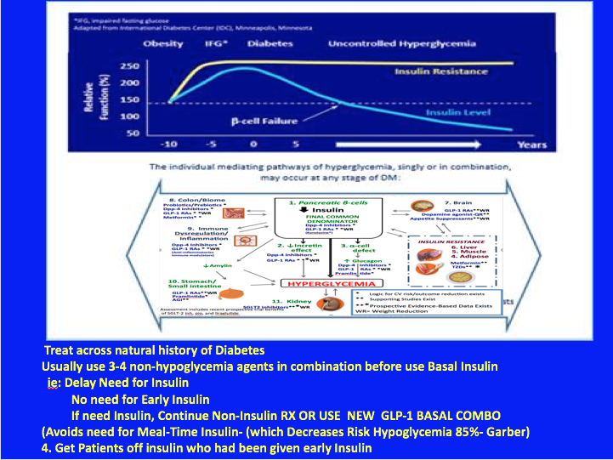
Notes:
. Treat with Least Number of agents that address most Number of Mechanisms of hyperglycemia
2. Treat across natural history of Diabetes
Delay Need for Insulin
No need for Early Insulin
If need Insulin, Continue Non-Insulin RX OR WITH USE NEW GLP-1 BASAL COMBO
(Avoids need for Meal-Time Insulin- (Decrease Risk Hypoglycemia 85%- Garber)
4. Get Patients off insulin who had been given early Insulin

