Slide 1
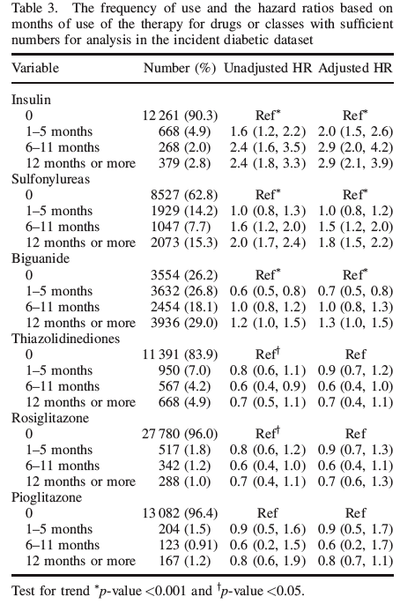
CV Risk of SU and Insulin
So benefit of both SU/Insulin in
research studies –UKPDS, DCCT/EDIC
But adverse risk in ‘real world’ use
Pharmacoepidemiology and Drug Safety. 2008;(17):753-759.

Slide 2
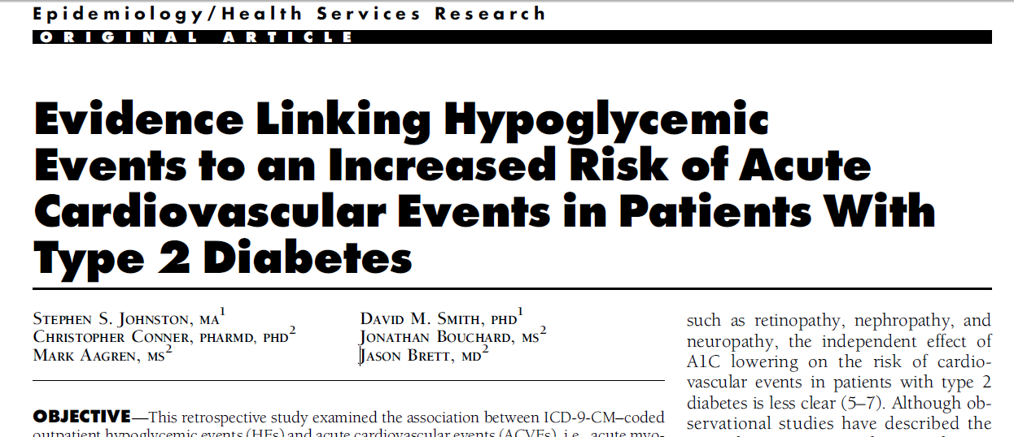

Link between hypoglycemia and acute cardiovascular events in type 2 diabetes
Retrospective, observational study (n=860,845) assessing association between hypoglycemia and acute CV events
Patients who experienced hypoglycemia had 79% higher odds of an acute CV event than patients without hypoglycemia
Johnston et al. Diabetes Care 2011; 34:1164–70
Notes:
The final study cohort comprised 860,845 patients with type 2 diabetes.

Slide 3
No SULFONYLUREAS or Glinides lose ischemic preconditioning; beta-cell apoptosis, could not pass FDA CV safety if new one applied not cheap, if consider test strip cost, accidents ER visits, hospitalizations
Delay Insulin
HYPOGLYCEMIA- cv risk
Increase Weight
Increase Insulin Resistance

Slide 4
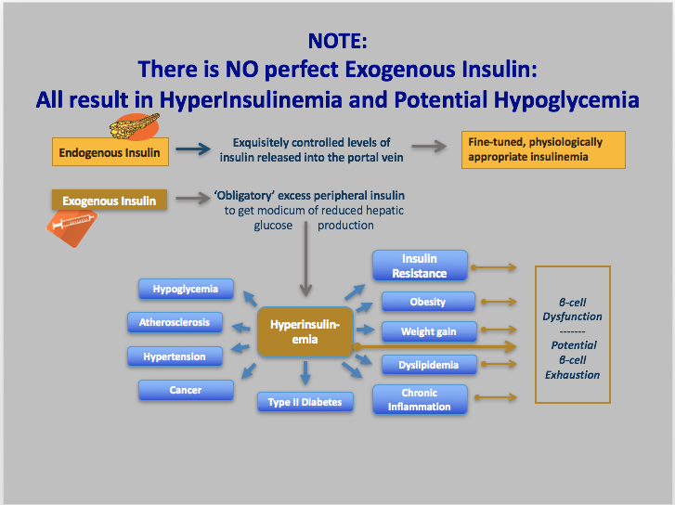
Notes:
All because all insulin results in hyperinsulinemia with risk of negative consequences

Slide 5
Reduced Need for Insulin:Debunking a Myth:
Taking DeFronzo’s EASD 2015 Lecture 1 step further ☺
MYTH: “Most Patients with ‘T2DM’ will eventually progress to insulin because of inexorable β-Cell loss”
- But data obtained on SU=apoptosis
Hyperinsulinism with weight gain> increased IR> adipocytokines and increased TG which
decrease beta-cell function
- Think of bariatric patients –no insulin after 25 years DM/ 20 years
insulin
- Most patients dying with DM have > 20% β-Cell mass- Butler
- Need to remove >80% pancreas in sub-total pancreatectomies to
leave patient with DM post-op
Triple therapy Durable Effect in Improving Beta-Cell Function-
DeFronzo(Diabetes, Obesity, Metab 2015)
THUS: SELECT AGENTS THAT CAN PRESERVE
β-Cell function/mass

Slide 6
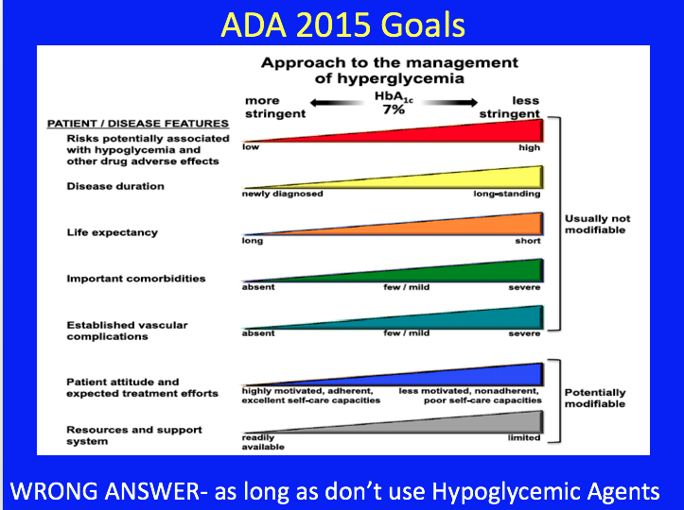

Slide 7
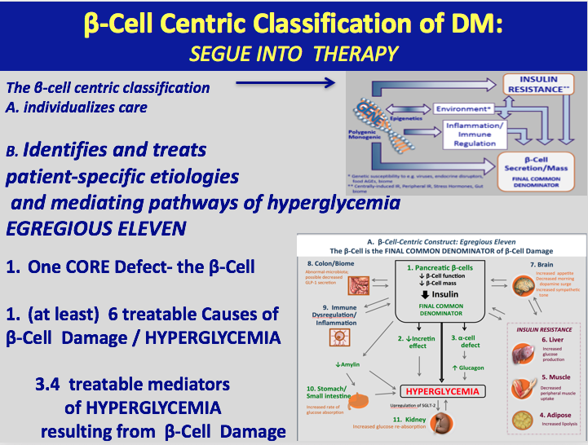

Slide 8
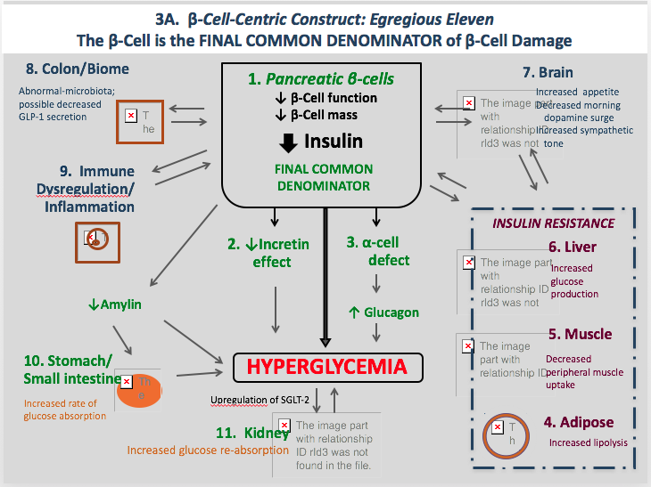

Slide 9
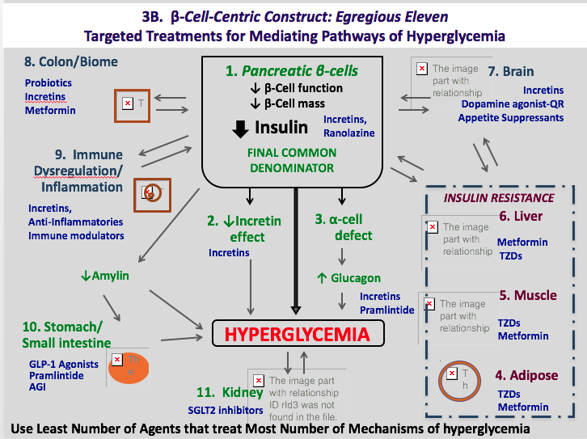

Slide 10
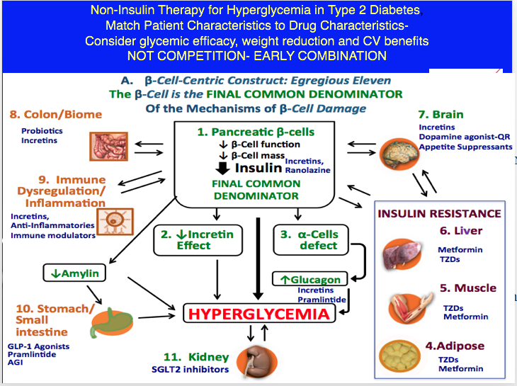
Notes:
10

Slide 11
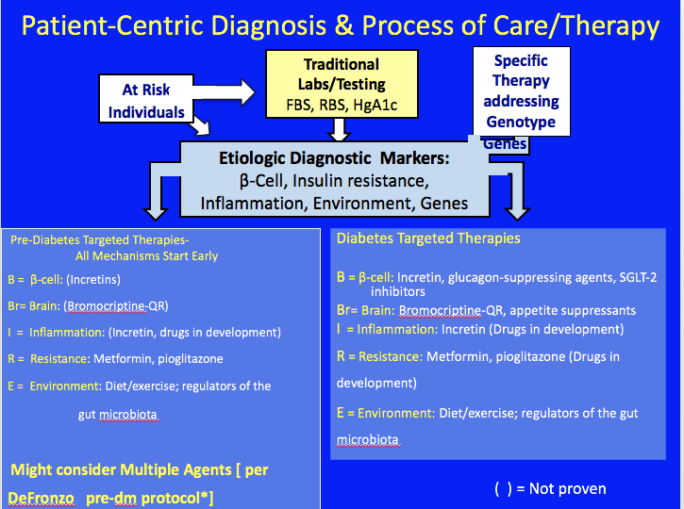

Slide 12
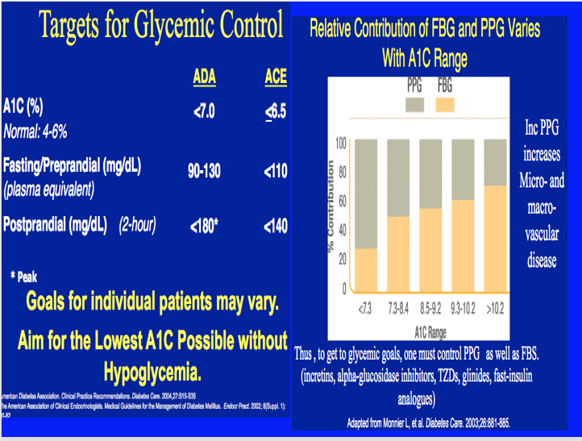

Slide 13
But Guidelines Gluco-Centric
Shouldn’t we take into account avoiding hypo
Shouldn’t we take into account avoiding weight gain
Shouldn’t we take into account CV risk

