Slide 1
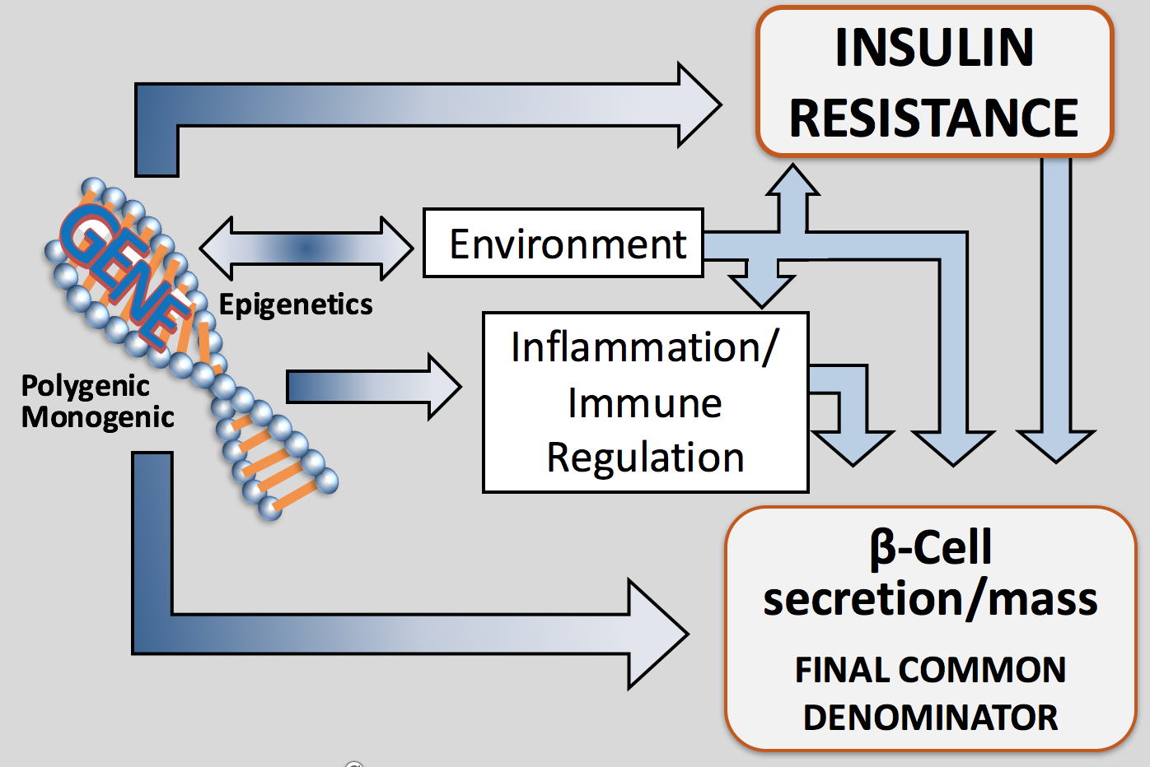
Natural History of ALL DM
Age 0-15 15-40+ 15-50+ 25-70+
Macrovascular Complications
Disability
IR Phenotype
MI
CVA
Amp
IGT ALL DM
DEATH
Blindness
Amputation
CRF
ETOH
BP
Smoking
Eye
Nerve
Kidney
Disability
Microvascular Complications
Risk of Dev. Complications
Notes:
1

Slide 2
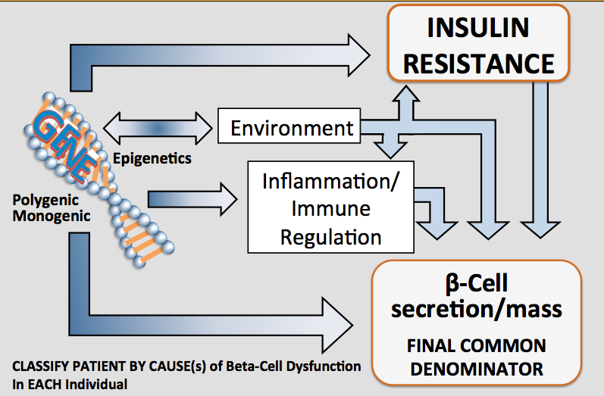
Most Mechanisms of B-Cell Damage (Hyperglycemia) Overlap with Causes of Vascular Disease :
Provides Logic for treatment Regimes
*Environment=Genetic susceptibility to
eg: poor diet,lack of exercise, sleep disorders,, food AGEs, Gut Biome
**Insulin Resistance= Centrally Induced, Peripheral, Stress Hormones, Gut Biome
MacroVascular
Damage
Inflammation
Immune Reg.
Polygenic
monogenic
epigenetic
Environment
Brownlee’s Unified
Theory of
Complications
Insulin Resistance-Part of
Cardiometabolic Syn. with BP, Lipid
MicroVascular
Damage
*Environment=Genetic suceptibility to eg: viruses, endocrine disruptors, food AGEs, Gut Biome; **Insulin Resistance= Centrally Induced, Peripheral, Stress Hormones, Gut Biome

Slide 3
Hyperglycemia Leads to Complications:
May Be Present Prior to Diagnosis
Hyperglycemia
Spike (+variability)
Argument for Early Discovery
Pre-diabetes, Early Treatment,
Determine on Hospital
Admission
Continuous
PPG
A1C
Chronic toxicity
Acute toxicity
Tissue lesion
Diabetic complications
Microvascular
Macrovascular
Retinopathy
Nephropathy
Neuropathy
PVD
MI
Stroke
American Diabetes Association. At: http://www.diabetes.org/diabetes-statistics/complications.jsp.
Brownlee M. Diabetes mellitus: theory and practice. Elsevier Science Publishing Co., Inc; 1990:279-291.
Ceriello A. Diabetes. 2005;54:1-7.
3
Notes:
3
3
Hyperglycemia Leads to Diabetic Complications
T2DM is marked by the development and progression of long-term complications. Hyperglycemia leads to acute toxicity due to postprandial glucose spikes, and chronic toxicity due to continuous elevations in glycosylated hemoglobin A1C (A1C) level, which both lead to microvascular (ie, retinopathy, nephropathy, neuropathy) and macrovascular (ie, peripheral vascular disease [PVD], myocardial infarction [MI], stroke) complications.¹⁻³
References:
American Diabetes Association. Complications of diabetes in the United States. Available at: http://www.diabetes.org/diabetes-statistics/complications.jsp. Accessed March 22, 2006.
Brownlee M. Advanced products of nonenzymatic glycosylation and the pathogenesis of diabetic complications. In: Rifkin H, Porte D, eds. 4th ed. Diabetes mellitus: theory and practice. New York, NY: Elsevier Science Publishing Co., Inc; 1990:279-291.
Ceriello A. Postprandial hyperglycemia and diabetes complications: is it time to treat? Diabetes. 2005;54:1-7.
Category: Hyperglycemia, Diabetes
Keywords: hyperglycemia, diabetes, complications

Slide 4
Cardiovascular disease and diabetes
No A1C threshold
is apparent
Finnish study by Kuusisto et al;
UKPDS epidemiologic analysis;
EPIC-Norfolk Study
~65% of deaths are due to CV disease
Cardiovascular complications of T2DM
Coronary heart disease deaths
2- to 4-fold
Stroke risk
2- to 4-fold
Impaired glucose tolerance (IGT)
and postprandial hyperglycemia
are CV risk factors
Funagata Diabetes Study;
Honolulu Heart Program;
DECODE Study;
Rancho Bernardo Study
Heart failure
2- to 5-fold
T2DM = type 2 diabetes mellitus
Bell DSH. Diabetes Care. 2003;26:2433-41.
Centers for Disease Control (CDC). www.cdc.gov.
Notes:
Cardiovascular (CV) disease is the primary complication of diabetes; approximately 65%
of deaths in people with diabetes are due to heart disease and stroke.
Adults with diabetes have higher rates of coronary heart disease (CHD), stroke, and heart failure (HF) than nondiabetic adults:
CHD death rates are 2 to 4 times higher
Risk of stroke is 2 to 4 times higher
HF occurs twice as frequently in men and 5 times more frequently in women aged
45 to 74 years
In 2004, the estimated prevalence of physician-diagnosed diabetes among adults was
15.2 million; the prevalence of undiagnosed diabetes was 5 million. According to the most recent government statistics, approximately one-third of the US population with diabetes
is undiagnosed.(1)
Cardiovascular disease and diabetes
1. American Heart Association. Heart Disease and Stroke Statistics. 2007 Update.

Slide 5
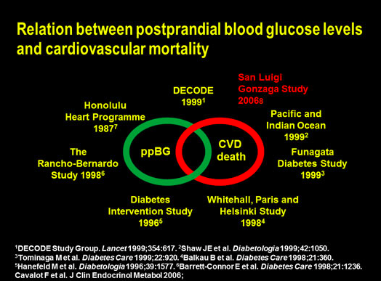
Diabetes is associated
with significant loss of life years
Men Women
7 7
Non-vascular deaths Vascular deaths
6
6
Starts with inc. PPG
Years of life lost
5
5
4
4
3
3
2
2
1
1
0
0
0 40 50 60 70
Age (years)
80 90
0 40 50 60 70
Age (years)
80 90
On average, a 50-year-old individual with diabetes and no history of vascular disease will die 6 years earlier compared to someone without diabetes
.
Seshasai et al. N Engl J Med 2011;364:829-41

Slide 6
Meta-analysis of intensive glucose control in T2DM: major CV events including heart failure
Number of events
More intensive
Less intensive
Difference in HR (95% CI)
HbA1c (%)
-0.88 0.96 (0.83, 1.10)
Stroke
378
370
Myocardial infarction
730
745
-0.88
0.85 (0.76, 0.94)
Hospitalisation for or death from heart failure
459
446
-0.88
1.00 (0.86, 1.16)
0,50 1,00
2,00
Favours more intensive
Favours less intensive
• Meta-analysis of 27,049 participants and 2370 major vascular events from:
–
–
–
–
ADVANCE UKPDS ACCORD VADT
HR, hazard ratio; CV, cardiovascular
Turnbull FM et al. Diabetologia 2009;52:2288–2298

Slide 7
Impact of Intensive Therapy in Type 2 Diabetes Summary of Major Clinical Trials:
BUT Subset Evaluations Show Reduced CV Outcomes if shorter duration of DM, without significant pre-existing complications
Initial Trial
Long Term Follow-up
Study | Microvascular |  | Macrovascular |  | Mortality
UGDP | ↔ |  | ↔ |  | ↔
UKPDS | ↓ | ↓ | ↔ | ↓ | ↔ | ↓
DCCT/EDIC* | ↓ | ↓ | ↔ | ↓ | ↔ | ↔
ACCORD | ↓ |  | ↔ |  | ↑(unadj.), ↔ (adj.)
ADVANCE | ↓ |  | ↔ |  | ↔
VADT | ↔ |  | ↓ |  | ↔
↑- likely due to hypoglycemia and weight gain
Notes:
7

Slide 8
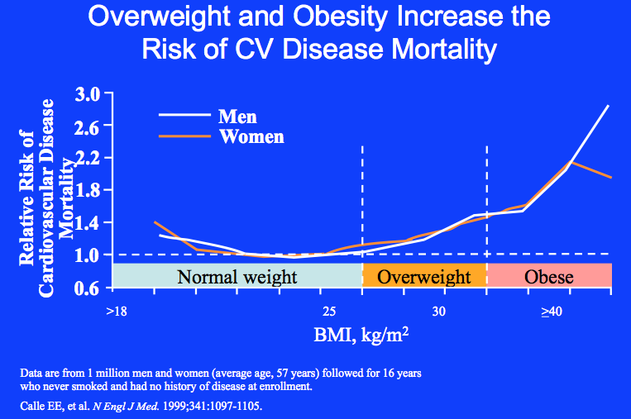
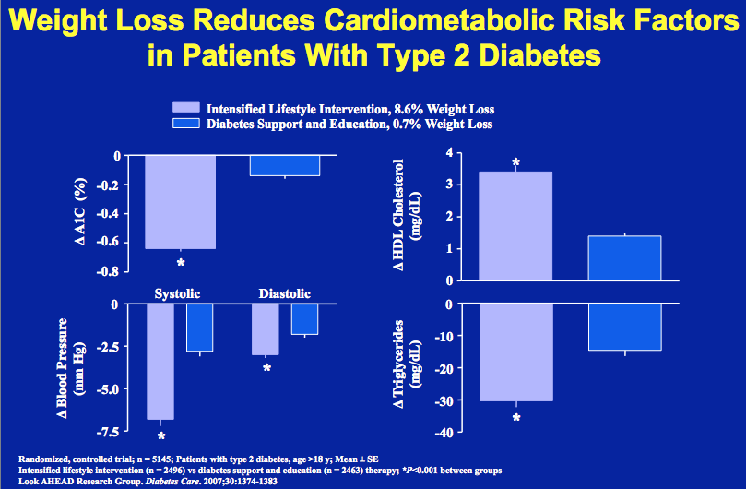

Slide 9
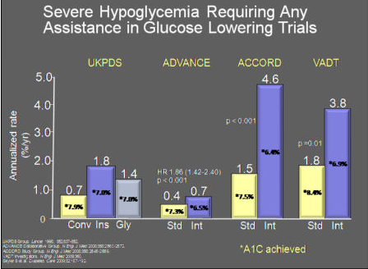

Remember- no measure of glucose at demise;
No assessment of hypoglycemia unawareness

Slide 10
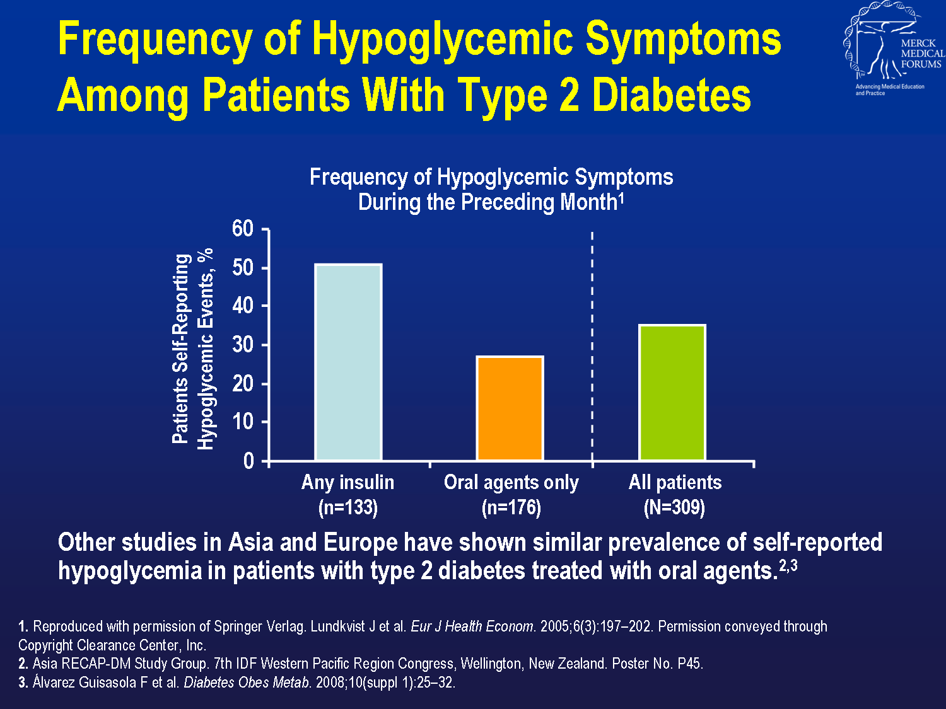
Notes:
Frequency of Hypoglycemic Symptoms Among Patients With Type 2 Diabetes
Lundkvist et al¹ compared the frequency of hypoglycemic symptoms among 309 patients with type 2 diabetes who were receiving oral agents only or insulin.
Symptoms of hypoglycemia were reported by 115 patients during the previous month, representing a 37% incidence of hypoglycemia (24% of patients experienced symptoms once during the month, 11% every week, and 2% every day).¹ The results demonstrated that the frequency of hypoglycemic symptoms in 1 month was lower for patients with type 2 diabetes using only oral agents than in patients taking insulin, as seen on this chart.¹
Other studies in Asia and Europe have shown similar prevalence of self-reported hypoglycemia in patients with type 2 diabetes treated with oral agents.^{2,3}

Slide 11
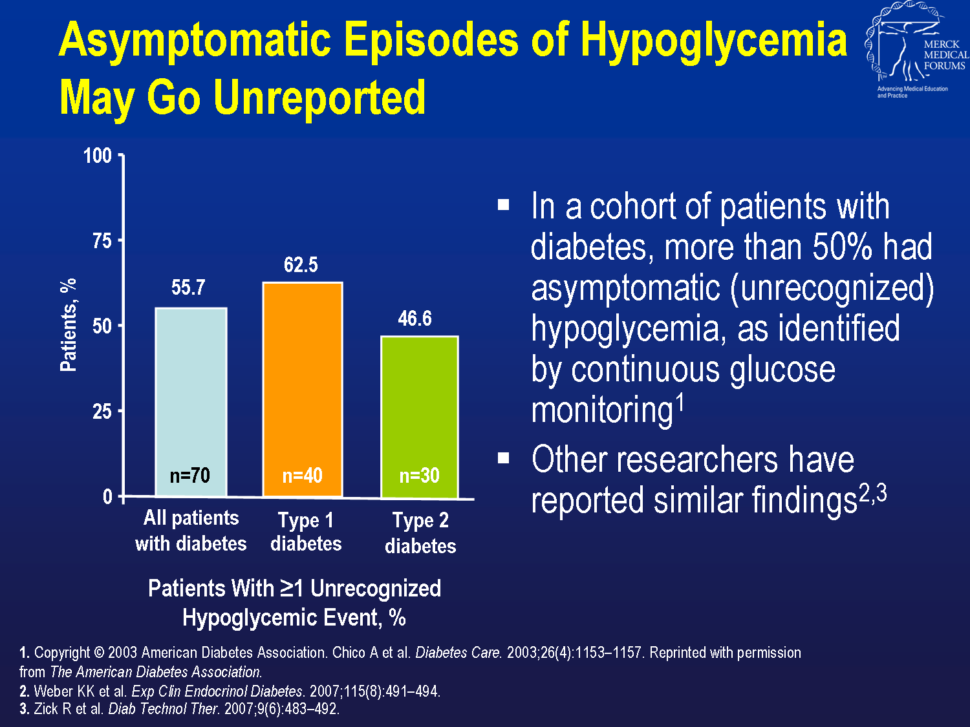
Notes:
Asymptomatic Episodes of Hypoglycemia May Go Unreported
In clinical studies of continuous glucose monitoring (CGM), episodes of hypoglycemia have been found to go unrecognized.^{1–3}
Chico et al¹ used CGM to measure the frequency of unrecognized episodes of hypoglycemia in patients with type 1 (n=40) and type 2 (n=30) diabetes. CGM detected unrecognized hypoglycemic events in 55.7% of all patients. In the subset of patients with type 2 diabetes, CGM detected hypoglycemic events in 46.6% of patients.¹
Other researchers have reported similar findings.^{2,3}

Slide 12
Consequences of Hypoglycemia
Prolonged QT- intervals- (Diabetologia 52:42,2009)
  Can be of pronged duration (IJCP Sup 129, 7/02)
  Greater with higher catecholamine levels (Europace 10:860)
Associated with Angina (Diabetes Care 26, 1485, 2003)
Ischemic EKG changes (Porcellati, ADA2010)
Associated with Arrhythmias
Associated with Sudden Death (Endocrine Practice 16,¾ 2010)
Increased Variability- increases inflammation, ICU mortality (Hirsch ADA2010)

Slide 13
But Guidelines Gluco-Centric
Shouldn’t we take into account avoiding hypo
Shouldn’t we take into account avoiding weight gain
Shouldn’t we take into account CV risk

