Slide 1
Beta-Cell Classification of Diabetes and the Egregious Eleven:
Logic for Newer Algorithms/
Processes of Care
The Role of Newer Anti-Diabetes Medications in Reducing CV Risk and Outcomes in Patients with Diabetes:
Diabetes Medications May be a Cardiologist’s Best Friend
Stan Schwartz MD,FACP
Affiliate, Main Line Health System
Emeritus, Clinical Associate Professor of Medicine,
U of Pa.
6105472000
Notes:
1

Slide 2
Current T2DM Guidelines
But limits therapeutic options in Type 1
Based on ‘old classification’ of DM

Slide 3
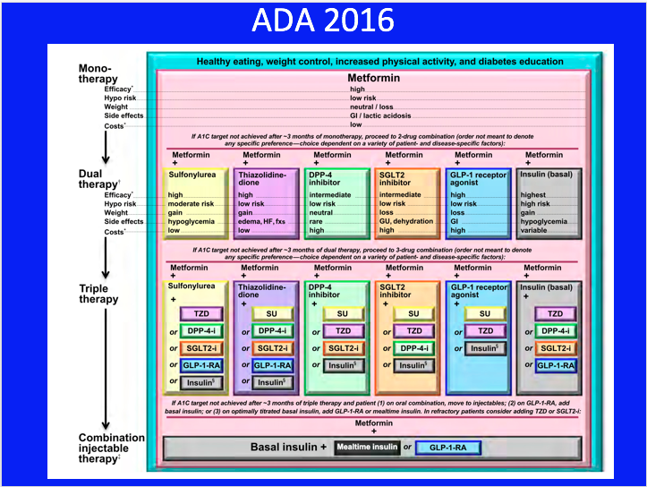

Slide 4
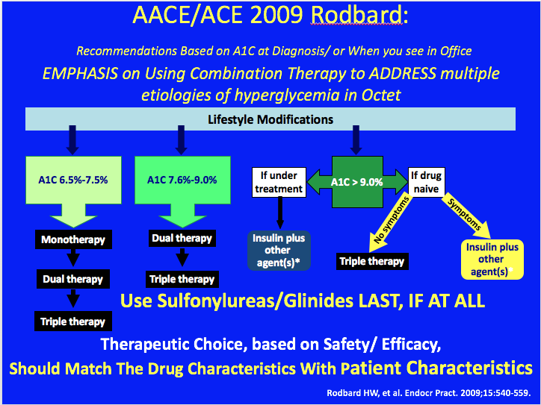
Notes:
4

Slide 5
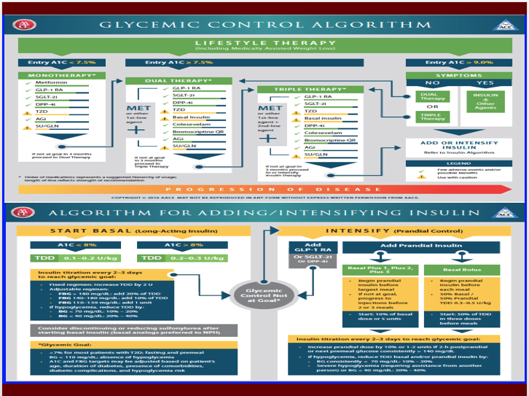

Slide 6
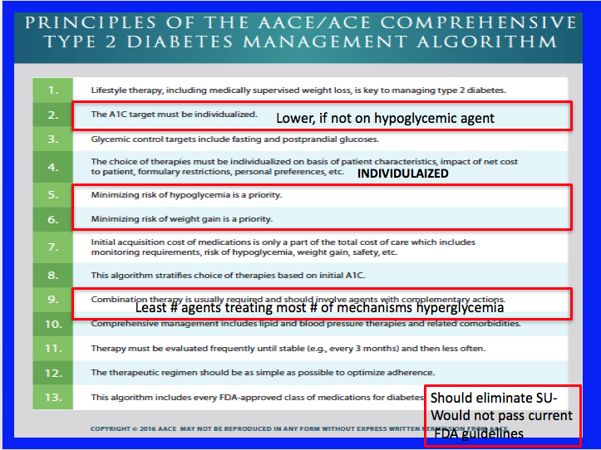

Slide 7
Current DM Classification Failing
(Certainly appropriate with knowledge available when current classification adopted)
BUT WE’VE LEARNED SO MUCH MORE
Immune destruction of β-cells / and Insulin Resistance
is used as basis of distinction between T1D, and T2D
and all other sub-types of DM
Diagnosis is often imprecise
  Flatbush DM- present in DKA- ‘turn out to be T2DM’
  LADA- Adults who look like ‘typical T1DM’
  Antibody positive who look like ‘T2DM’
  T1DM with Insulin Resistance (like T2DM)
Ie: Complicated by extensive overlap
yet distinct differences in etiology and phenotype
Notes:
The four types of diabetes include:
The typical child with type 1 diabetes;
Early onset of type 2 diabetes, particularly in non-Caucasian groups;
An atypical form of diabetes sometimes with fluctuating insulin dependency, seen in African Americans; and
The very rare “maturity onset diabetes of youth” (MODY), which has been found to be related to identifiable genetic mutations, transmitted in an autosomal dominant pattern, and virtually always in Caucasians.

Slide 8
β-Cell Centric Classification of Diabetes:
Implications for Classification, Diagnosis, Prevention, Therapy, Research
INSULIN RESISTANCE
G
E
Environment
N
E
Epigenetics
Inflammation/
Immune Regulation
Polygenic
Monogenic
β-Cell
secretion/mass
FINAL COMMON
DENOMINATOR
CLASSIFY PATIENT BY CAUSE(s) of Beta-Cell Dysfunction
In EACH Individual

Slide 9
β-Cell Centric Classification of Diabetes:
Implications for Classification, Diagnosis, Prevention, Therapy, Research
INSULIN** RESISTANCE
G
E
Environment*
N
E
Epigenetics
Inflammation/
Immune Regulation
Polygenic
Monogenic
β-Cell
secretion/mass
FINAL COMMON
DENOMINATOR
*Environment=Genetic suceptibility to
eg: viruses, endocrine disruptors, food AGEs, Gut Biome
**Insulin Resistance= Centrally Induced, Peripheral, Stress Hormones, Gut Biome

Slide 10
Phenotypic Presentation is defined by:
Slope = ‘Natural History’ over time,i.e.,RATE OF β-cell LOSS. Slope is not linear in either T1DM or T2DM, and may be intermittently relapsing, remitting, stabilized, and improved. Complete loss of β-cell mass may never be reached, especially if newer agents better preserve β-cells.
100%
−
−
−
−
−
−
−
−
−
0% −
Severity =
β-cell loss of mass
Pre-Diabetes = FBS ≥100, PPG ≥140
All DM = FBS ≥126, PPG ≥200
Critical
β−Cell
Mass
%
β−Cell
Mass
Disease Modification
I I I I I/ ≈ / I I I I I I I I I I I I I I I I I I I I I I I I I I I I I I I I I I I I I I I I I I I I I I I I I I I I I I I I I I I I
Increasing Age
Age at presentation = tipping point when the combined gene effect / environmental trigger is exposed as phenotypic hyperglycemia

Slide 11
Pathophysiology of Cardio-Vascular Disease Involves the Same Etiologies/ Pathophysiologic mechanisms of Diabetes/Hyperglycemia :
Implications for Classification, Diagnosis, Prevention, Therapy, Research
INSULIN RESISTANCE
G
E
Environment
N
E
Epigenetics
Inflammation/
Immune Regulation
Polygenic
Monogenic
Vasculature
FINAL COMMON
DENOMINATOR
CLASSIFY PATIENT BY CAUSE(s)/Mechanisms
of VASCULAR Dysfunction In EACH Individual

Slide 12
Pathophysiology of Cardio-Vascular Disease Involves the Same Etiologies/ Pathophysiologic mechanisms of Diabetes/Hyperglycemia :
Implications for Classification, Diagnosis, Prevention, Therapy, Research
INSULIN RESISTANCE
G
E
Environment
N
E
Epigenetics
Inflammation/
Immune Regulation
Polygenic
Monogenic
Vasculature Damage
*Environment=Genetic suceptibility to
eg: poor diet,lack of exercise, sleep disorders,, food AGEs, Gut Biome
**Insulin Resistance= Centrally Induced, Peripheral, Stress Hormones, Gut Biome

