Slide 1
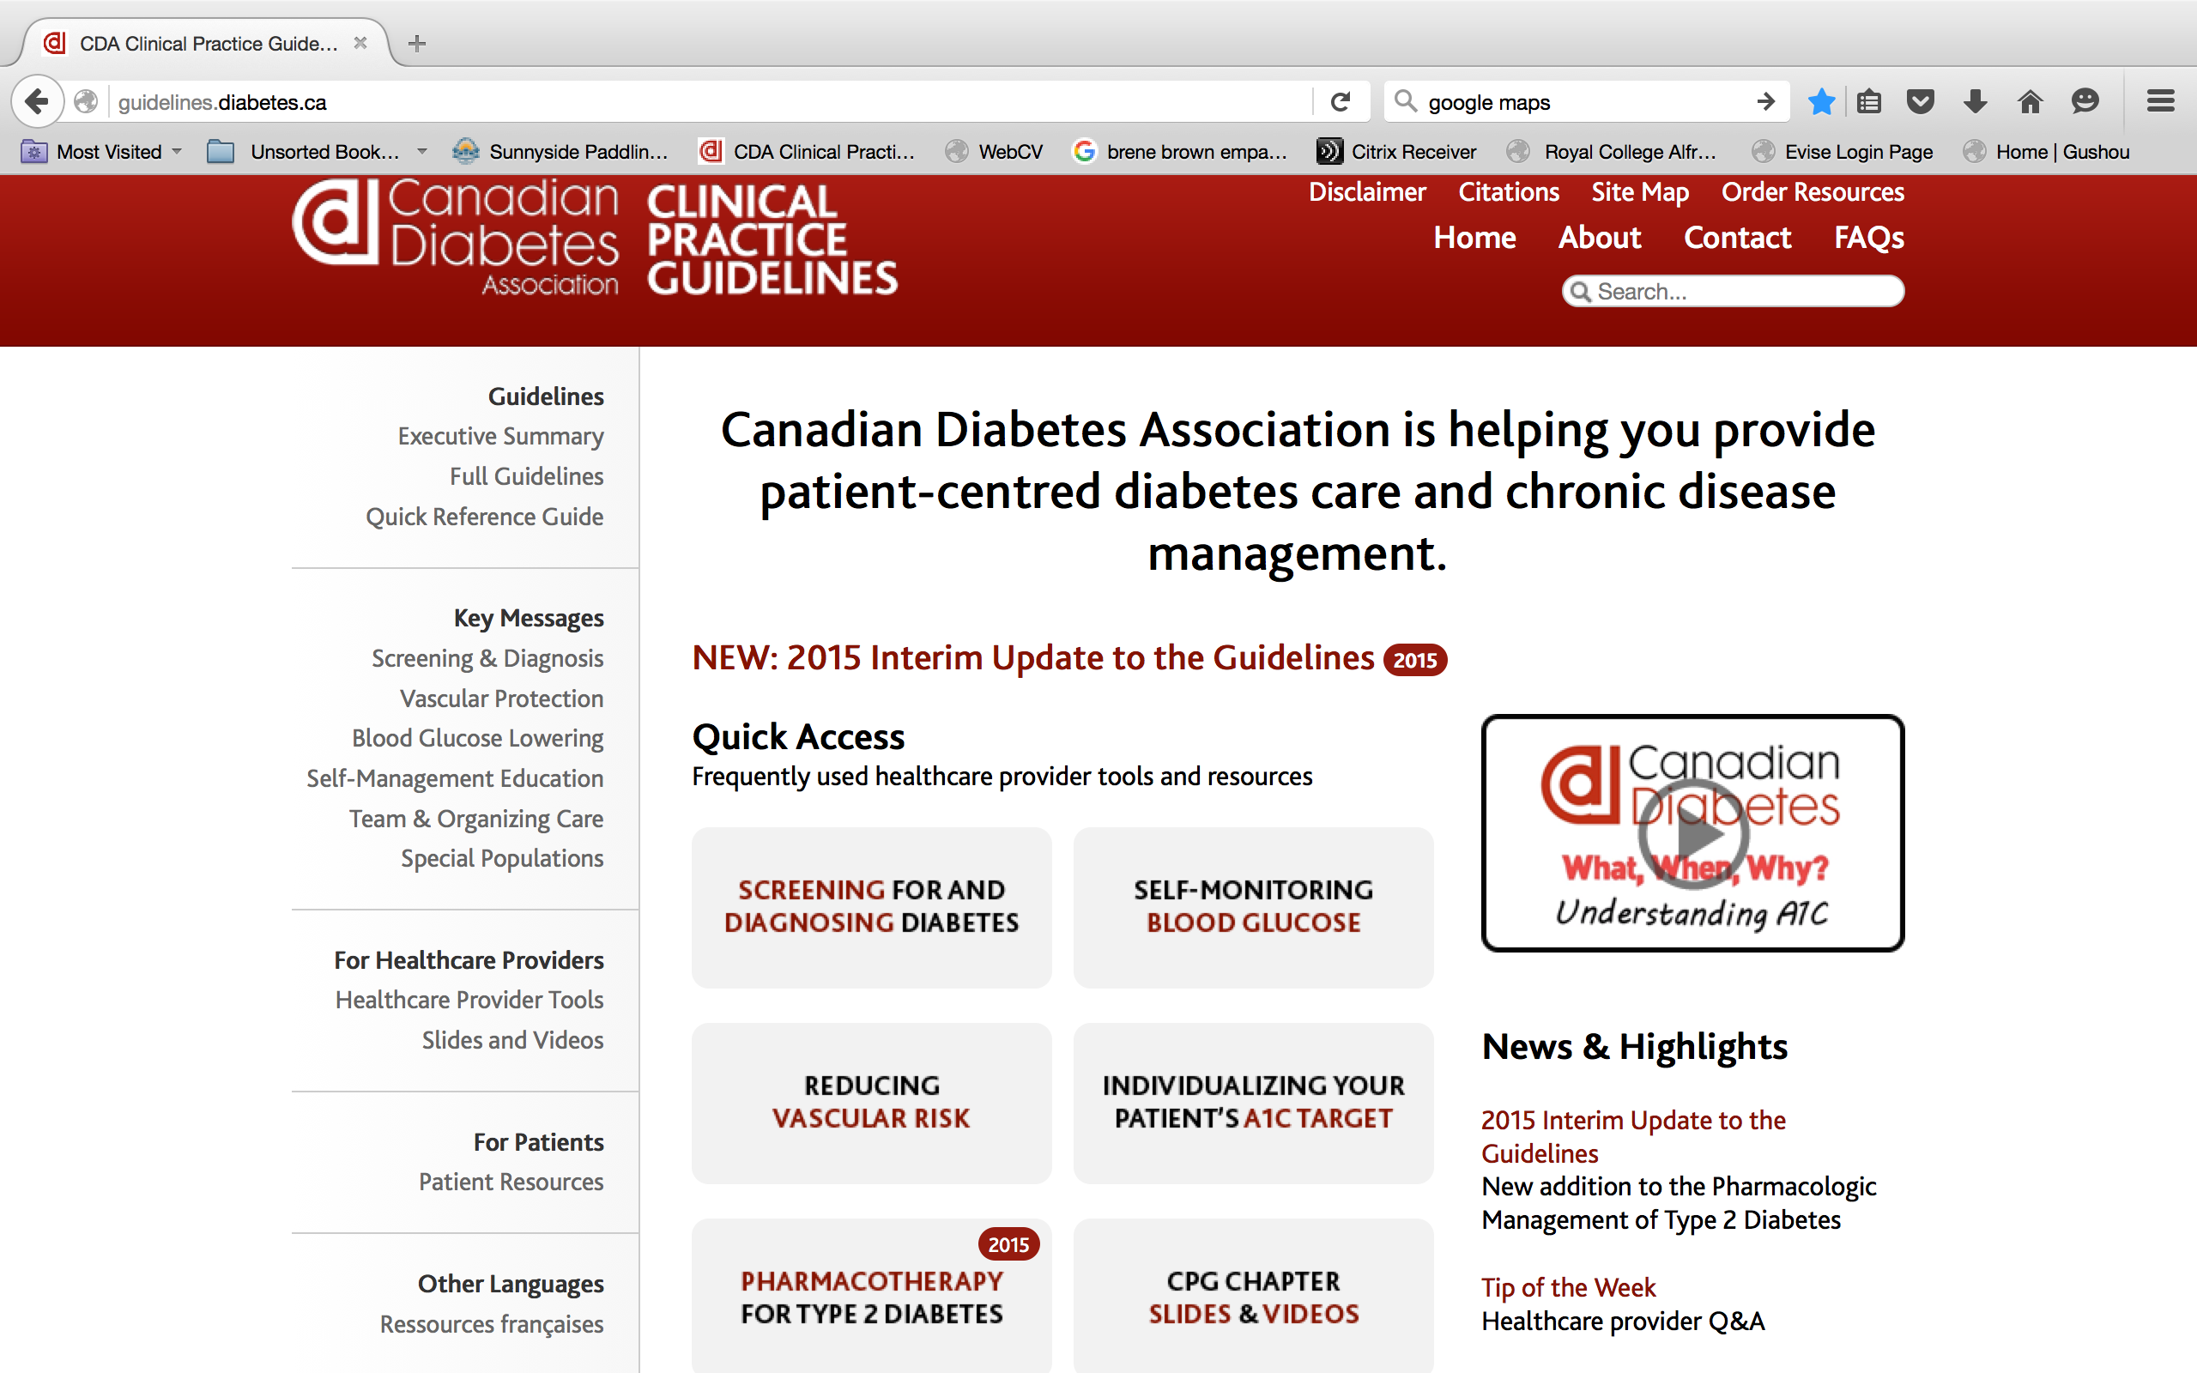

Slide 2
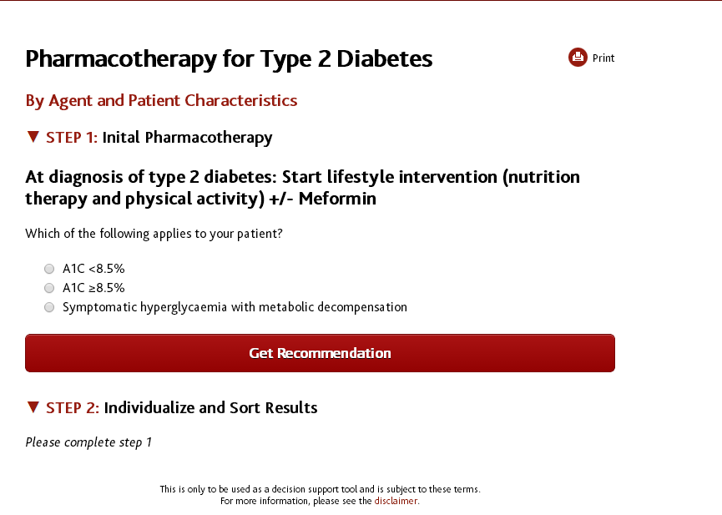

Slide 3
Recommendation 1
In people with a new diagnosis of type 2 diabetes:
  Metformin may be used at time of diagnosis, in conjunction with lifestyle management [Grade D, consensus]
  If A1C ≤8.5% and glycemic targets are not achieved using lifestyle management within 2-3 months, antihyperglycemic agent therapy with metformin should be initiated [Grade A, level 1].

Slide 4
Recommendation 1 (continued)
  If A1C ≥8.5%, antihyperglycemic agents should be initiated concomitantly with lifestyle management, and consideration should be given to initiating combination therapy with two agents, one of which may be insulin (Grade D, consensus)
Individuals with symptomatic hyperglycemia and metabolic decompensation should receive an initial antihyperglycemic regimen containing insulin with or without metformin [Grade D, Consensus]

Slide 5
Recommendation 2
Metformin should be the initial drug used in monotherapy [(Grade A, Level 1) for overweight patients; (Grade D, consensus) for non-overweight patients]

Slide 6
Recommendation 3
Other classes of antihyperglycemic agents, including insulin, should be added to metformin, or used in combination with each other, if glycemic targets are not met, taking into account the information in Figure 1 and Table 1 [Grade D, consensus] and these adjustments to and/or additions of antihyperglycemic agents should be made in order to attain target A1C within 3-6 months [Grade D, consensus]

