Slide 1
Types of Insulin
2016
Insulin Type (trade name) | Onset | Peak | Duration
Bolus (prandial) Insulins
Rapid-acting insulin analogues (clear): Insulin aspart (NovoRapid®) Insulin glulisine (Apidra™) Insulin lispro (Humalog®) Insulin lispro U200 (Humalog® 200 units/mL) | 10 - 15 min 10 - 15 min 10 - 15 min 10 - 15 min | 1 - 1.5 h 1 - 1.5 h 1 - 2 h 1 - 2 h | 3 - 5 h 3 - 5 h 3.5 - 4.75 h 3.5 - 4.75 h
Short-acting insulins (clear): Insulin regular (Humulin®-R) Insulin regular (Novolin®geToronto) | 30 min | 2 - 3 h | 6.5 h
Basal Insulins
Intermediate-acting insulins (cloudy): Insulin NPH (Humulin®-N) Insulin NPH (Novolin®ge NPH) | 1 - 3 h | 5 - 8 h | Up to 18 h
Long-acting basal insulin analogues (clear) Insulin detemir (Levemir®) Insulin glargine (Lantus®) Insulin glargine U300 (Toujeo®) Insulin glargine (BasaglarTM) | 90 min 90 min Up to 6 h 90 min | Not applicable | Up to 24 h (detemir 16-24 h) Up to 24 h (glargine 24 h) Up to 30 h Up to 24 h (glargine 24 h)

Slide 2
Types of Insulin (continued)
Insulin Type (trade name) | Time action profile
Premixed Insulins
Premixed regular insulin – NPH (cloudy): 30% insulin regular/ 70% insulin NPH (Humulin® 30/70) 30% insulin regular/ 70% insulin NPH (Novolin®ge 30/70) 40% insulin regular/ 60% insulin NPH (Novolin®ge 40/60) 50% insulin regular/ 50% insulin NPH (Novolin®ge 50/50) | A single vial or cartridge contains a fixed ratio of insulin (% of rapid-acting or short-acting insulin to % of intermediate-acting insulin)
Premixed insulin analogues (cloudy): 30% Insulin aspart/70% insulin aspart protamine crystals (NovoMix® 30) 25% insulin lispro / 75% insulin lispro protamine (Humalog® Mix25®) 50% insulin lispro / 50% insulin lispro protamine (Humalog® Mix50®)

Slide 3
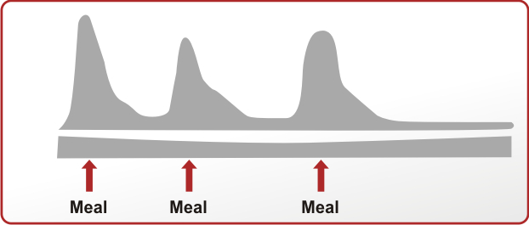
Serum Insulin Level
Time
Human Basal
Human Bolus
Analogue Basal
Analogue Bolus
guidelines.diabetes.ca | 1-800-BANTING (226-8464) | diabetes.ca
Copyright © 2013 Canadian Diabetes Association

Slide 4
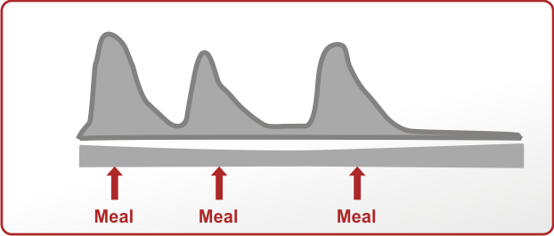
Serum Insulin Level
Time
Human Premixed
Analogue Premixed
guidelines.diabetes.ca | 1-800-BANTING (226-8464) | diabetes.ca
Copyright © 2013 Canadian Diabetes Association

Slide 5
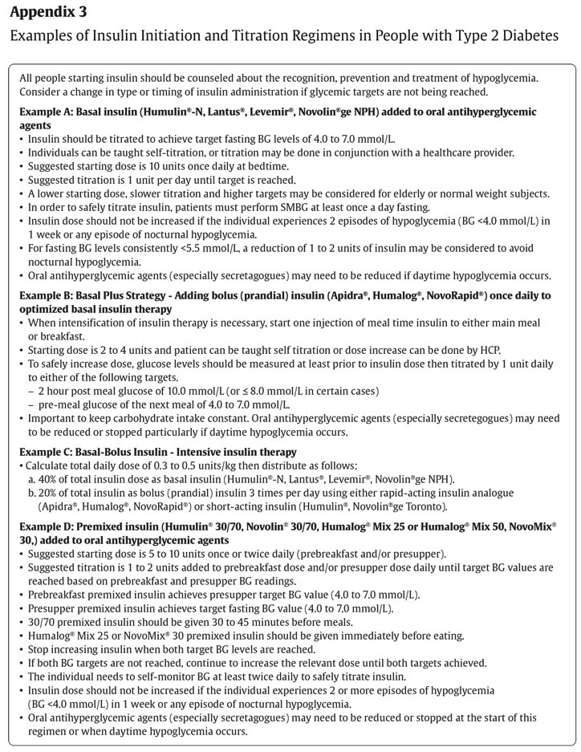
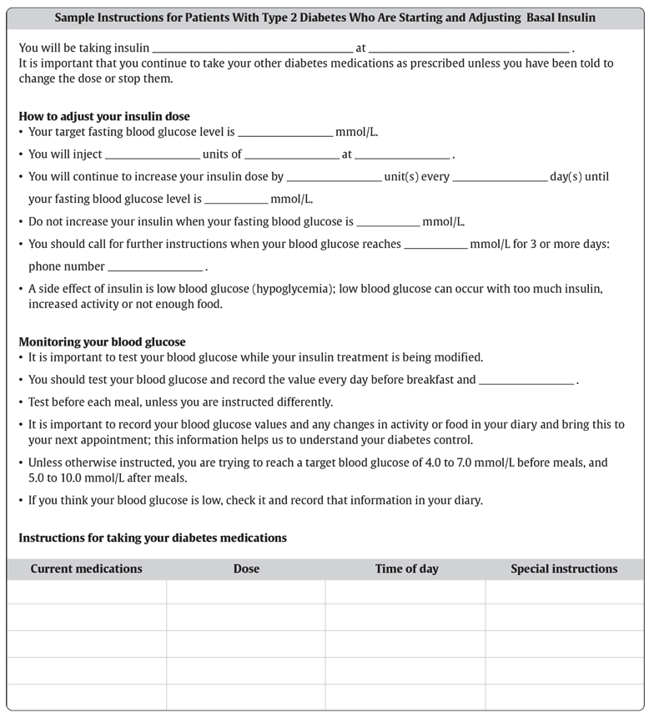
guidelines.diabetes.ca | 1-800-BANTING (226-8464) | diabetes.ca
Copyright © 2013 Canadian Diabetes Association

Slide 6
