Slide 1
Choice of agent after initial metformin needs to be
INDIVIDUALIZED

Slide 2
2016
Add another agent best suited to the individual by prioritizing patient characteristics:
PATIENT CHARACTERISTIC
CHOICE OF AGENT
PRIORITY:
Clinical Cardiovascular Disease
SGLT2 inhibitor with demonstrated CV outcome benefit
Degree of hyperglycemia
Risk of hypoglycemia
Overweight or obesity
CV disease or multiple risk factors
Comorbidities (renal, CHF, hepatic)
Preferences & access to treatment
Consider relative A1C lowering
Rare hypoglycemia
Weight loss or weight neutral
Effect on cardiovascular outcome
See therapeutic considerations
See cost column; consider access

Slide 3
Add another class of agent best suited to the individual (agents listed in alphabetical order):
Class | Relative A1C Lowering | Hypo- glycemia | Weight | Effect in Cardiovascular Outcome Trial | Other therapeutic considerations | Cost
α-glucosidase inhibitor (acarbose) | ↓ | Rare | neutral to ↓ |  | Improved postprandial control, GI side-effects | $$
Incretin agents: DPP-4 Inhibitors GLP-1R agonists | ↓↓ ↓↓ to ↓↓↓ | Rare Rare | Neutral to ↓ ↓↓ | Neutral (alo, saxa, sita) Neutral (lixi) | Caution with saxagliptin in heart failure GI side-effects | $$$ $$$$
Insulin | ↓↓↓ | Yes | ↑↑ | Neutral (glar) | No dose ceiling, flexible regimens | $-$$$$
Insulin secretagogue: Meglitinide Sulfonylurea | ↓↓ ↓↓ | Yes Yes | ↑ ↑ |  | Less hypoglycemia in context of missed meals but usually requires TID to QID dosing Gliclazide and glimepiride associated with less hypoglycemia than glyburide | $$ $
SGLT2 inhibitors | ↓↓ to ↓↓↓ | Rare | ↓↓ | Superiority (empa in T2DM patients with clinical CVD) | Genital infections, UTI, hypotension, dose-related changes in LDL-C, caution with renal dysfunction and loop diuretics, dapagliflozin not to be used if bladder cancer, rare diabetic ketoacidosis (may occur with no hyperglycemia) | $$$
Thiazolidinediones | ↓↓ | Rare | ↑↑ | Neutral | CHF, edema, fractures, rare bladder cancer (pioglitazone), cardiovascular controversy (rosiglitazone), 6-12 weeks required for maximal effect | $$
Weight loss agent (orlistat) | ↓ | None | ↓ |  | GI side effects | $$$
2016
alo=alogliptin; glar=glargine; saxa=saxagliptin; sita=sitagliptin; lixi=lixisenatide; empa=empagliflozin

Slide 4
AT DIAGNOSIS OF TYPE 2 DIABETES
L
I
F
E
S
T
Y
L
E
Start lifestyle intervention (nutrition therapy and physical activity) +/- Metformin
A1C <8.5%
A1C ≥8.5%
Symptomatic hyperglycemia with metabolic decompensation
If not at glycemic target (2-3 mos)
Start metformin immediately
Consider initial combination with another antihyperglycemic agent
Initiate insulin +/-
metformin
Start / Increase metformin
If not at glycemic targets
Add another agent best suited to the individual by prioritizing patient characteristics:
PATIENT CHARACTERISTIC
CHOICE OF AGENT
PRIORITY: SGLT2 inhibitor with demonstrated CV
Clinical Cardiovascular Disease outcome benefit
Degree of hyperglycemia
Risk of hypoglycemia
Overweight or obesity
Cardiovascular disease or multiple risk factors
Comorbidities (renal, CHF, hepatic)
Preferences & access to treatment
Consider relative A1C lowering
Rare hypoglycemia
Weight loss or weight neutral
Effect on cardiovascular outcome
See therapeutic considerations, consider eGFR
See cost column; consider access
2016
See next page…
Notes:
May start Metformin at the time of diagnosis
Change to 8.5% as threshold
Start metformin immediately as an option
Concept of individualizing therapy based on patient and agent characteristics
With that in mind, the next figure shows the characteristics of the agents ….

Slide 5
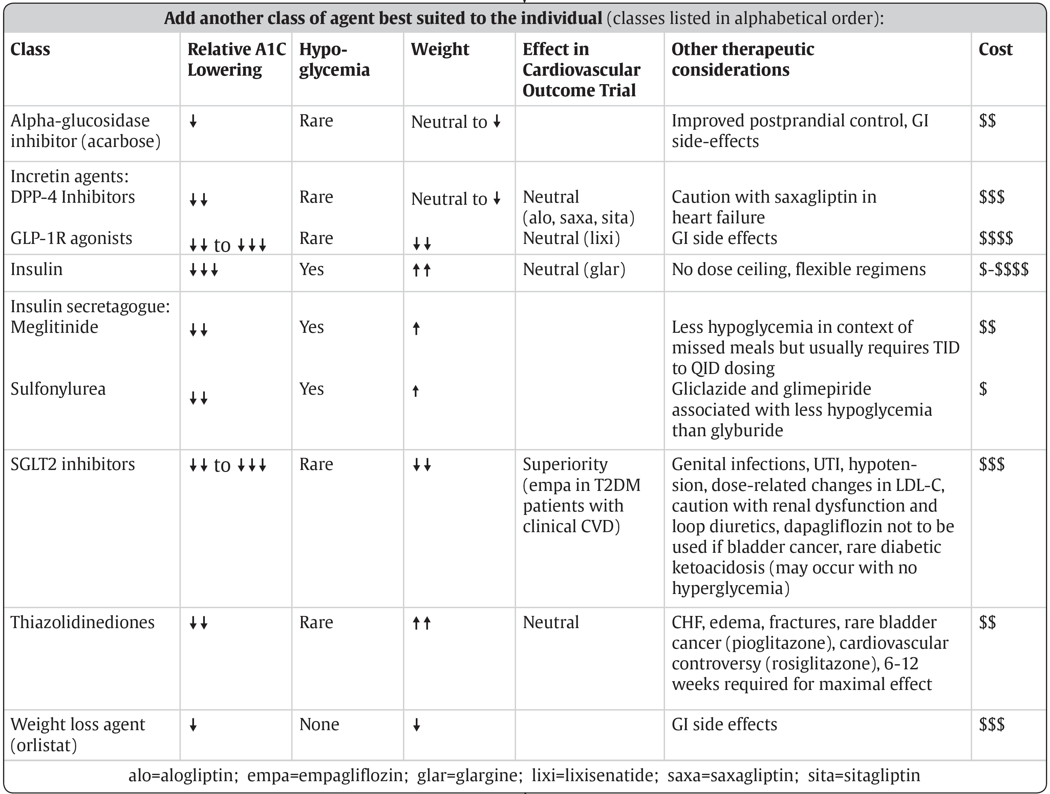
From prior page…
L
I
F
E
S
T
Y
L
E
If not at glycemic target
Add another agent from a different class
Add/Intensify insulin regimen
2016
Make timely adjustments to attain target A1C within 3-6 months
Notes:
Concept of RELATIVE A1c lowering – not absolute
Concept of RELATIVE cost considerations
Change to achieve target within 3-6 months.
Updated June 2015

Slide 6
Add another class of agent best suited to the individual (agents listed in alphabetical order):
Class | Relative A1C Lowering | Hypo- glycemia | Weight | Effect in Cardiovascular Outcome Trial | Other therapeutic considerations | Cost
α-glucosidase inhibitor (acarbose) | ↓ | Rare | neutral to ↓ |  | Improved postprandial control, GI side-effects | $$
Incretin agents: DPP-4 Inhibitors GLP-1R agonists | ↓↓ ↓↓ to ↓↓↓ | Rare Rare | Neutral to ↓ ↓↓ | Neutral (alo, saxa, sita) Neutral (lixi) | Caution with saxagliptin in heart failure GI side-effects | $$$ $$$$
Insulin | ↓↓↓ | Yes | ↑↑ | Neutral (glar) | No dose ceiling, flexible regimens | $-$$$$
Insulin secretagogue: Meglitinide Sulfonylurea | ↓↓ ↓↓ | Yes Yes | ↑ ↑ |  | Less hypoglycemia in context of missed meals but usually requires TID to QID dosing Gliclazide and glimepiride associated with less hypoglycemia than glyburide | $$ $
SGLT2 inhibitors | ↓↓ to ↓↓↓ | Rare | ↓↓ | Superiority (empa in T2DM patients with clinical CVD) | Genital infections, UTI, hypotension, dose-related changes in LDL-C, caution with renal dysfunction and loop diuretics, dapagliflozin not to be used if bladder cancer, rare diabetic ketoacidosis (may occur with no hyperglycemia) | $$$
Thiazolidinediones | ↓↓ | Rare | ↑↑ | Neutral | CHF, edema, fractures, rare bladder cancer (pioglitazone), cardiovascular controversy (rosiglitazone), 6-12 weeks required for maximal effect | $$
Weight loss agent (orlistat) | ↓ | None | ↓ |  | GI side effects | $$$
2016
alo=alogliptin; glar=glargine; saxa=saxagliptin; sita=sitagliptin; lixi=lixisenatide; empa=empagliflozin

