Slide 1
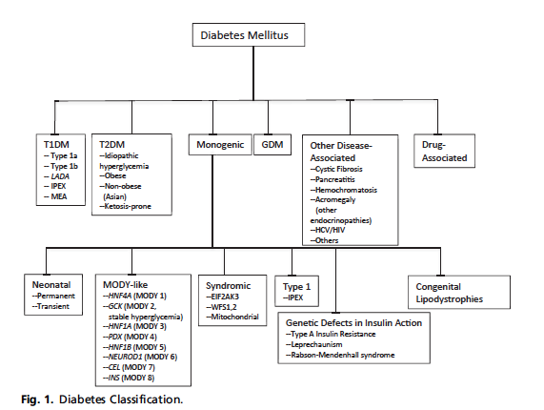
Current Classification of DM
Update on Diabetes Classification Celeste C. Thomas, MD, MSa,*, Louis H. Philipson, MD, PhD,Med Clin N Am 99 (2015) 1–16

Slide 2
Can Keep Current Terminology
Incorporate the β-Cell Centric Approach with each to determine issues in individual patient or a New Terminology?
Younger
Older
‘LADA’
 | T2D | MODY, monogenic | T1D | SPIDDM | Autoimmune T2D | T2D
Genes
- mono |  | +,which
- poly | +,which |  | +,which | +,which | +,which | +,which
Inflammation | +/- | ─ | + | + | + | +/-
Resistance | +/- |  | +/- | ─ | +/- | +/-
Environment | +,which |  | +,which | +,which | +,which | +,which
Easier to get buy-in from many different stakeholers, MDs, etc

Slide 3
Or New Terminology Should Reflect the β-Cell Centric Approach; Easier to get insurers to pay for best therapy
Disease = DIABETES; Phenotype= Hyperglycemia
Younger
Older
‘LADA’
 | T2D | MODY, monogenic | T1D | SPIDDM | Autoimmune T2D | T2D
Genes
- mono |  | +,which
- poly | +,which |  | +,which | +,which | +,which | +,which
Inflammation | +/- |  | + | + | + | +/-
Resistance | +/- |  | +/- | ─ | +/- | +/-
Environment | +,which |  | +,which | +,which | +,which | +,which
Implications for Therapy: Use whatever logically sensible/necessary based on cause of hyperglycemia in each patient

Slide 4
A Classification of DM
Diabetes-
B-Cell Insufficiency
Polygenic
(GDM)
Define Gene,
+/- Resistance,
Environment,
Inflammation
MODIFIED FROM-Update on Diabetes Classification Celeste C. Thomas, MD, MSa,*, Louis H. Philipson, MD, PhD,Med Clin N Am 99 (2015) 1–16

Slide 5
New β-Cell Centric Construct: Implications
Diagnosis Markers
By Virtue of Family History ‘DM”, Physiogomy, hyperglycemia, in prediabetic and diabetic range *
Genes
  • Family History
  • Genotype- HLA, TCF7L2, etc
β-Cell
  • FBS, 2hr ppg, HgA1c, ? C-peptide, ?other- β-Cell mass measures
Inflammation
• Antibodies, Inflammatory Markers, T-Cell function, ?other
Insulin Resistance
• BMI, Adiponectin, Adipocytokines, ? Other
* Individualized and reliant on cost, insurance coverage, formulary, government

Slide 6
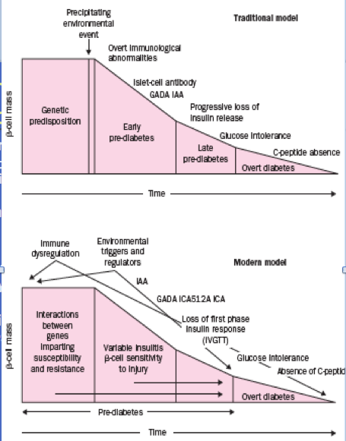
Going Forward: New Focus of Care:
Primary Prevention: ? For All DM in New Classification
Genetic / antibody screening 1 effort to identify eligible subjects
Potential Immune Modulators 2
Environmental Modulation 3
  Especially as we learn more- vaccination, endocrine disruptors, diet, exercise
Intervention needs to be extremely safe
Defining risk factors will facilitate primary prevention studies
3
1
APPLY MODEL TO ALL DM
Atkinson, Eisenbarth,THE LANCET • Vol 358 • July 21, 2001 225

Slide 7
An ‘Evidence-Based Practice, Patient Centeric’ Approach
Evidence-Based AND Patient Centric:
EVIDENCE-BASED PRACTICE
Mechanism of Disease +
Mechanism of Drug +
Patient Factors =
Right Drug
Clinical Expertise, Expert Opinions
Patient-Based experience
Evidence-Based Medicine
Randomized, prospective trials –( if exists and if patient fits )
As a Clinician
Think Inside a
Larger Box ☺
Duggal, Evidence-Based Medicine in Practice,, Int’l j. Clinical Practice,65:639-644,2011,Allan D. Sniderman, MD; Kevin J. LaChapelle, MD; Nikodem A. Rachon, MA;
and Curt D. Furberg, MD, PhDMayo Clin Proc The Necessity for Clinical Reasoning in the Era of Evidence-Based Medicine October 2013;88(10):1108-1114
Trisha Greenhalgh et al, Evidence based medicine: a movement in crisis? BMJ 2014; 348

Slide 8
Choice of Therapy
Based on
  Causes of β-Cell dysfunction
  Abnormalities resulting from β-Cell dysfunction
No Logic for Agents that Decrease
  β-Cell dysfunction
MYTH: “Most Patients with ‘T2DM’ will eventually progress to insulin
because of inexorable β-Cell loss”
- But data obtained on SU=apoptosis
Hyperinsulinism with weight gain
- Think of bariatric patients –no insulin after 25 years DM/ 20 years
insulin
- Most patients dying with DM have > 20% β-Cell mass- Butler
- Need to remove >80% pancreas in sub-total pancreatectomies to
leave patient with DM post-op
Triple therapy Durable Effect in Improving Beta-Cell Function-
DeFronzo(Diabetes, Obesity, Metab 2015); Wysham (Diabetes Care,2014 Aug;37(8):2159-67 )

Slide 9
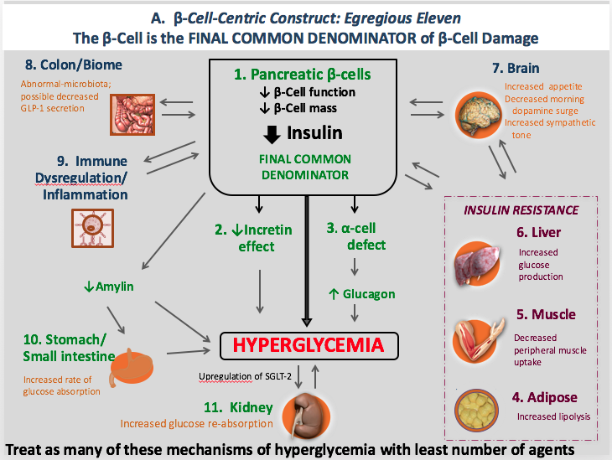

Slide 10
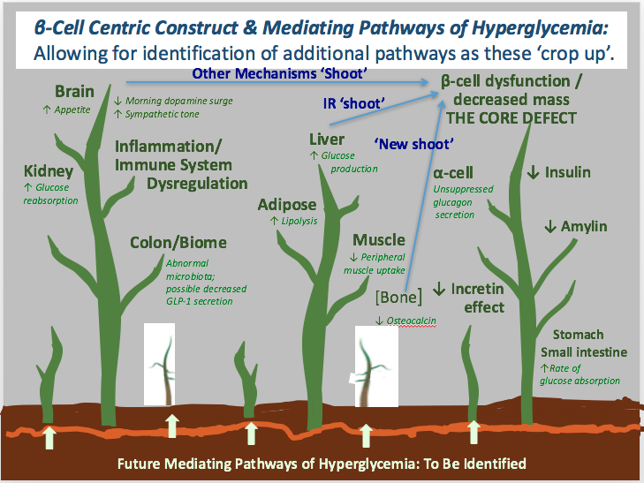
Notes:
Biochem Biophys Res Commun. 2015 Jun 19;462(1):21-6. doi: 10.1016/j.bbrc.2015.04.095. Epub 2015 Apr 27.
Osteocalcin protects pancreatic beta cell function and survival under high glucose conditions.
Kover K¹, Yan Y², Tong PY², Watkins D², Li X², Tasch J³, Hager M³, Clements M², Moore WV².

Slide 11
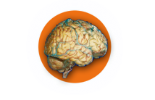


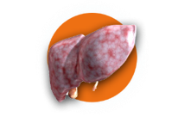



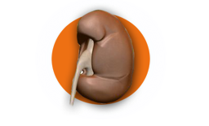
B. β-Cell-Centric Construct: Egregious Eleven
Targeted Treatments for Mediating Pathways of Hyperglycemia
8. Colon/Biome
1. Pancreatic β-cells
↓ β-Cell function
↓ β-Cell mass
7. Brain
Probiotics
Incretins
Metformin
Incretins
Dopamine agonist-QR
Appetite Suppressants
Insulin
Incretins,
Ranolazine
9. Immune
Dysregulation/
Inflammation
FINAL COMMON DENOMINATOR
Incretins,
Anti-Inflammatories
Immune modulators
INSULIN RESISTANCE
2. ↓Incretin
effect
3. α-cell
defect
6. Liver
Metformin
TZDs
Incretins
↓Amylin
↑ Glucagon
Incretins
Pramlintide
5. Muscle
10. Stomach/
Small intestine
Hyperglycemia
TZDs
Metformin
GLP-1 Agonists
Pramlintide
AGI
4. Adipose
11. Kidney
TZDs
Metformin
SGLT2 inhibitors
Not competition betw. Classes; early combination

Slide 12
