Slide 1
For Now, with Current Terminology, Cost- Driven
Diagnosis of Diabetes in Adults ‡
FH +
FH -
FH+
(-) Ketosis prone
( +) ketosis prone
(-) Ketosis prone
Younger
Younger
Older
BMI >30
<30 BMI
BMI >30
BMI <30
BMI >30
‘LADA’
‘LADA’
SPIDDM Autoimmune Type2
Type 2
MODY
Type 1
SPIDDM Autoimmune Type2
Type 2
Genome to Clarify
Antibody /HLA to Verify
Antibody /HLA to Verify
‡ BASED ON
FAMILY HX (GENES)
AGE, ?KETOSIS PRONE
BMI, ANTIBODIES
If cost ‘less of an Issue’- antibodies in all
Stanford Antibody Chip- fraction of cost of RAI
At some point ,NOW- genotype all ☺

Slide 2
So For Now, with Current Terminology, Cost- Driven
Diagnosis of Diabetes in Adults ‡
FH +
FH+
(-) Ketosis prone
(-) Ketosis prone
Younger
Older
BMI >30
<30 BMI
BMI <30
BMI >30
‘LADA’
Type 2
MODY
SPIDDM Autoimmune Type2
Type 2
Genome to Clarify
Antibody /HLA to Verify
‡ BASED ON
FAMILY HX (GENES)
AGE, ?KETOSIS PRONE
BMI, ANTIBODIES
If cost ‘less of an Issue’- antibodies in all
Stanford Antibody Chip- fraction of cost of RAI
At some point, NOW-genotype all ☺

Slide 3
So For Now, with Current Terminology, Cost- Driven
Diagnosis of Diabetes in Adults ‡
FH -
( +) ketosis prone
Younger
BMI >30
‘LADA’
Type 1
SPIDDM Autoimmune Type2
Antibody /HLA to Verify
‡ BASED ON
FAMILY HX (GENES)
AGE, ?KETOSIS PRONE
BMI, ANTIBODIES
If cost ‘less of an Issue’- antibodies in all
Stanford Antibody Chip- fraction of cost of RAI
At some point, NOW- genotype all ☺

Slide 4
So For Now, with Current Terminology, Cost- Driven
Diagnosis of Diabetes in Adults ‡
FH +
FH -
FH+
(-) Ketosis prone
( +) ketosis prone
(-) Ketosis prone
Younger
Younger
Older
BMI >30
<30 BMI
BMI >30
BMI <30
BMI >30
‘LADA’
‘LADA’
SPIDDM Autoimmune Type2
Type 2
MODY
Type 1
SPIDDM Autoimmune Type2
Type 2
Genome to Clarify
Antibody /HLA to Verify
Antibody /HLA to Verify
If cost ‘less of an Issue’- antibodies in all
Stanford Antibody Chip- fraction of cost of RAI
At some point, NOW- genotype all ☺
VOILA et MERCI
‡ BASED ON
FAMILY HX (GENES)
AGE, ?KETOSIS PRONE
BMI, ANTIBODIES

Slide 5
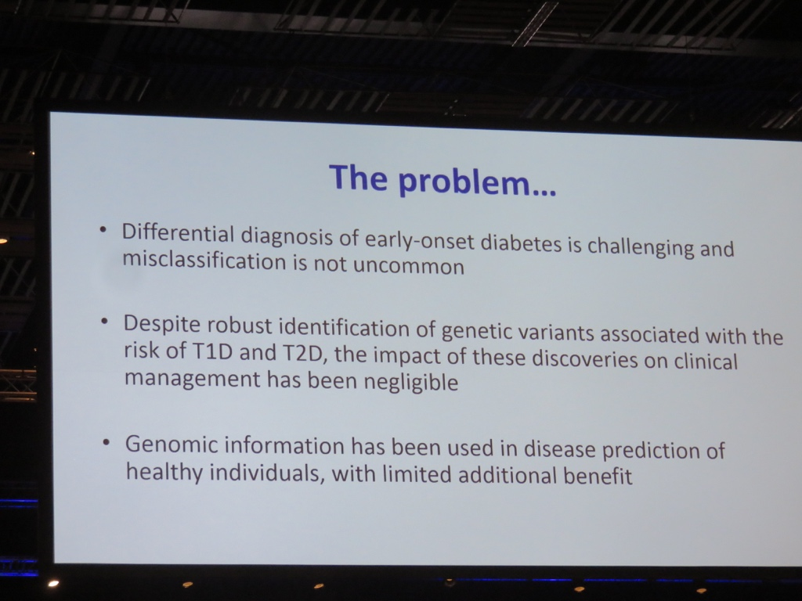


Slide 6
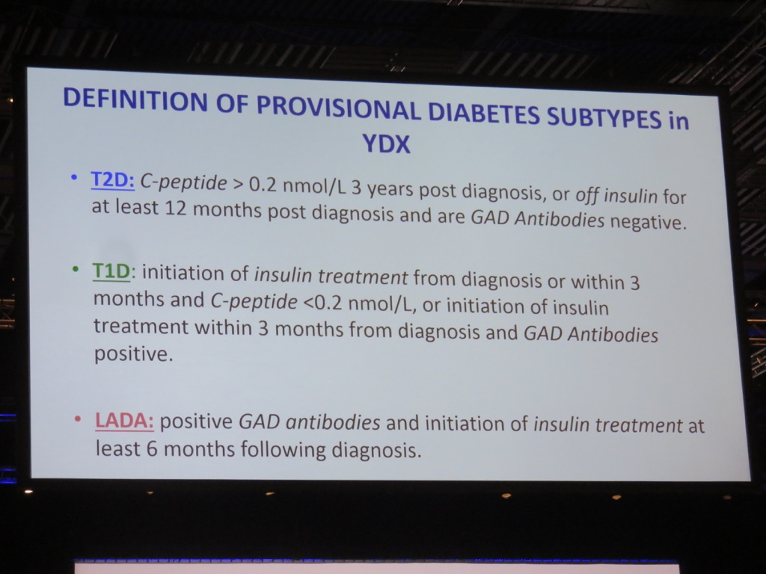

Slide 7
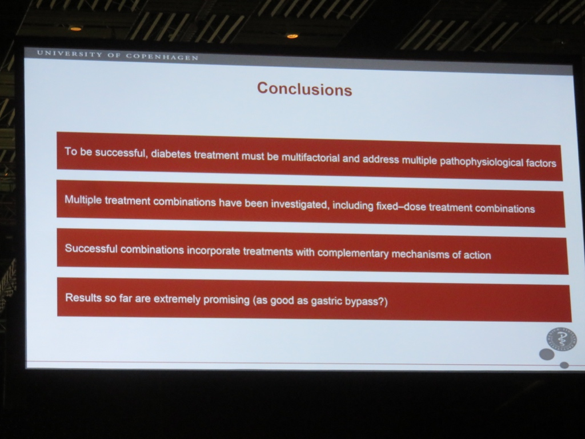

Slide 8
