Slide 1
β-Cell (Islet Cell) Classification Model-
Implications for Therapy:
Targets for Therapies/ New Guidelines
Medication Choice Based on
Glycemic Efficacy
BUT ALSO
2. Number of Targets of Therapy each drug addresses
( combo therapy efficacy likely depends on number of
overlapping mechanisms)
3.Weight loss
4. Proven Reduction in Risk Factors/ CV outcomes-Synergies–eg: SGLT-2, ( pioglitazone, brompcriptine QR, metformin, GLP-1)

Slide 2
Reduced Need for Insulin:Debunking a Myth:
Taking DeFronzo’s EASD 2015 Lecture 1 step further ☺
MYTH: “Most Patients with ‘T2DM’ will eventually progress to insulin because of inexorable β-Cell loss”
- But data obtained on SU=apoptosis
Hyperinsulinism with weight gain
- Think of bariatric patients –no insulin after 25 years DM/ 20 years
insulin
- Most patients dying with DM have > 20% β-Cell mass- Butler
- Need to remove >80% pancreas in sub-total pancreatectomies to
leave patient with DM post-op
Triple therapy Durable Effect in Improving Beta-Cell Function-
DeFronzo(Diabetes, Obesity, Metab 2015)
THUS: SELECT AGENTS THAT CAN PRESERVE
β-Cell function/mass

Slide 3
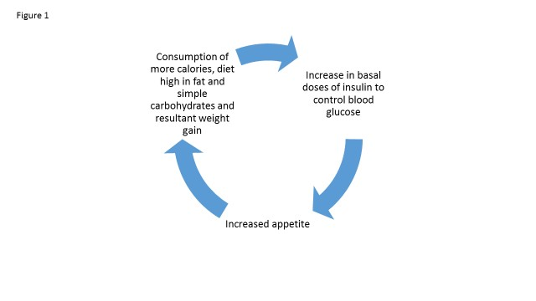
Avoid Early Insulin Therapy (except in Ketosis-prone)
Vicious Circle(s) of Hyperinsulinemia-
Result in Weight Gain and Hypoglycemia
Blood glucose rises
Undue Basal
Or bolus Insulin
=Overinsulinized
Patient eats too much
Or simple sugars
Hypoglycemia
Symptomatic or not!
INCREASED APPETITE

Slide 4


NOTE:
There is NO perfect Exogenous Insulin:
All result in HyperInsulinemia and Potential Hypoglycemia
Endogenous Insulin
Exquisitely controlled levels of insulin released into the portal vein
Fine-tuned, physiologically appropriate insulinemia
Exogenous Insulin
Flooding of the circulatory system with insulin
Insulin Resistance
β-cell Dysfunction
-------
Potential
β-cell Exhaustion
Hypoglycemia
Obesity
Atherosclerosis
Hyperinsulin-emia
Weight gain
Hypertension
Dyslipidemia
Cancer
Chronic Inflammation
Type II Diabetes

Slide 5
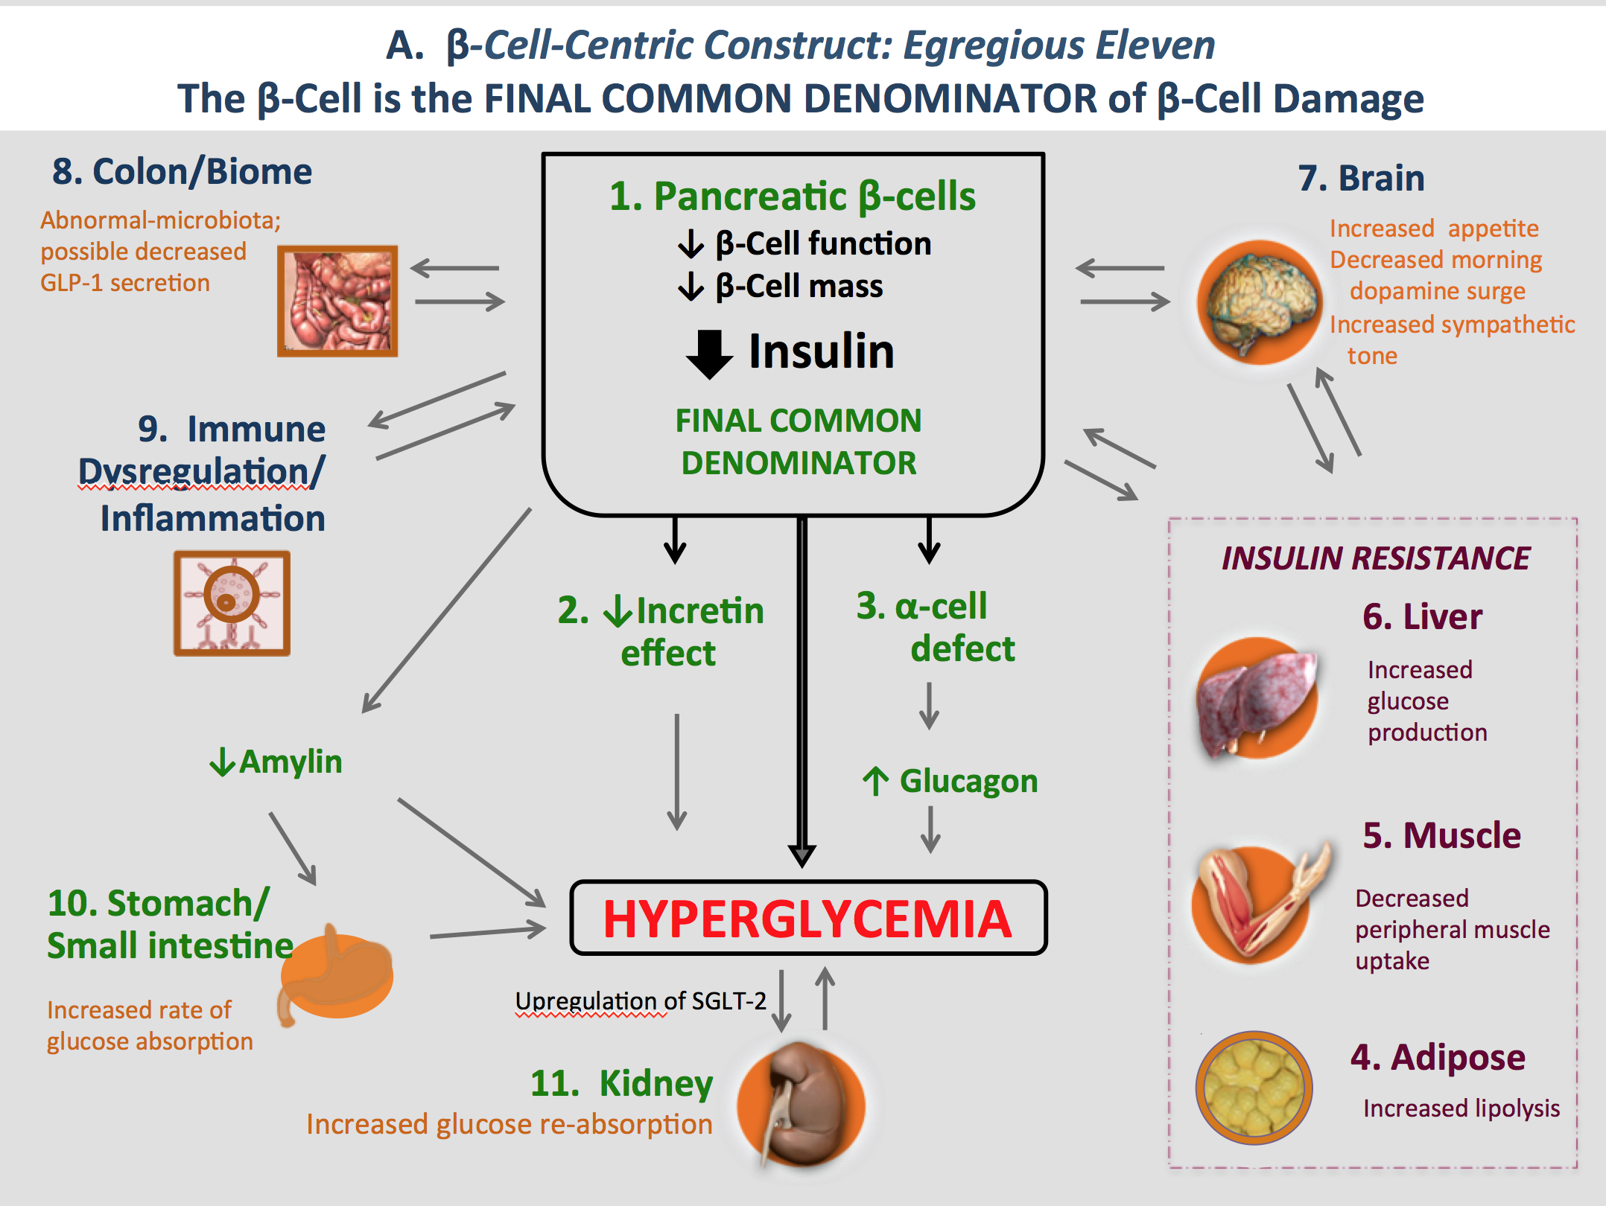
Patient-Centric Diagnosis & Process of Care/Therapy
Traditional Labs/Testing
FBS, RBS, HgA1c
Specific Therapy addressing Genotype
At Risk
Individuals
Genes
Etiologic Diagnostic Markers:
β-Cell, Insulin resistance, Inflammation, Environment, Genes
Pre-Diabetes Targeted Therapies-
All Mechanisms Start Early
B = β-cell: (Incretins)
Br= Brain: (Bromocriptine-QR)
I = Inflammation: (Incretin, drugs in development)
R = Resistance: Metformin, pioglitazone
E = Environment: Diet/exercise; regulators of the
gut microbiota
Might consider Multiple Agents [ per DeFronzo pre-dm protocol*]
Diabetes Targeted Therapies
B = β-cell: Incretin, glucagon-suppressing agents, SGLT-2 inhibitors
Br= Brain: Bromocriptine-QR, appetite suppressants
I = Inflammation: Incretin (Drugs in development)
R = Resistance: Metformin, pioglitazone (Drugs in development)
E = Environment: Diet/exercise; regulators of the gut microbiota
( ) = Not proven

Slide 6
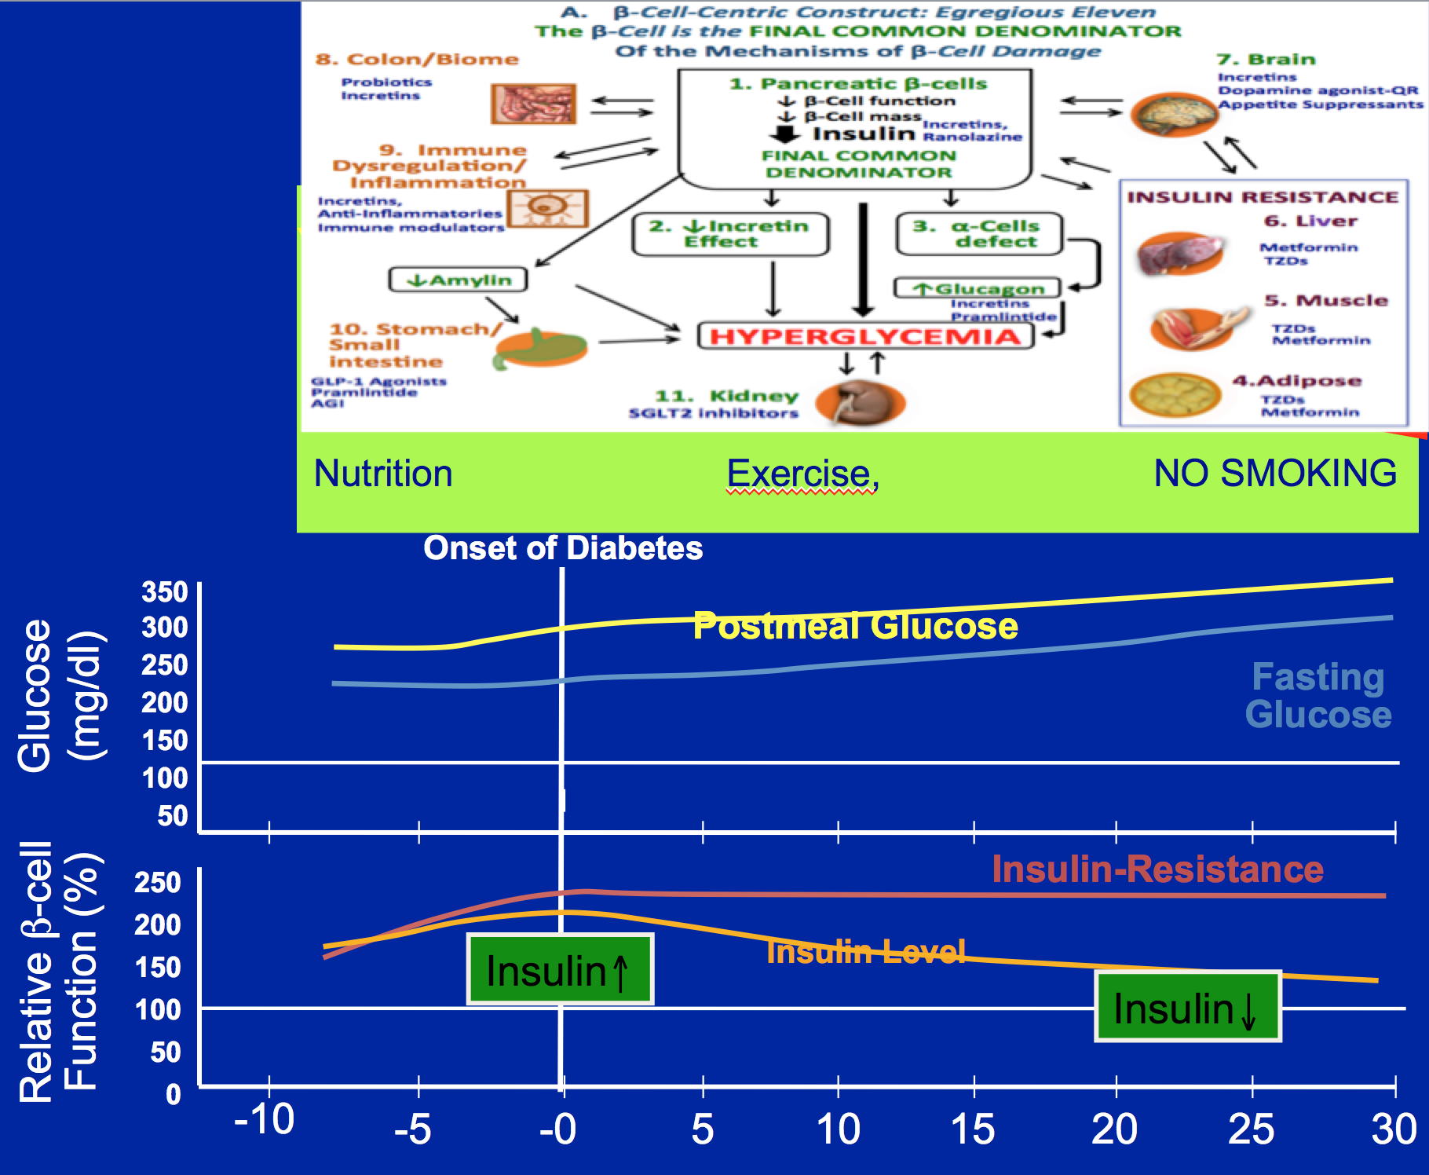
Therapeutic Principles Across Continuum of Care eg:
Right Drug for Right Patient and vice versa
DETERMINE INSULIN DEPENDENCY-(DKA, c-peptide,?other
DETERMINE Patient Specific Mechanisms of Hyperglycemia
Treat ? For prevention/ pre-diabetes
Treat as many of the Egregious 11 Targets as needed,
least # of agents, lowest sugars/HgA1c as possible
without undue weight gain or hypoglycemia
Early Combination Therapy- Patient Centric-
even 6.5-7.5 HgA1c
Efficacy, - CV event reduction, Weight Loss
(Not first-second-third line; Not competition between classes)
Can Modify therapy after 1m-not 3m-use Fructosamie
Stabilize, preserve β-cells, the CORE DEFECT
( NO SU/GLINIDES)-
Ideally agents will have potential to
synergistically decrease in CV risk factors / outcomes

Slide 7
Therapeutic Principles Across Continuum of Care eg:
Right Drug for Right Patient and vice versa
Delay Need for Insulin
2. No need for Early Insulin
3. If need Insulin, Continue
Non-Insulin RX
(Avoids need for Meal-Time Insulin-
(Decrease Risk Hypoglycemia 85%- Garber)
4. Get Patients off insulin who had been given early Insulin

Slide 8
Hedge your Bets: Incretins for all patients
DPP4 inhibitors, GLP-1 RAs, [other agents that increase GLP-1 eg: metformin, colsevalam, (TGR-5)]
T1DM: minimize brittle, dawn, unpredictablity, variability, ? CV benefits, Treat those ‘Type 2’ Genes’, ANTI-INFLAMMATORY
LADA = SPIDDM/ Autoimmune T2DM. Same as above - Slow , stabilize disease process, ANTI-INFLAMMATORY
T2DM: Same as above, treats 7 MOA’s of DeFronzo’s Octet, decreases oxidative stress, β-cell inflammation decreases lipo- and gluco-toxicity, ?preserve mass, decreases appetite, treats IR via wt. loss
MODY 3- recent report
FOR ALL DM – potential CV benefit (ANTI-INFLAMMATORY)

Slide 9
Reference list for last slide
LADA
Zhao Y,et al . Dipeptidyl peptidase 4 inhibitor sitagliptin maintains β-cell function in patients with recent-onset latent autoimmune diabetes in adults: one year prospective study.,J Clin Endocrinol Metab. 2014 Jan 16:jc20133633.
TYPE 1
Ellis et al, Effect of Sitagliptin on glucose control in Adult patients with Type 1 DM, Diabetic Medicine DOI: 10.1111/j.1464-5491.2011.03331
Kielgast U., et al Treatment of Type 1 Diabetic Patients with GLP-1 and GLP-1 Agonists, Current Diabetes Reviews,2009, 5:266-275
TYPE 2
Ju-Young Kim,Exendin-4 Protects Against Sulfonylurea-Induced β-Cell Apoptosis, J Pharmacol Sci 118, 65 – 74 (2012)
Drucker DJ, Rosen CF. Glucagon-like peptide-1 (GLP-1) receptor agonists, obesity and psoriasis: diabetes meets dermatology. Diabetologia 2011;54:2741–2744
Chaudhuri A, Ghanim H, Vora M, et al. Exenatide exerts a potent antiinflammatory effect. J Clin Endocrinol Metab 2012;97:198–207
Makdissi A, Ghanim H, Vora M, et al. Sitagliptin exerts an antinflammatory action. J Clin Endocrinol Metab 2012;97:3333–3341
Drucker, D., Incretin Action in the Pancreas: Potential Promise, Possible Perils, and Pathological PitfallsDiabetes 62:3316–3323, 2013
Shimoda M, Kanda Y, Hamamoto S, Tawaramoto K, Hashiramoto M, Matsuki M, Kaku K.The human glucagon-like peptide-1 analogue liraglutide preserves pancreatic beta cells via regulation of cell kinetics and suppression of oxidative and endoplasmic reticulum stress in a mouse model of diabetes. Diabetologia. 2011 May;54(5):1098-108. doi: 10.1007/s00125-011-2069-9. Epub 2011 Feb 22.
Kim JY, Lim DM, Moon CI, Jo KJ, Lee SK, Baik HW, Lee KH, Lee KW, Park KY, Kim BJ.Exendin-4 protects oxidative stress-induced β-cell apoptosis through reduced JNK and GSK3β activity. J Korean Med Sci. 2010 Nov;25(11):1626-32. doi: 10.3346/jkms.2010.25.11.1626. Epub 2010 Oct 26.
Liu Z, Stanojevic V, Brindamour LJ, Habener GLP1-derived nonapeptide GLP1(28-36)amide protects pancreatic β-cells from glucolipotoxicity. J Endocrinol. 2012 May;213(2):143-54. doi: 10.1530/JOE-11-0328. Epub 2012 Mar 13.
Glucagon-like peptide 1 analogue therapy directly modulates innate immune-mediated inflammation in individuals with type 2 diabetes mellitus Diabetologia - Clinical and Experimental Diabetes and Metabolism, 03/04/2014

Slide 10
Based on ‘New’ Classification: Recommended Process For Prevention, Diagnosis and Therapy
Convene ADA/EASD/WHO/AACE Committee: Revise Classification of DM
Put processes into place. Increase current repositories. JAEB, JDRI to include LADA patients, (but all kinds of hyperglycemic patient types), HDLI, Large Health Systems (K-P)
Research into these ideas/approaches
EDUCATE MDs re :issues
Allan D. Sniderman et al The Necessity for Clinical Reasoning in the Era of Evidence-Based Medicine,Mayo Clin Proc. 2013;88(10):1108-1114
Use Evidence-Based Practice Approaches to DX
Where evidence is incomplete but logic exists,
apply appropriate treatment to improve patient care.

Slide 11
Conclusion 1
Current classifications of DM are inadequate:
new classification schema -the β-cell as THE CORE DEFECT in ALL DM,
The various mediators of β-cell dysfunction offer key opportunities for Prevention, Therapy, Research and Education
Patient care should shift from current classifications that limit therapeutic choices to:
one that views a given patient’s disease and treatment course based on their individual cause(s) of metabolic dysregulation, e.g. genes, inflammation, insulin resistance, gut biome, central (brain) mechanisms, etc.

Slide 12
Conclusion-2
Defining markers, and Processes of Care = patient-centric approaches
In T1D and LADA, in particular, incretins, insulin sensitivity agents, SGLT-2 inhibitors and others are either underutilized in some cases, and under-evaluated in others
More research always needed, but,
in an evidence-based PRACTICE approach to care, we can START NOW

Slide 13
Acknowledgements
Mentors- taught how to ‘think diabetes’
  John Williamson, Barbara Corkey
  Al Winegrad,
  Arthur Rubenstein, David Rabin, Jesse Roth
  Lester Baker
  Ralph Defronzo
  Co-Authors
  Sol Epstein, Barbara Corkey, Struan Grant,
  James Gavin, Richard Aguilar

