Slide 1
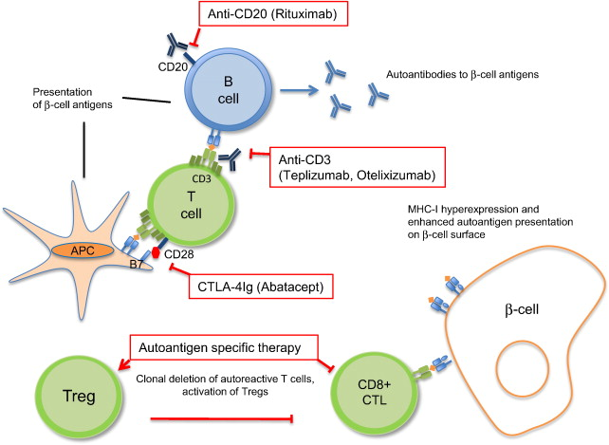
Pathogenesis and biological interventions in
T1DM- LIKE autoimmune diabetes- Insulitis
The class I MHC molecules are hyperexpressed on the β-cell surface in T1D patients making β-cells more susceptible to cytotoxic lymphocyte (CTL)-mediated destruction.
Novel diagnostic and therapeutic approaches for autoimmune diabetes — A prime time to treat insulitis as a disease
http://dx.doi.org/10.1016/j.clim.2014.11.007
Clinical Immunology, 2014
Juha Grönholm , Michael J. Lenardo

Slide 2
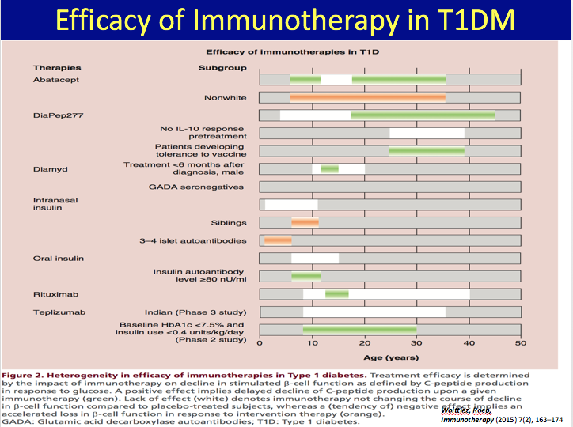

Slide 3
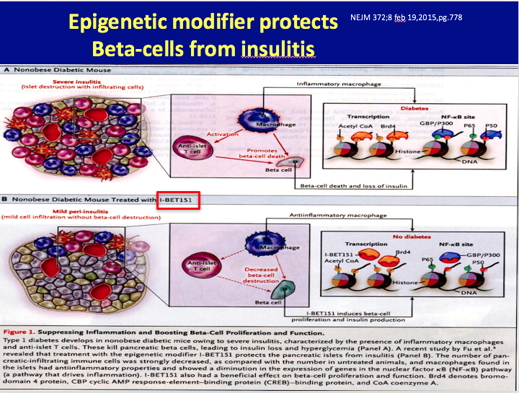

Slide 4
Note: Antibodies
? Like antibodies in thyroiditis ie:
1. epi-phenomena- no effect on function
OR
2. causative- destroy beta cell
MAKES IT DIFFICULT TO EVALUATE EFFICACY OF AGENTS in Trials
And note : may be function of other inflammatory causes
of beta-cell imflammation eg: biome

Slide 5
Insulin Resistance within the β-Cell Centric Construct
Insulin Resistance is understood to expose and exacerbate the core β-cell defect
Genetically- Based
Exacerbated by Environmental issues: Diet, Activity, Biome
Includes Multiple Causes of Insulin Resistance
Insulin Resistance Impairs β-Cell Function by:
Lipo- and gluco-toxicity
Inflammatory mechanisms
Adipocytokines effect on β-cell

Slide 6
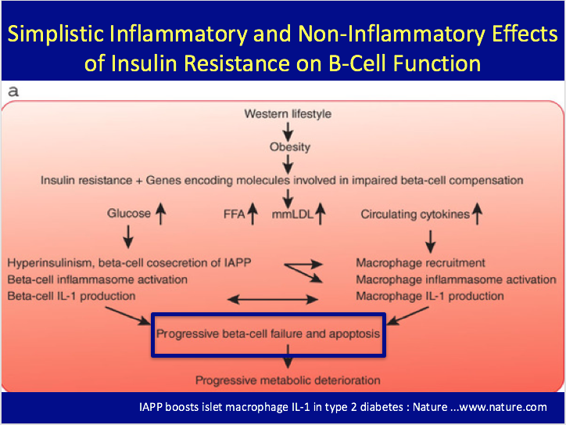

Slide 7
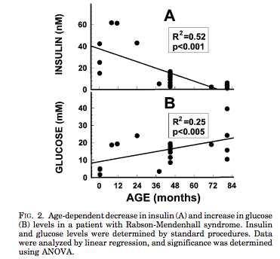
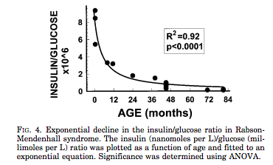
Insulin Resistance within the
β-Cell Centric Construct
Rare Insulin Resistance Syndromes- eg: leprechaunism may not have a specific β-Cell genetic defect, but β-cells may ultimately suffer damage
Longo, et al, Progressive decline in insulin levels in Rabson-Mendenhall syndrome. JCEM,1999 Aug;84(8):2623-9.

Slide 8
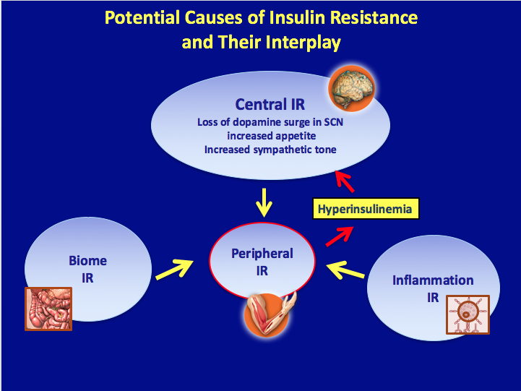

Slide 9
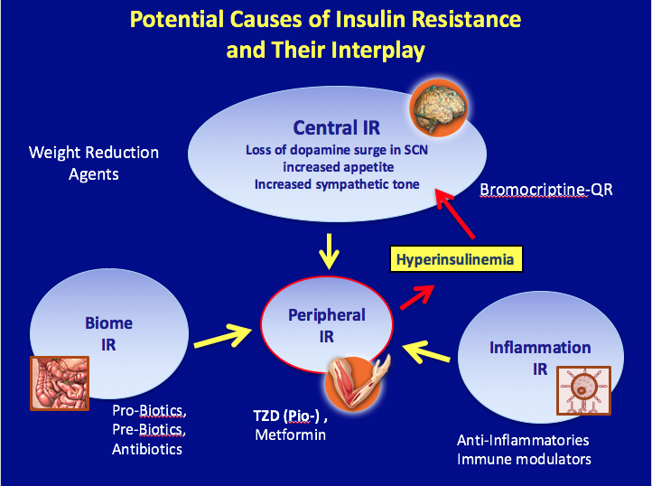

Slide 10
New β-Cell Centric Construct: Implications
Environmental Risk Factors in T1D/T2D, ? ‘LADA’
T1D
Seasonality at diagnosis
Migrants assume risk of host country
Risk factors from case-control studies
  • Hormones • Vitamin D
  • Stress • Cow’s Milk
  • Improved Hygiene • Gut-microbial Balance – Biome
  • Infant/childhood diet • Lack of Physical Activity
  • Viruses – exposures as early as in utero
T2D
Obesity-Diet
Lack of Physical Activity
AGE ingestion
LADA
Coffee
More Educated

