Slide 1
Brief Discussions
Genetics
Beta-Cell
Immune Modulation/Inflammation
Insulin Resistance
Environment

Slide 2
New β-Cell Centric Construct: Implications
Genetics 101 for DM
Phenotype is DEPENDENT ON
Genotype:
Number of Genes- which genes- their nature, how many different ones, the ‘severity/intensity’ of expression!; epigenetics*
i.e: Genes influence:
Insulin secretory dynamics, insulin resistance, sites of susceptibility of β-Cell to destruction by endogenous/ exogenous triggers
e.g.: inflammation, etc.
Immune Modulation/Inflammation
Insulin Resistance
Environment
*Int J Biochem Cell Biol. 2015 May 27. pii: S1357-2725(15)00143-0. doi: 10.1016/j.biocel.2015.05.022. [Epub ahead of print]
Epigenetic dynamics in immunity and autoimmunity.
Zhao M1, Wang Z1, Yung S2, Lu Q.
Understanding type 2 diabetes: from genetics to epigenetics. Raciti GA, Longo M, Parrillo L, Ciccarelli M, Mirra P, Ungaro P, Formisano P, Miele C, Béguinot F.
Acta Diabetol. 2015 Apr 5.

Slide 3
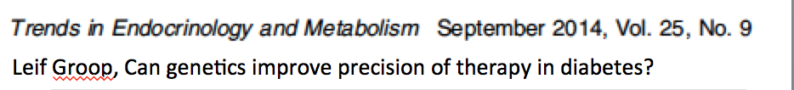
Genotyping
Genotyping should be used for research (cost ~$100)
and later as diagnostic markers on custom chips (even LESS )
Use for Pharmacogenetics should help guide choice of treatment
Find Gene action/ Function - Leads to understanding mechanisms
  e.g.: TCF7L2; Potential Therapy re: PARP-1 Inhibitor, other
  Other Gene/Mechanism/ Therapy
    low BMR- results in morbid obesity
    Asian/ Eastern Europeans- store more Visceral Fat at Lower BMI
    ? PREVENT T2DM-SLC30A8
    Increase RISK- TBC1D4 (Greenland)

Slide 4
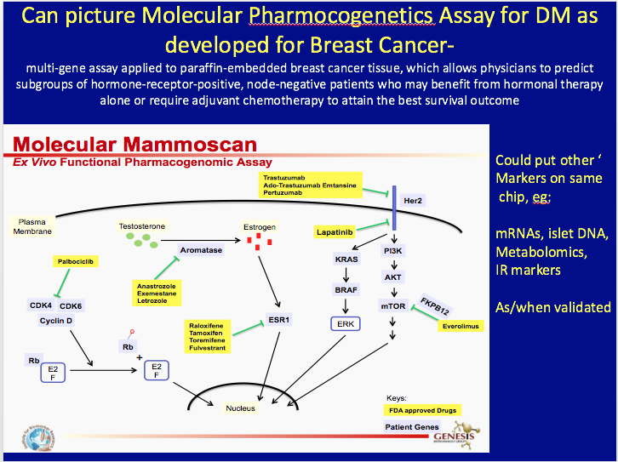

Slide 5
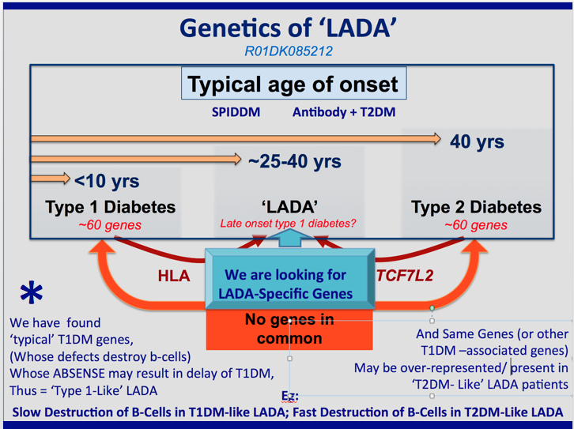

Slide 6
New β-Cell Centric Construct: Implications β-cell Issues
Usual use of Glycemic Criteria- HgA1c, FBS, PPG
Markers-Usual/Occasional Use of C-Peptide
New Non-Invasive
  β-Cell Mass Measures-
  Nano-particle labeled exendin imaging
  Circulating DNA Markers of β-Cell Destruction
  Glazer- Hebrew Univ
  Circulating mRNAs (easd)
Try to Determine Mono-Genetic Causes
NO LOGIC FOR USE OF AGENTS THAT MAY CONTRIBUTE TO APOPTOSIS of β-Cell
STOP USING SU’s, GLINIDES; Minimize INSULIN THERAPY

Slide 7
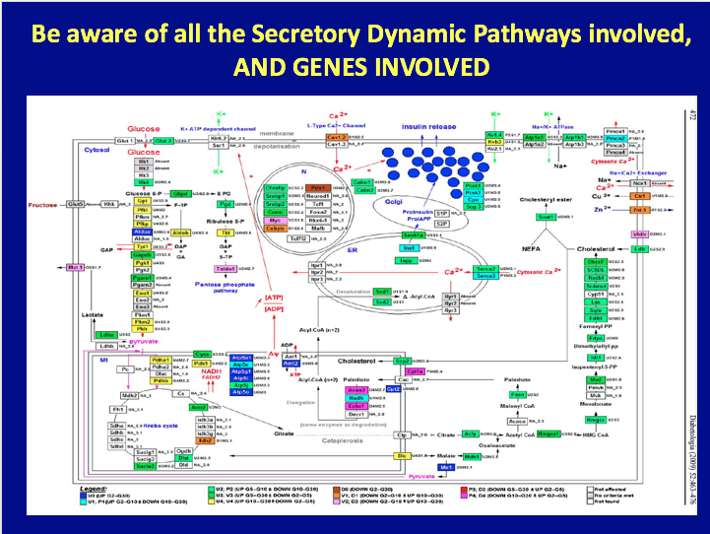

Slide 8
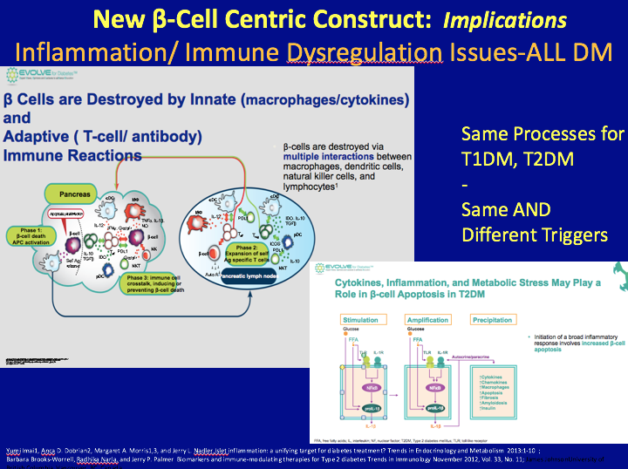

Slide 9
