Slide 1
The β-Cell Centric Classification of DM
Intuitively obvious approach…
ANSWERS THE CALL TO ACTION
ALL DM = Hyperglycemia
Classify each patient by the specific cause(s) of the
β-cell dysfunction in the clinical presentation of their disease
Prescribe personalized treatment
(patient-centric/ PRECISION MEDICINE)
through targeted therapies
aimed at all possible mediating pathways of hyperglycemia
The ‘β-Cell Centric’ Classification will help improve diagnosis and treatment, especially as our knowledge-base expands

Slide 2
Pushback
What about ‘pure’ Insulin Resistance Syndromes?

Slide 3
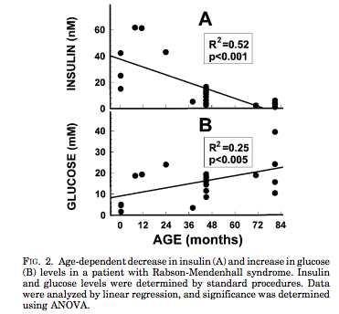
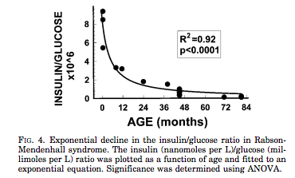
The β-Cell:
The ‘Final Common Denominator’
Rare Insulin Resistance Syndromes, e.g. leprechaunism, may not have a specific β-cell genetic defect, but β-cells damage may be part of the disease
Longo, et al, Progressive decline in insulin levels in Rabson-Mendenhall syndrome. JCEM,1999 Aug;84(8):2623-9.

Slide 4
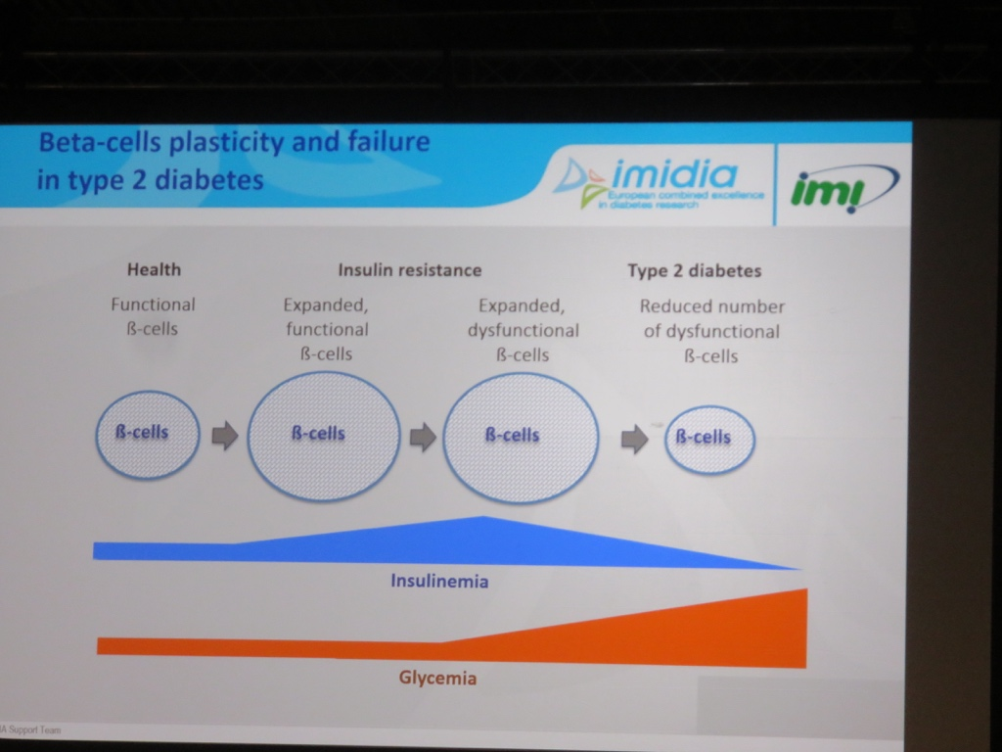

And ‘T1DM
FINAL
COMMON
DENOMINATOR
And in T1DM, autoimmune aspects
may be setoff by environmental
factors, IR

Slide 5
Pushback-2
I comment As First Recipient of the Bobby Clarke JDF fellowship:
Loss of ‘T1DM’ Designation WILL NOT take away from
Focus on ‘the CURE’
New Classification will
FACILITATE SEARCH FOR ‘THE CURE”
(focusing on mechanisms that slow the injury/destruction of the b-cell in ‘T1-LADA’, or speed destruction in ‘T2-LADA’etc
Actually , ‘Juvenile Diabetes’ Fits better, again ☺

Slide 6
β-Cell Centric Classification of Diabetes:
Implications for Classification, Diagnosis, Prevention, Therapy, Research
INSULIN RESISTANCE
G
E
Environment
N
E
Epigenetics
Inflammation/
Immune Regulation
Polygenic
Monogenic
β-Cell
secretion/mass
FINAL COMMON
DENOMINATOR
CLASSIFY PATIENT BY CAUSE(s) of Beta-Cell Dysfunction
In EACH Individual

Slide 7
β-Cell Centric Classification of Diabetes:
Implications for Classification, Diagnosis, Prevention, Therapy, Research
INSULIN** RESISTANCE
G
E
Environment*
N
E
Epigenetics
Inflammation/
Immune Regulation
Polygenic
Monogenic
β-Cell
secretion/mass
FINAL COMMON
DENOMINATOR
*Environment=Genetic suceptibility to
eg: viruses, endocrine disruptors, food AGEs, Gut Biome
**Insulin Resistance= Centrally Induced, Peripheral, Stress Hormones, Gut Biome

Slide 8
Phenotypic Presentation is defined by:
Slope = ‘Natural History’ over time, i.e.,RATE OF β-cell LOSS. Slope is not linear in either T1DM or T2DM, and may be intermittently relapsing, remitting, stabilized, and improved. Complete loss of β-cell mass may never be reached, especially if newer agents better preserve β-cells.
100%
−
−
−
−
−
−
−
−
−
0% −
Severity =
β-cell loss of mass
Pre-Diabetes = FBS ≥100, PPG ≥140
All DM = FBS ≥126, PPG ≥200
Critical
β−Cell
Mass
%
β−Cell
Mass
I I I I I/ ≈ / I I I I I I I I I I I I I I I I I I I I I I I I I I I I I I I I I I I I I I I I I I I I I I I I I I I I I I I I I I I I
Increasing Age
Age at presentation = tipping point when the combined gene effect / environmental trigger is exposed as phenotypic hyperglycemia

Slide 9
Phenotypic Presentation is defined by:
Slope = ‘Natural History’ over time,i.e.,RATE OF β-cell LOSS. Slope is not linear in either T1DM or T2DM, and may be intermittently relapsing, remitting, stabilized, and improved. Complete loss of β-cell mass may never be reached, especially if newer agents better preserve β-cells.
100%
−
−
−
−
−
−
−
−
−
0% −
Severity =
β-cell loss of mass
Pre-Diabetes = FBS ≥100, PPG ≥140
All DM = FBS ≥126, PPG ≥200
Critical
β−Cell
Mass
%
β−Cell
Mass
Disease Modification
I I I I I/ ≈ / I I I I I I I I I I I I I I I I I I I I I I I I I I I I I I I I I I I I I I I I I I I I I I I I I I I I I I I I I I I I
Increasing Age
Age at presentation = tipping point when the combined gene effect / environmental trigger is exposed as phenotypic hyperglycemia

Slide 10
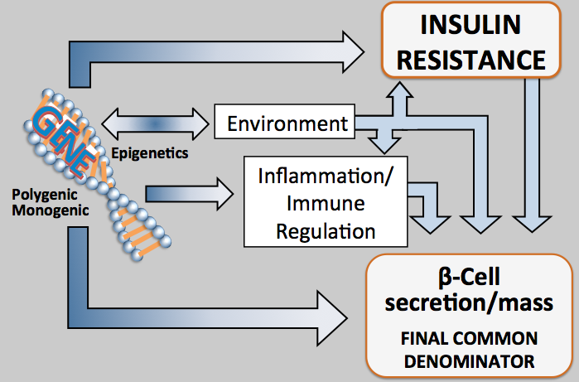
Natural History of ALL DM
Age 0-15 15-40+ 15-50+ 25-70+
Macrovascular Complications
Disability
IR Phenotype
MI
CVA
Amp
IGT ALL DM
DEATH
Blindness
Amputation
CRF
ETOH
BP
Smoking
Eye
Nerve
Kidney
Disability
Microvascular Complications
Risk of Dev. Complications
Notes:
10

Slide 11
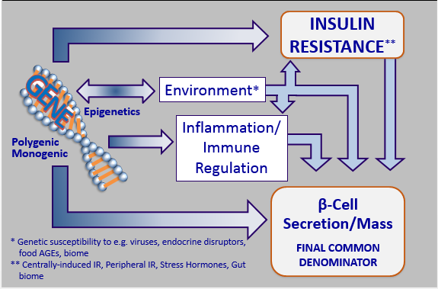
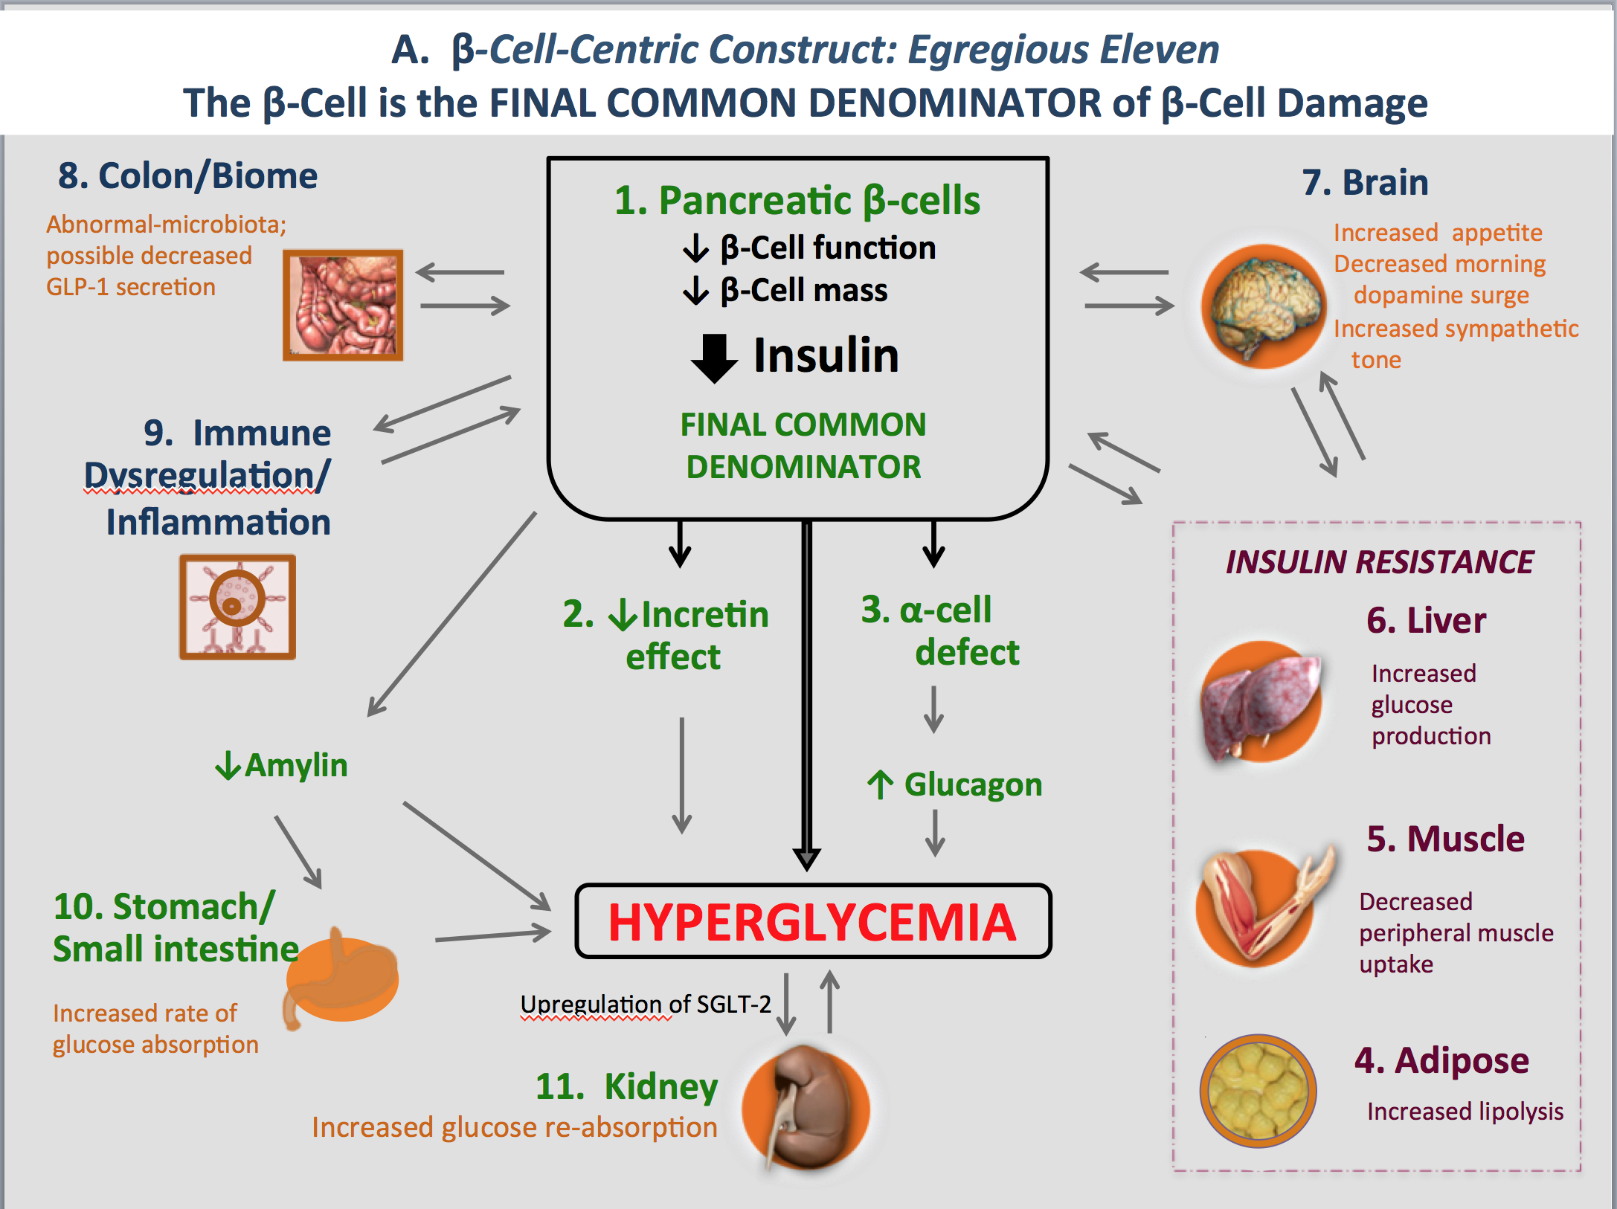
The β-cell centric classification allows for individualized care by identifying and treating patient-specific etiologies and mediating pathways of hyperglycemia
EGREGIOUS ELEVEN
β-Cell Centric Classification of DM:
Implications for Classification, Diagnosis, Prevention, Therapy, Research
One CORE Defect- the β-Cell
(at least) 6 treatable Causes of
β-Cell Damage / HYPERGLYCEMIA
  4 treatable mediators
  of HYPERGLYCEMIA
resulting from β-Cell Damage

Slide 12
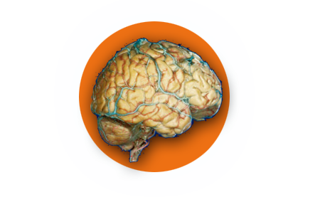
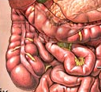
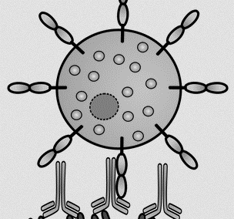
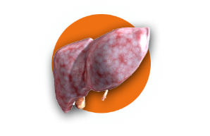

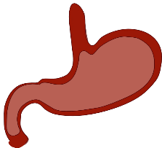
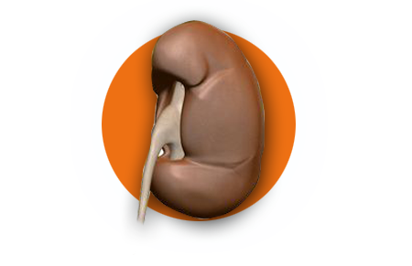

A. β-Cell-Centric Construct: Egregious Eleven
The β-Cell is the FINAL COMMON DENOMINATOR of β-Cell Damage
8. Colon/Biome
1. Pancreatic β-cells
↓ β-Cell function
↓ β-Cell mass
7. Brain
Abnormal-microbiota;
possible decreased
GLP-1 secretion
Increased appetite
Decreased morning dopamine surge
Increased sympathetic tone
Insulin
9. Immune
Dysregulation/
Inflammation
FINAL COMMON DENOMINATOR
INSULIN RESISTANCE
2. ↓Incretin
effect
3. α-cell
defect
6. Liver
Increased
glucose
production
↓Amylin
↑ Glucagon
5. Muscle
10. Stomach/
Small intestine
Hyperglycemia
Decreased peripheral muscle uptake
Increased rate of glucose absorption
Upregulation of SGLT-2
11. Kidney
Increased glucose re-absorption
4. Adipose
Increased lipolysis

Slide 13

BRAIN
INSURES it’s GETTING ENOUGH
GLUCOSE TO WORK!!
↑Appetite
SCN
↓Dopa surge
Inc. Symp. Tone
Gene(s)
Cells ‘complain’ not getting
enough glucose
Inflammation
Fat Liver Muscle
Insulin resistance
Lipotoxicity
Gene/
Envir
inter-
Action!!
Stomach
Fast emptying
↑Glucagon
Colon
biome
↓ β-Cell function
↓ β-Cell mass
↓ Amylin
↓ Incretin effect
↑ GLP-1resistance
↓Insulin
PPG-HYPERGLYCEMIA
Environment
Glucotoxicity
β-Cell Centric Construct
For Pathogenesis of All Diabetes:
Implications for RX- EGREGIOUS ELEVEN
Up-regulates SGLT-2
Kidney
CROSSTALK- Not Linear

