Slide 1
Diagnosing Diabetes Mellitus in Adults:
Type 1, LADA, Type 2
A Clinical-Translator’s Point-of-View:
At the Interface of Patient Care and Basic Science
Stanley Schwartz MD, FACE, FACP
Affiliate, Main Line Health System
Emeritus, Clinical Assoc. Professor of Medicine
University of Pennsylvania
stschwar@gmail.com

Slide 2
Diagnosing Diabetes Mellitus in Adults:
Type 1, Type 2, LADA or
Since Confusion Abounds, Isn’t it
Time for A New Classification Schema for the
Diagnosis and Treatment of Diabetes Mellitus (DM)
Get us ready for ‘PRECISION MEDICINE’

Slide 3
Presenter Disclosure Information
In compliance with the accrediting board policies, the
American Diabetes Association requires the following
disclosure to the participants:
Stanley Schwartz
Research Support: 0
Employee: 0
Board Member/Advisory Panel: Janssen, Merck, AZ-BMS, BI-Lilly, Salix, Novo, Takeda, Genesis Biotechnology Group
Stock/Shareholder: 0
Consultant: NIH RO1 DK085212, Struan Grant PI
Other: Speaker’s Bureaus: Takeda, Janssen, Merck, Novo, Salix, BI-LILLY, Eisai, AZ-Int’l, GSK, Amgen

Slide 4
Purely Clinical Answer
Empiric, Pragmatic Approach
It doesn’t matter which label is applied ☺
Insulin-Dependent
  DKA- ketosis prone : insulin needed for survival
OR NOT- Everyone else
Use ‘best clinical guess’; ‘label’ patient; Independent of age
Treat ‘as needed’ to get glycemic control,
(but must work under constraints of current ‘definitions’ for the classification of T2D- per payors/ governments)

Slide 5
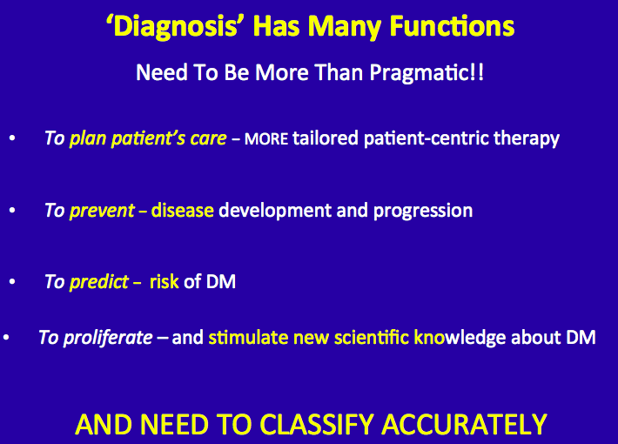
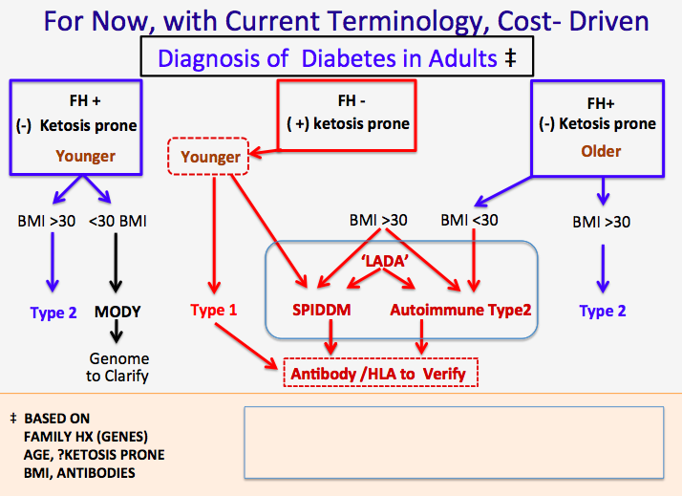

Slide 6
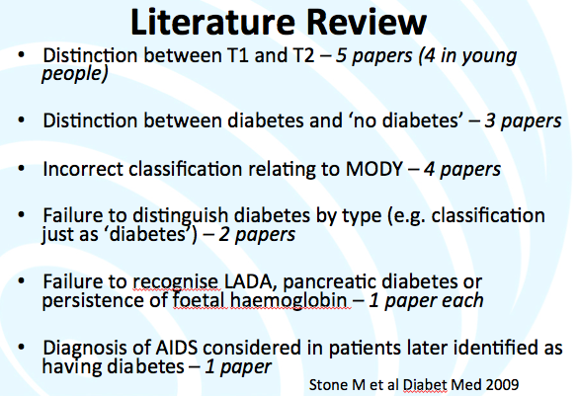
Current DM Classification Failing
(Certainly appropriate with knowledge available when current classification adopted)
BUT WE’VE LEARNED SO MUCH MORE
Immune destruction of β-cells / and Insulin Resistance
is used as basis of distinction between T1D, and T2D
and all other sub-types of DM
Diagnosis is often imprecise
  Flatbush DM- present in DKA- ‘turn out to be T2DM’
  LADA- Adults who look like ‘typical T1DM’
  Antibody positive who look like ‘T2DM’
  T1DM with Insulin Resistance (like T2DM)
Ie: Complicated by extensive overlap
yet distinct differences in etiology and phenotype
Notes:
The four types of diabetes include:
The typical child with type 1 diabetes;
Early onset of type 2 diabetes, particularly in non-Caucasian groups;
An atypical form of diabetes sometimes with fluctuating insulin dependency, seen in African Americans; and
The very rare “maturity onset diabetes of youth” (MODY), which has been found to be related to identifiable genetic mutations, transmitted in an autosomal dominant pattern, and virtually always in Caucasians.

Slide 7
Definitions: T1D, ‘LADA’, T2D
May Seem Precise BUT…, Overlapping Phenotypes
T1D (Formerly- IDDM, juvenile diabetes)
Hyperglycemia resulting from autoimmune destruction
of insulin-producing beta cells in the pancreas
Insulin therapy is necessary for survival = insulin-dependent
  Insurers/gov’t don’t permit ‘adjunctive’ therapy
T2D (Formerly- NIDDM; adult-onset diabetes)
Hyperglycemia resulting from inadequate insulin/ insulin-effect-, usually in the context of insulin resistance
Insulin may be ‘needed’ for good control, but not for survival

Slide 8
Definitions: T1D, ‘LADA’, T2D
May Seem Precise BUT…, Overlapping Phenotypes
In particular :
‘LADA’- Ambiguous classification
Later age; SPIDDM, ‘Slowly progressive T1D
  ‘Slower’ destruction of β-cells than T1D
    Antibody positive T2D = ‘T1.5D’
      ‘Faster’ destruction of β-cells than in T2D
    T-cell abnormal SPIDDM
      Antibody negative
    Insulin commonly considered the ‘go to’ drug, even in patients with LADA with retained β-cell function

Slide 9
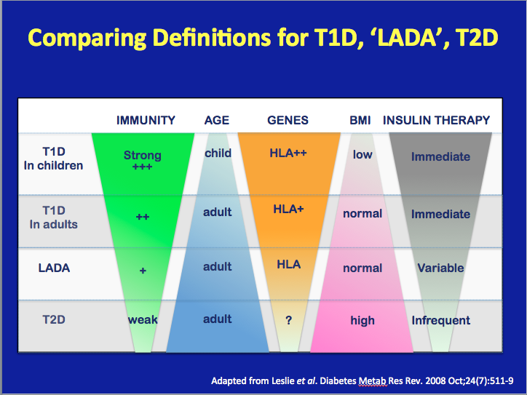

Slide 10
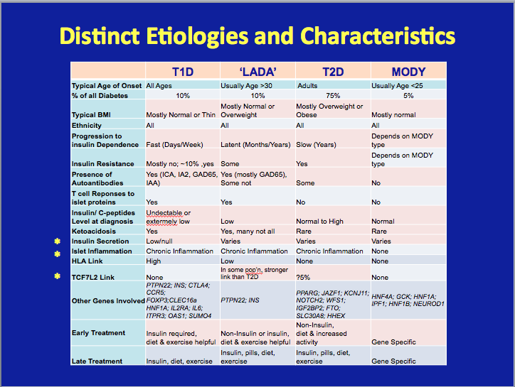

Slide 11
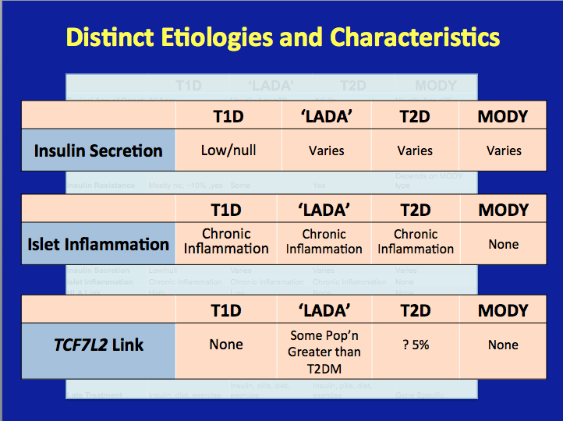

Slide 12
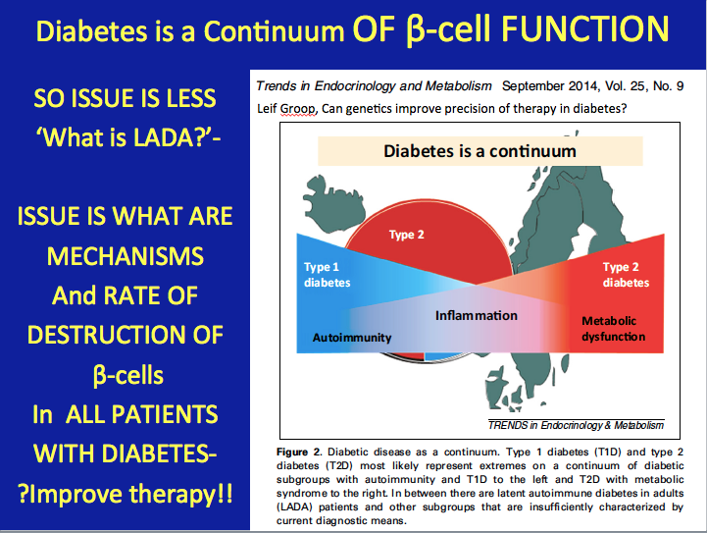

Slide 13
Summary
Current definitions are imprecise and ambiguous
  Complicated by overlapping characteristics (e.g. T1D with T2D parents, or,
  T2D with antibodies-no insulin)
  Don’t take into account newer understandings of causes of DM/
  mechanisms of hyperglycemia
Need to focus on preservation/ improvement of β-cell function
Insulin is overused in patients with retained β-cell function
Multiple mediating pathways of hyperglycemia
  are not taken into account in choice of treatment
Gov’t and payers limit coverage for therapies based on ‘diagnosis’
THUS….

Slide 14
Call to Action
There is a need for a nomenclature for the classification and diagnosis of DM that is in line with up-to-date knowledge of pathophysiology and newer therapies,
That supports individualized ( PRECISION)medicine
And creates and targets regimens that build upon all available treatment options, for the multiple mediating pathways of hyperglycemia
Forces , by the logic of the new system, gov’t and insurers to pay for the logical, effective, safe therapies
Can accommodate future developments

